Slide 1


Blending it all together: stress management for work and life success
Aimee C. Kimball, Ph.D.
KPEX Consulting
(412) 657-0362
AimeeKimball@KPEXconsulting.com
www.KPEXconsulting.com
Notes:
In the past 2 weeks, on a scale of 1-10 what is the most stress you have felt in one day and what is the least?

Slide 2
Revolutionize the Way You Think
The world as we have created it is a process of our thinking. It cannot be changed without changing our thinking.
–Albert Einstein

Slide 3

You Control Your Mind

Slide 4
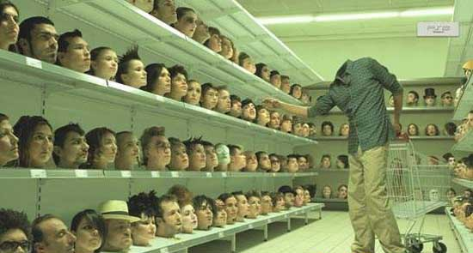
Choose Your Mindset

Slide 5

Choose to be a peak performer
Your Peak Performance Zone
    What can I do to improve today?
Your Comfort Zone
    What do I need to do to be content?
Your Pride Zone
    What is the minimum expected of me?

Slide 6
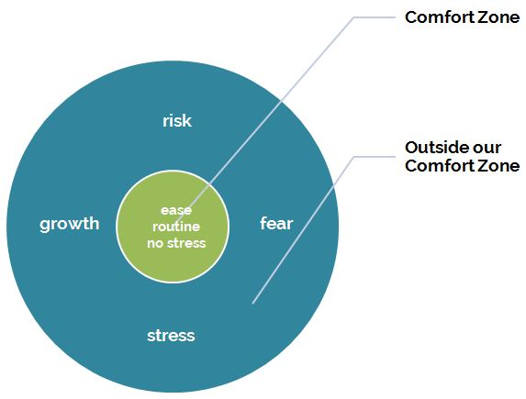
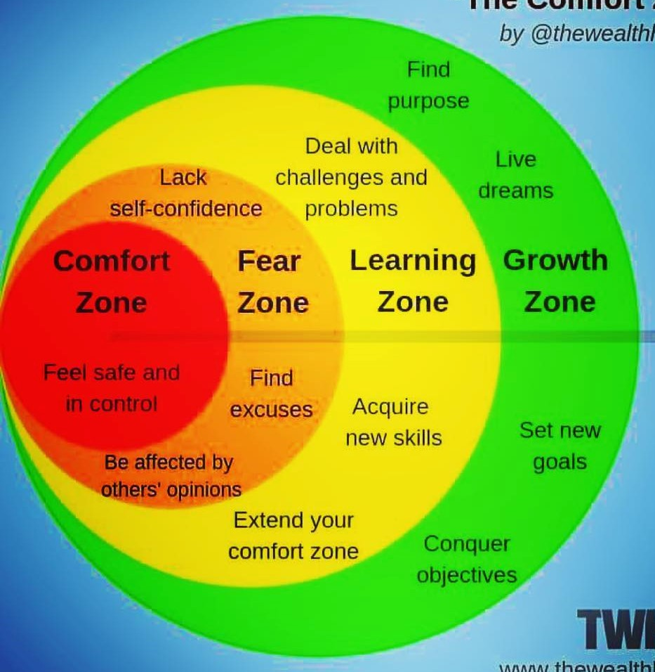
Comfortable is Boring

Slide 7

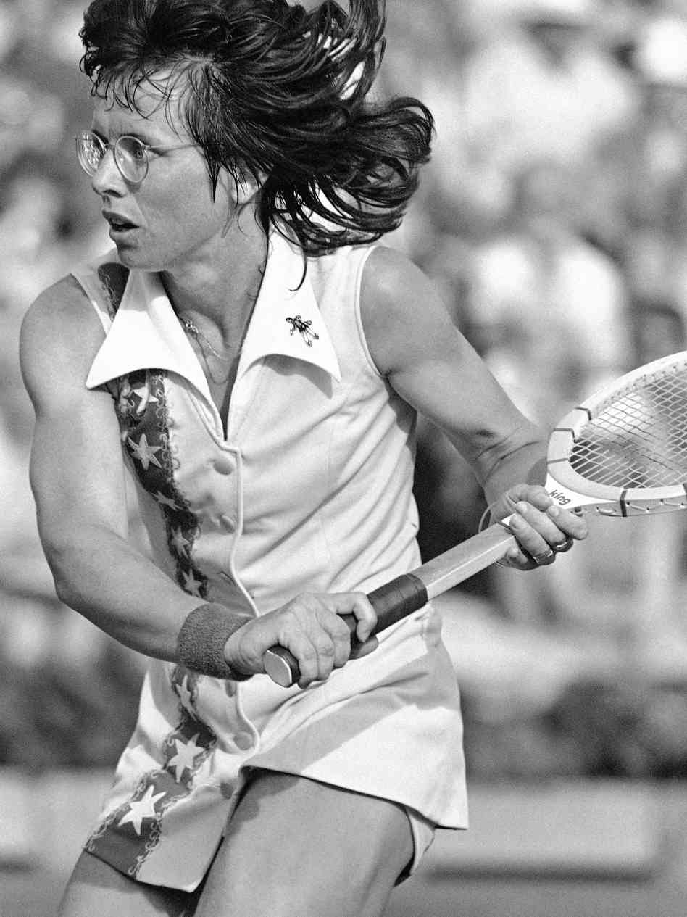
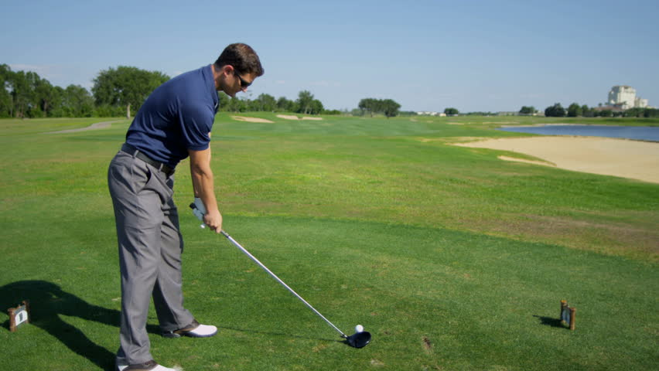
Growing Pains
“Embrace the suck.”
-Ian Rosenberger
“Pressure is a privilege. It only comes to those who earn it.”
-Billy Jean King
“There doesn’t have to be a train wreck. This is you now.”
- Aimee Kimball

Slide 8
Don’t Stress Over Stress
“Most people are about as happy as they make up their minds to be.”
-Abraham Lincoln

Slide 9
What is Stress?
STRESS
How It Is
How You Want It to Be
STRESS
Perceived Demands > Resources

Slide 10
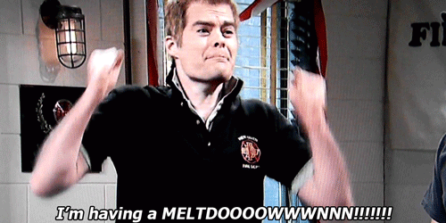
Identifying Your Stress
Get it All Out…

Slide 11
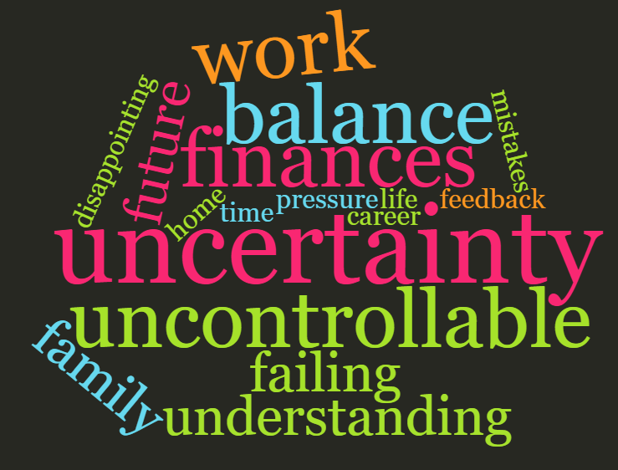
Common Stressors

Slide 12

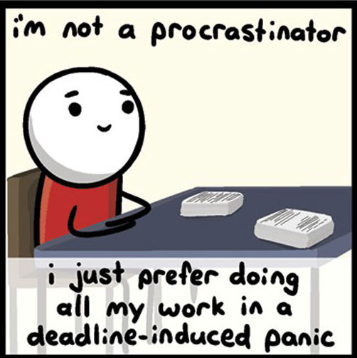
Can Stress Be Good?
Personal development
Feelings of pride
Performance benefits
Focus
Preparation
Motivation

Slide 13


Stress Drains Your Account
Energy withdraws=energy deposits
Failure to balance ➔
  illness, failure to focus, frustration, negativity, burnout, moodiness
Successful balancing ➔
  greater motivation, happiness, fun, stronger relationships
Remember: Stress is cumulative!

Slide 14
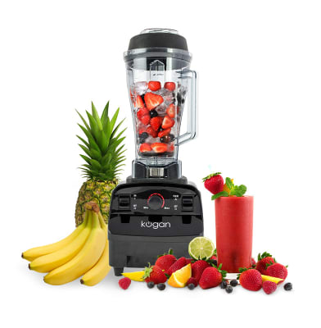
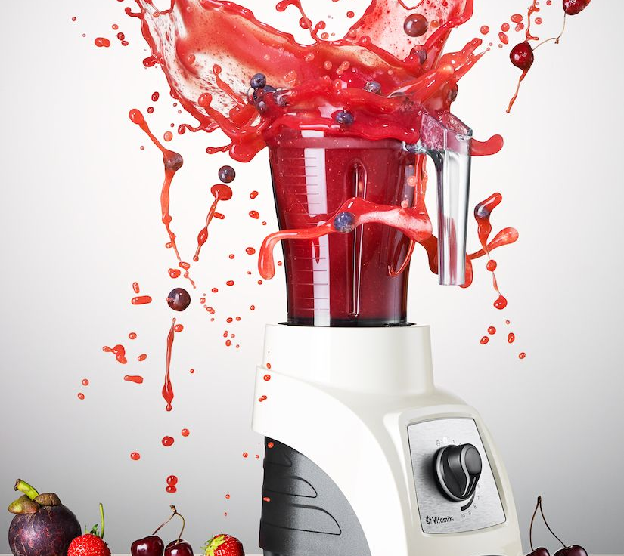
Life Isn’t About Balance-It’s About Blending
Strawberries =Family/Relationships (add a different fruit for each dependent child or adult)
Blueberries = Health
Bananas = Fun/Recreation/Social
Spinach = Work
Yogurt = Growth/Learning
Ice=Chores or other non-desirable task
Notes:
14

Slide 15
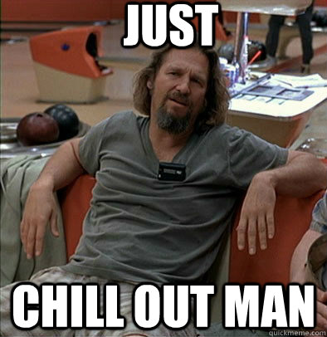
Coping with Stress
Talking it out
Exercise
Prayer
Meditation
Wine ☺
Journaling
Lists/ organization
Cleaning

Slide 16

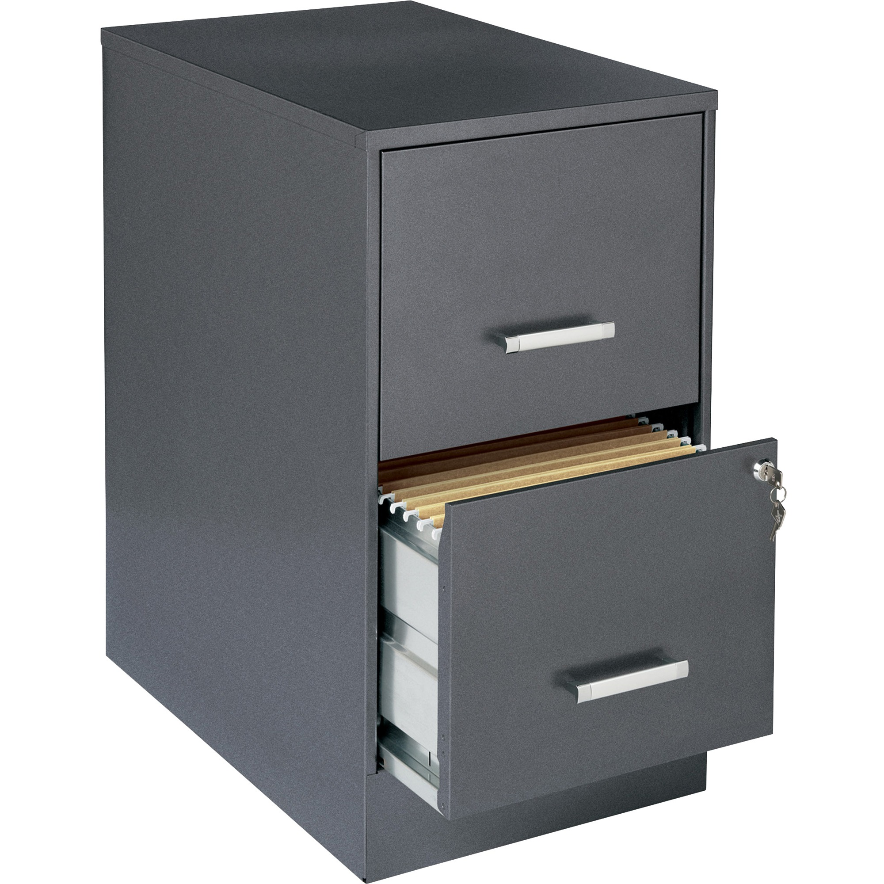
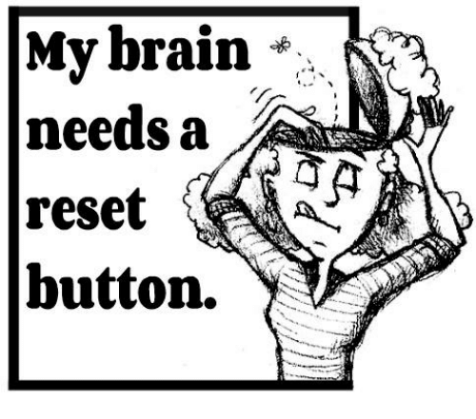
Coping 101
“To do” list
  Prioritize-what’s important to ME vs OTHERS
  Identify task time and energy required
  Do the worst first
Compartmentalize
  Different place/shoes= different focus
  Task box
Have Routines
  How do you start and end each day?
  Choose a “reset number”

Slide 17
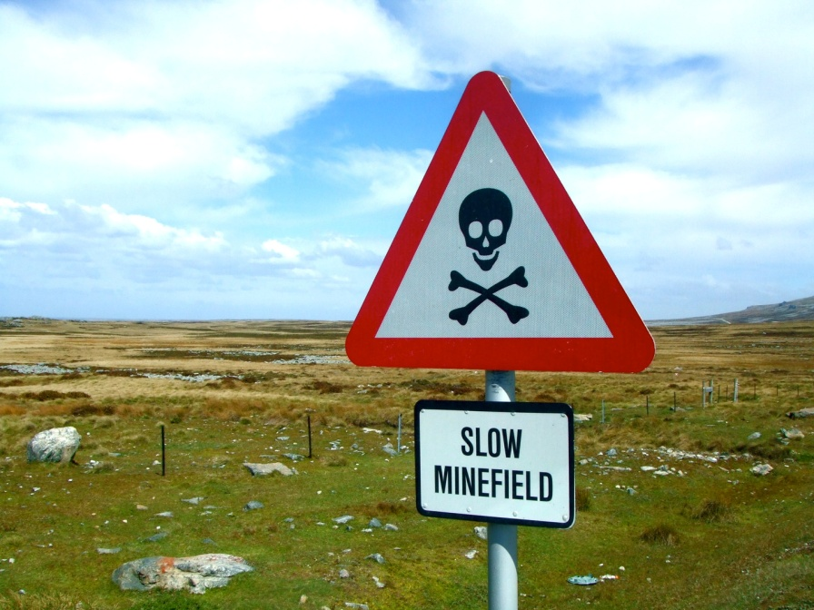
Flag the Minefield: Control the Controllable
Notes:
3 ft world

Slide 18
Flag the Minefield: Control the Controllable
Grip
Gravity
Important
“Fix it”
“Accept it”
Response: Act
Response: Accept & Act
Ex: Multiple Tasks
Ex: Other people
Not Important
“Eliminate it”
“Ignore it”
Response: Eliminate
Response: Integrate & Act
Ex: Spilled milk
Ex: Weather
Notes:
3 ft world

Slide 19

Acceptance Decreased Anxiety/Stress
Pain x Resistance = Suffering
The more negative thoughts or emotions you pile on top of the “pain”, the more suffering you will experience.
You make the situation harder when you ruminate on the negatives.
Discomfort x Focus = Experience

Slide 20
Discomfort x Focus = Experience
DISCOMFORT/STRESSOR | DESIRED EMOTION/ FOCUS | EXPECTED OUTCOME/EXPERIENCE
Back pain going into a major event | Challenge, what CAN be controlled, preparation | Better result, extra stretching and care
Assistant isn’t as organized as I need | Strengths, help you are getting, gratitude | Improved relationship, better communication

Slide 21
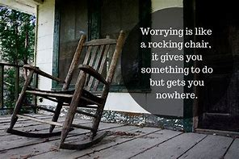
Focus on the Task not the Situation
Situation: On-site, office, virtual, elite athlete, etc.
Objective: Doing your best to help others be at their best
Task/Process: The fundamentals are the same

Slide 22
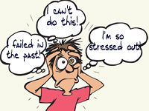

Watch Your Self Talk
Be your own biggest fan
Your thoughts will eventually leave your head and show up in your words and actions
Increase your awareness of what’s in your head
  What do you think about?
  What do you dwell on?

Slide 23
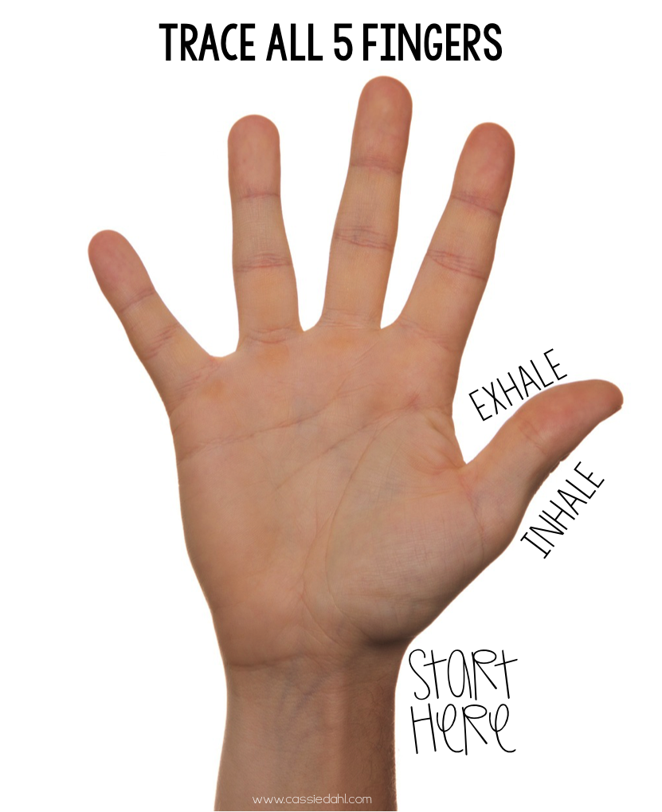
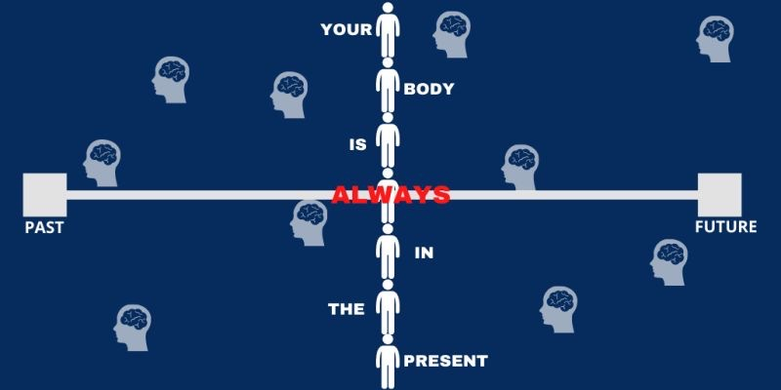
Be Where Your Feet Are
What’s Important Now?

Slide 24
W.I.N. THE DAY WITH HOMEWORK
Over the next week, what’s MOST important for you to accomplish and focus on for the following:
MISSION:
Be the most partner friendly organization in all of sports.
PROFESSIONALLY
PERSONALLY
SELFISHLY
“Everything will be ok in the end. If it’s not ok, it’s not the end.”

Slide 25
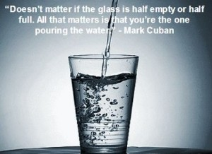
Take Away/ Leave Behind
What three things will you take with you and use?
Leave behind whatever stresses you out.

Slide 26
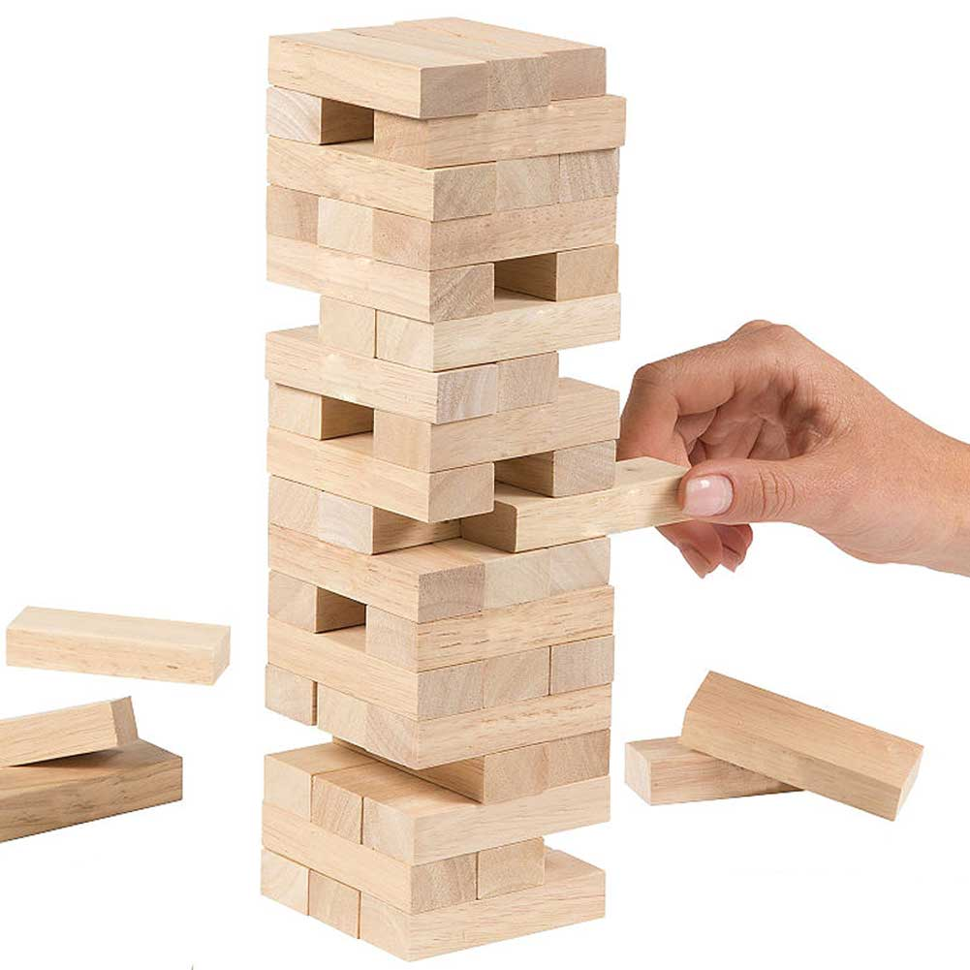

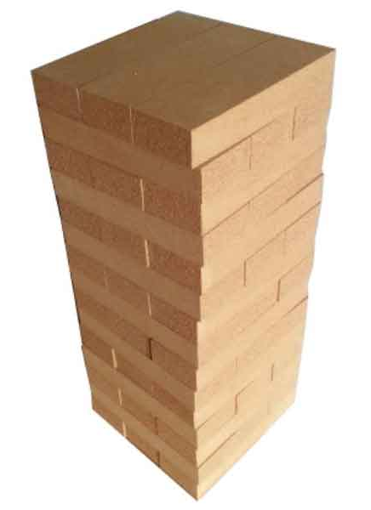
Choose Wisely
Notes:
26

Slide 27
Make it Great!
Aimee C. Kimball, Ph.D.
KPEX Consulting
(412) 657-0362
AimeeKimball@KPEXconsulting.com
www.KPEXconsulting.com

Slide 28


Now a little relaxation…

