Slide 1
A wise man should consider that health is the greatest of human blessings and learn how by his own thought to derive benefit from his illnesses.
— Hippocrates

Slide 3
Pat Helma, DC, DACBSP © 2021 All rights reserved

Slide 4
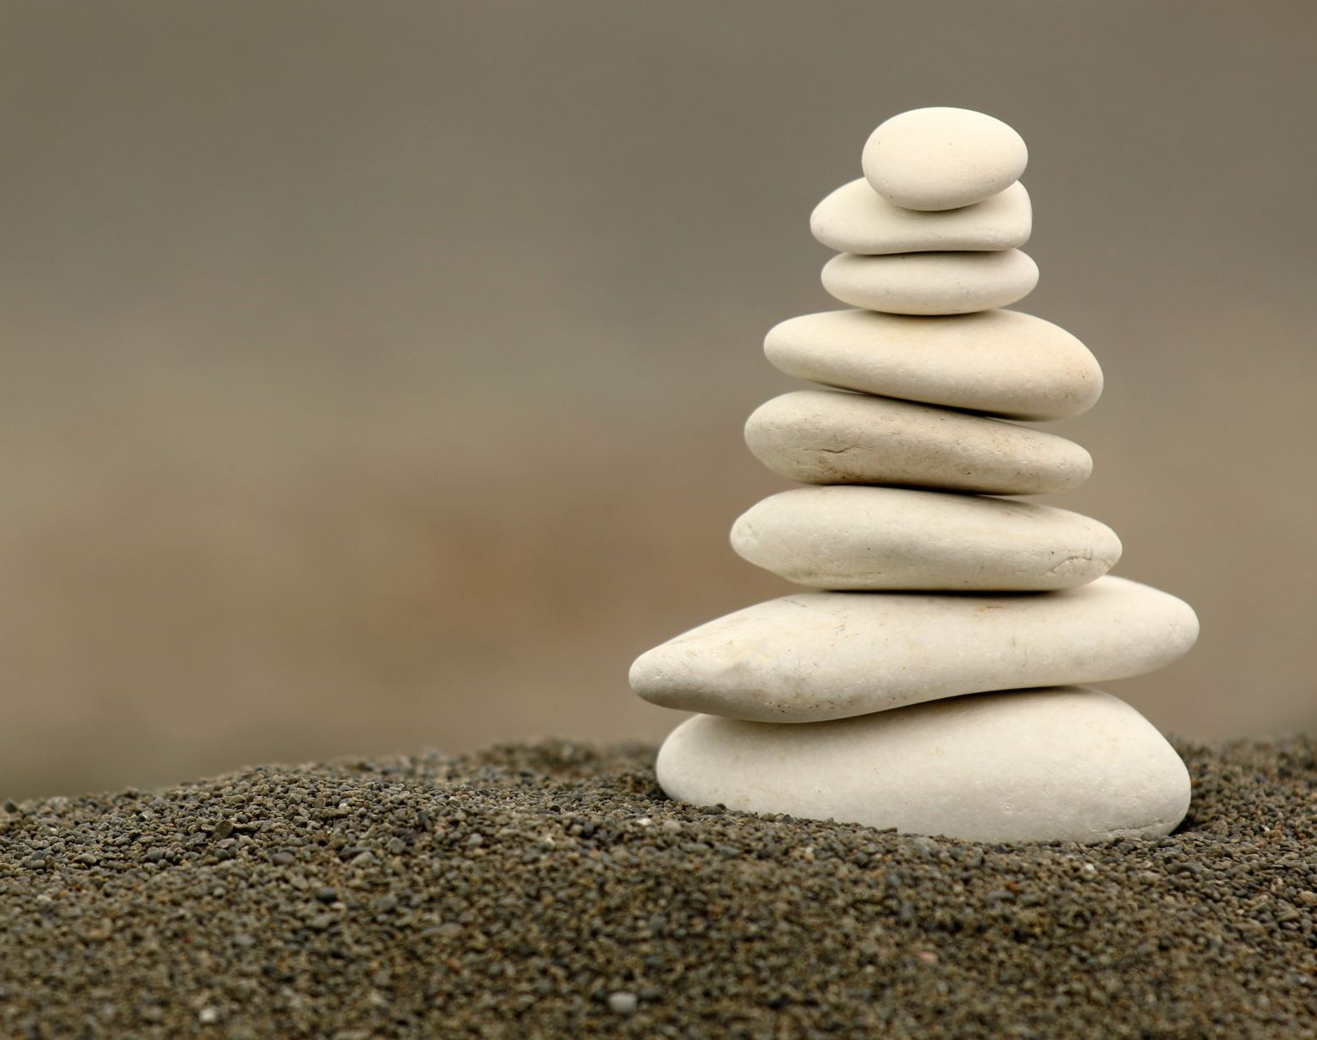
Disclaimer
The opinions, viewpoints and recommendations contained in this presentation represent those of the author(s) alone and do not represent the opinions, viewpoints or recommendations of any organization in which the author(s) may be affiliated, including, without limitation, the ACBSP, DConline, Foundation Training, RallySport Boulder and ECFit Strength.

Slide 5
Tensegrity
The forces of tension (provided by muscles, tendons, ligaments and fascia) pulling on structure (bones and joints) that help keep the body both stable and efficient in mass and movement

Slide 6
Complacent Adaptation
Our bodies adapt to the repetitive stressors placed upon it
Can be good or bad

Slide 7
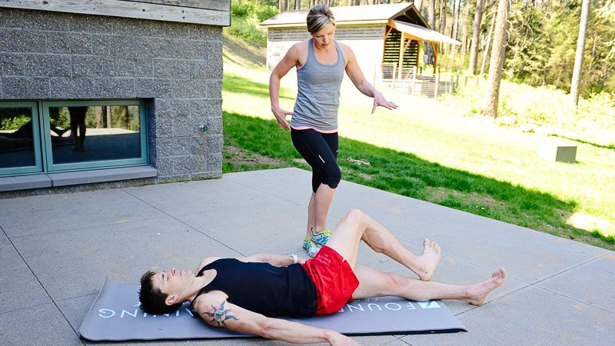
What Do You Feel?
“The awareness of poor body movements and patterns this program brings is priceless... Because it’s hard to change something you never thought needed changing.”

Slide 8
This is the difference between a corrective exercise and a general workout. Foundation Training gives the patient a very powerful tool they can use on their own terms to manage their health and promote wellness. That’s huge!

Slide 9
Muscle Weakness Causes Joint Degeneration
Walter Herzog, David Longino, The role of muscles in joint degeneration and osteoarthritis, Journal of Biomechanics, Volume 40, Supplement 1, 2007, Pages S54-S63, ISSN 0021-9290, https://doi.org/10.1016/j.jbiomech.2007.03.001
Abstract: The purpose of this work was to establish a controlled and reversible muscle weakness model for studying the effects of weakness on joint degeneration leading to osteoarthritis (OA). Gross morphology of the knees and histology of articular cartilage suggested that, 4 weeks of muscle weakness resulted in initial signs of joint degeneration, indicating that weakness may be an independent risk factor for joint degeneration leading to OA.

Slide 10
It Just Gets Worse From There
Hinman, R.S., Hunt, M.A., Creaby, M.W., Wrigley, T.V., McManus, F.J. and Bennell, K.L. (2010), Hip muscle weakness in individuals with medial knee osteoarthritis. Arthritis Care Res, 62: 1190-1193. https://doi.org/10.1002/acr.20199
In people with knee OA, significant strength deficits were evident for all hip muscle groups evaluated (hip abductors, adductors, flexors, extensors, internal and external rotators) (P < 0.05). Compared with controls, strength deficits ranged from 16% (hip extensors) to 27% (hip external rotators) after accounting for differences in sex and age between groups.
People with knee OA demonstrate significant weakness of the hip musculature compared with asymptomatic controls. It is not clear if hip muscle weakness precedes the onset of knee OA or occurs as a consequence of disease. Findings from this study support the inclusion of hip strengthening exercises in rehabilitation programs.

Slide 13
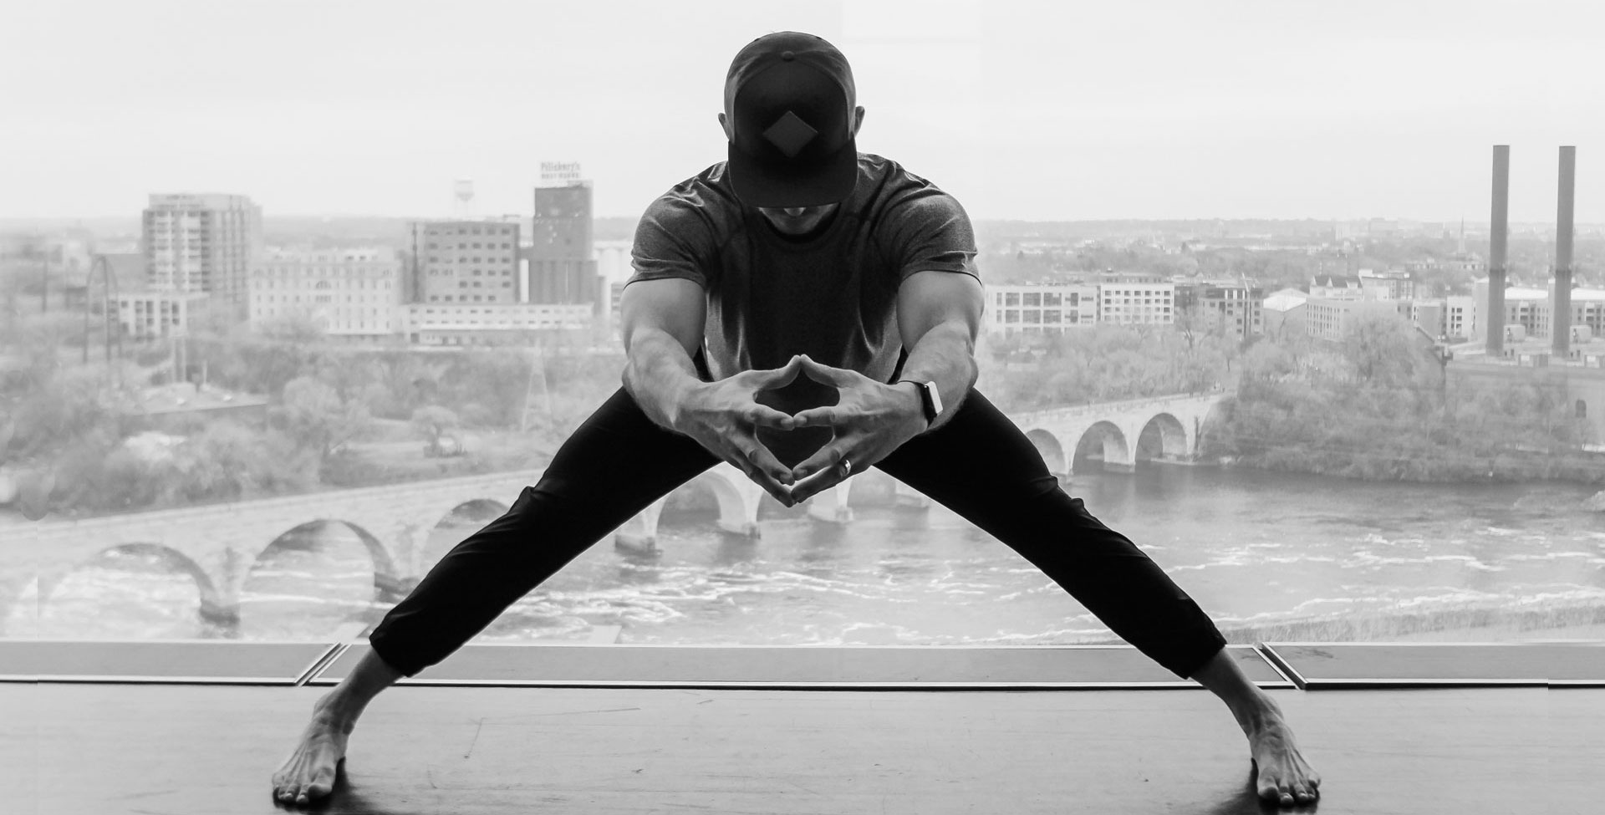
Anchoring
A sustained bilateral contraction among the muscles which connect the bottom of the pelvis to the femur and tibia.
Adductors, Tensor Fascia Lata, Iliacus, Sartorius and Hamstrings

Slide 14
Decompression
The action of creating downward spinal traction by anchoring the pelvis, counter tensioned by upward spinal traction from muscular deep breathing.
The result is a subtle lengthening of the deepest para-spinal muscles leading to a decrease in the force placed on individual segments of the spine.

Slide 15
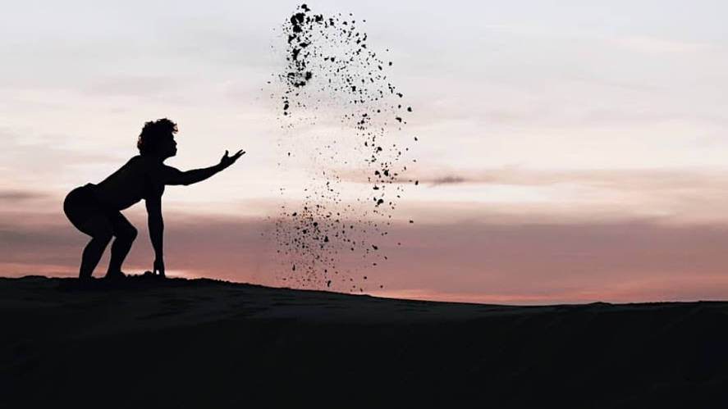
Hinging
Utilizing the hip joint, the most dynamic joint in the body, for its purpose.
Hinging properly allows your body to remain braced and anchored during nearly any pulling, reaching, lifting or folding movement.
The posterior chain must be held within its effective length to allow this integrated movement.

Slide 16
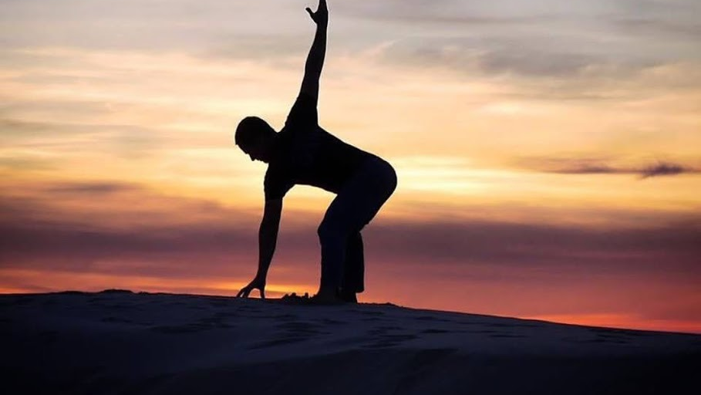
Bringing it Together
Good vs. Balanced posture
Posterior Chain
Never lock joints
It’s not about how far you move, it’s about creating tension

Slide 17
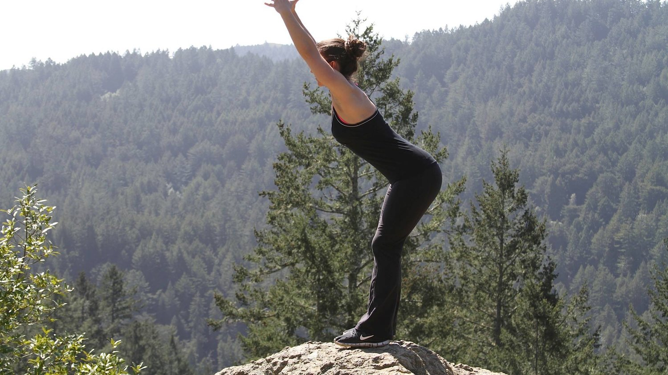
Let’s Move
Standing Decompression
Decompression Breathing
Anchoring
Founder
Hinging
Supine Decompression

Slide 18
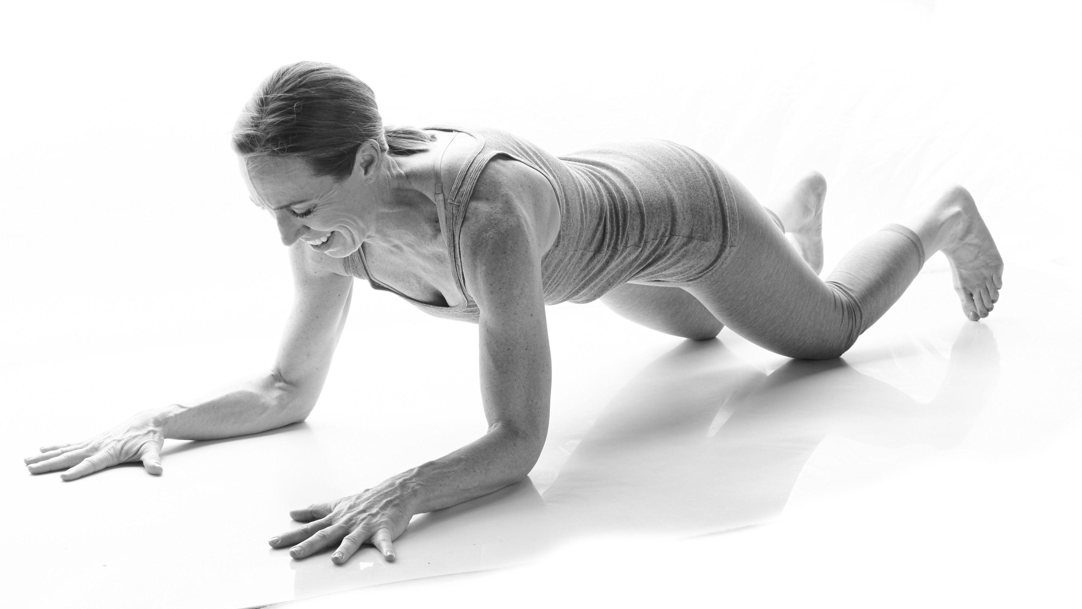
Want More?
https://www.foundationtraining.com/
https://stream.foundationtraining.com/
pat@foundationtraining.com

