Slide 1
Updates in Prehospital Emergency Medicine
Saturday, April 24, 2021
60 minutes
Walt Stoy, Ph.D. EMT-P
Professor, Emergency Medicine
University of Pittsburgh

Slide 2
Disclosure Statement
My retirement accounts are managed by many others
They inform me that I have a very diverse portfolio
Most likely, there might be some investments that tie to something related here, however, I am not sure
So, I say, to the best of my knowledge – I have no financial conflicts to declare

Slide 3
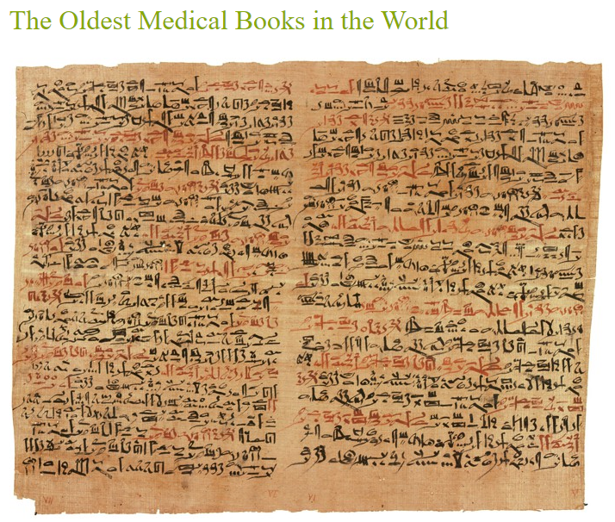
The Kahoun Papyrus is the most ancient scroll and was discovered at Fayoum and was called by mistake the Kahoun Papyrus. It dates from 1950 B.C.

Slide 4

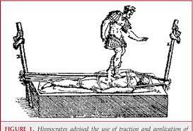
Abstract
Axial traction to correct spinal deformity is a very old concept. The oldest reference available is in ancient Hindu mythological epics (written between 3500 BC and 1800 BC) where it is mentioned how Lord Krishna corrected the hunchback of one of his devotees. Later, Hippocrates (460 BC to 377 BC) described certain devices. Galen (131 AD to 201 AD), a follower of Hippocrates, used axial traction with direct pressure. Ibn Sena (980 AD to 1037 AD) in the Middle East also used similar methods. Osteopaths of Turkey also used axial traction to correct spinal deformities.

Slide 5
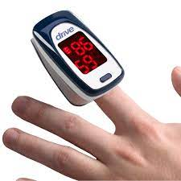
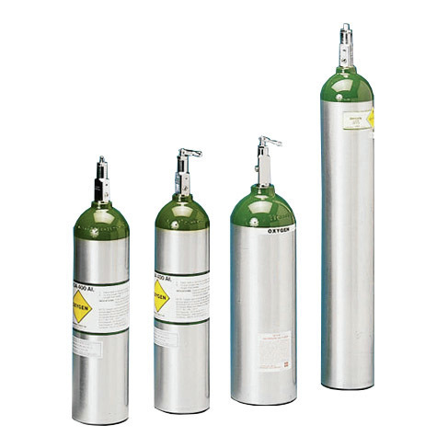
Oxygen is good
Blue is bad
Air ought (should) go in and out
Oxygen administration
Based on pulse oxy readings
94% or lower

Slide 6
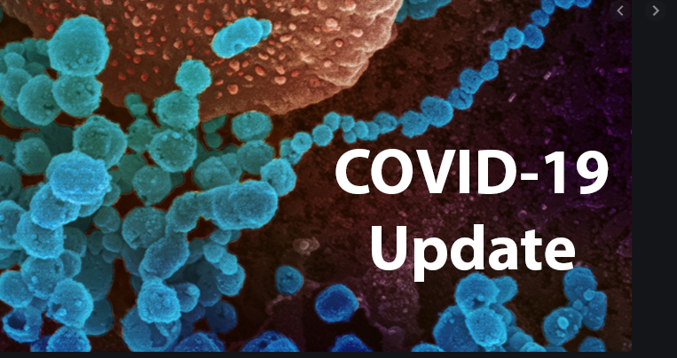

Slide 7
True or False
  The most recent changes to the American Heart Association (AHA) Guidelines for CPR and ECC took place in 2015?
    ANSWER = FALSE – it took place in 2020

Slide 8
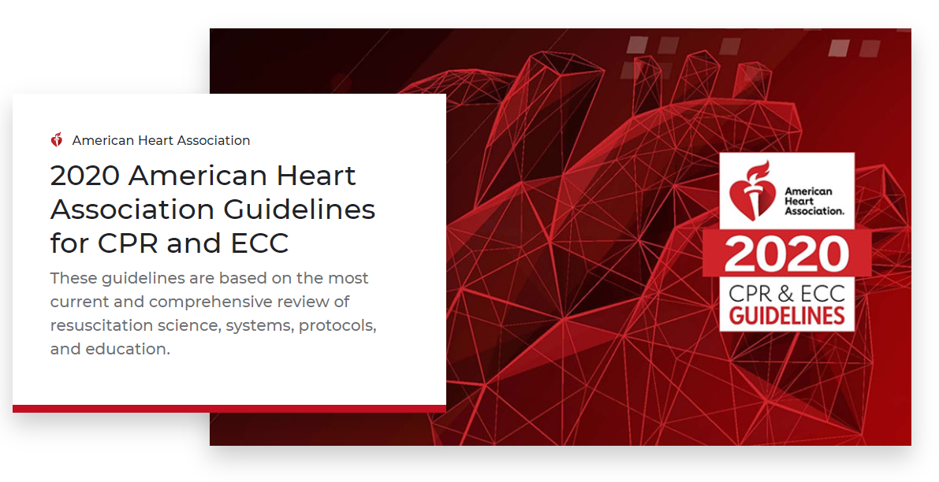

Slide 9
True or False
  Spinal motion restriction is defined as attempting to maintain the spine in anatomic alignment and minimizing gross movement irrespective of adjuncts or devices?
    ANSWER = TRUE

Slide 10
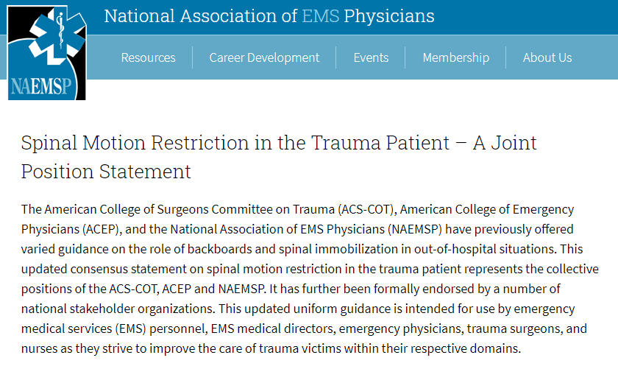
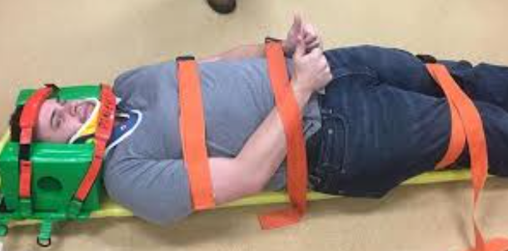
Spinal motion restriction is defined as attempting to maintain the spine in anatomic alignment and minimizing gross movement irrespective of adjuncts or devices.

Slide 11
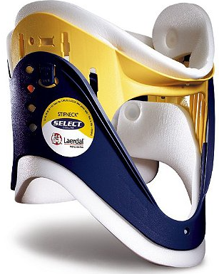

Radiography is not necessary if the patient satisfies ALL of the following low risk criteria:
No midline cervical tenderness
No focal neuro deficits
Normal alertness
No intoxication
No painful distracting injury
Mnemonic - NSAID:
Neuro deficit
Spinal midline tenderness in C-spine
Alertness
Intoxication
Distracting injury

Slide 12

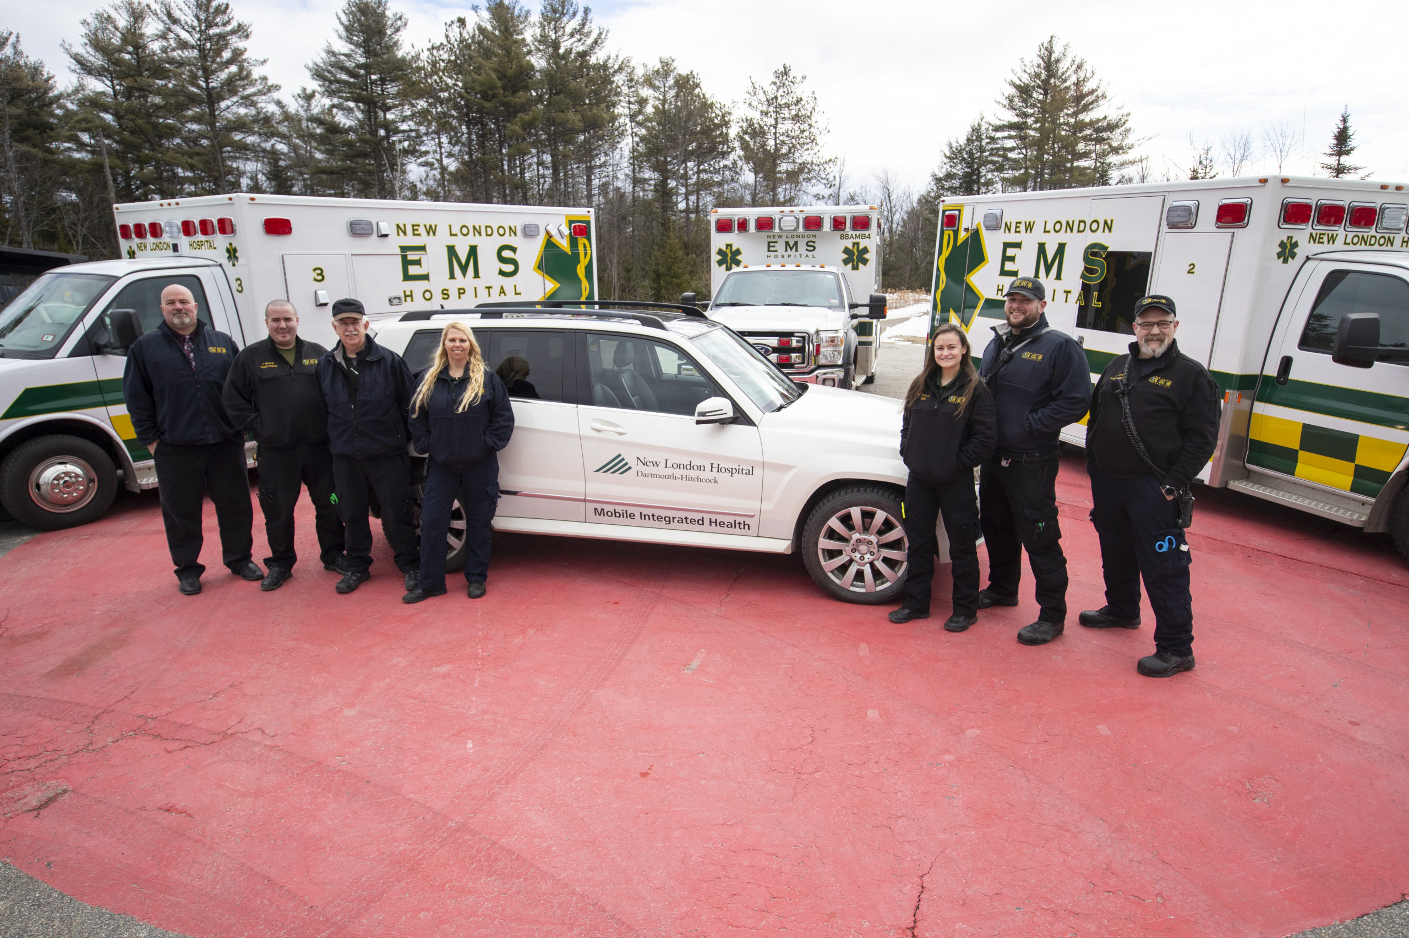

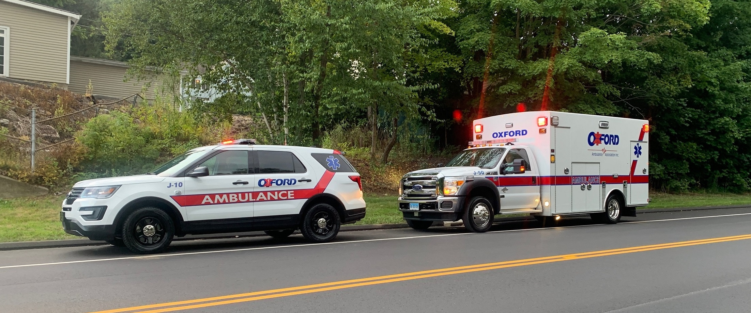
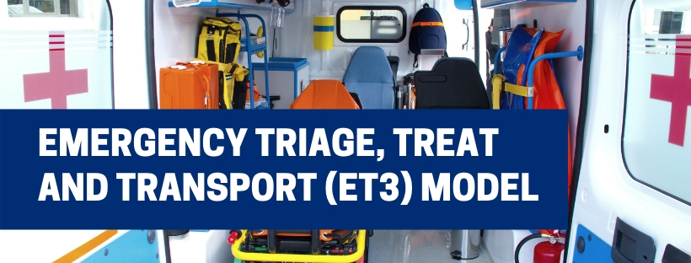
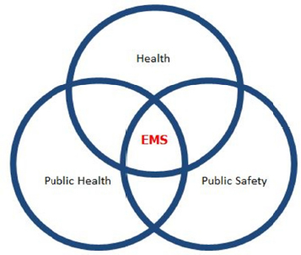

Response Times No Longer the Critical Measure
Right-Sizing Response as a New Performance Measure
Taking the Fire Service’s Prevention Approach to Population Health
Seven EMS Trends
Extending Care
Changing Payment Models
EMS Industry Consolidation
Provider Wellness Programs and Policies
https://www.fitchassoc.com/7-ems-trends-affecting-cities/

Slide 13


Slide 14
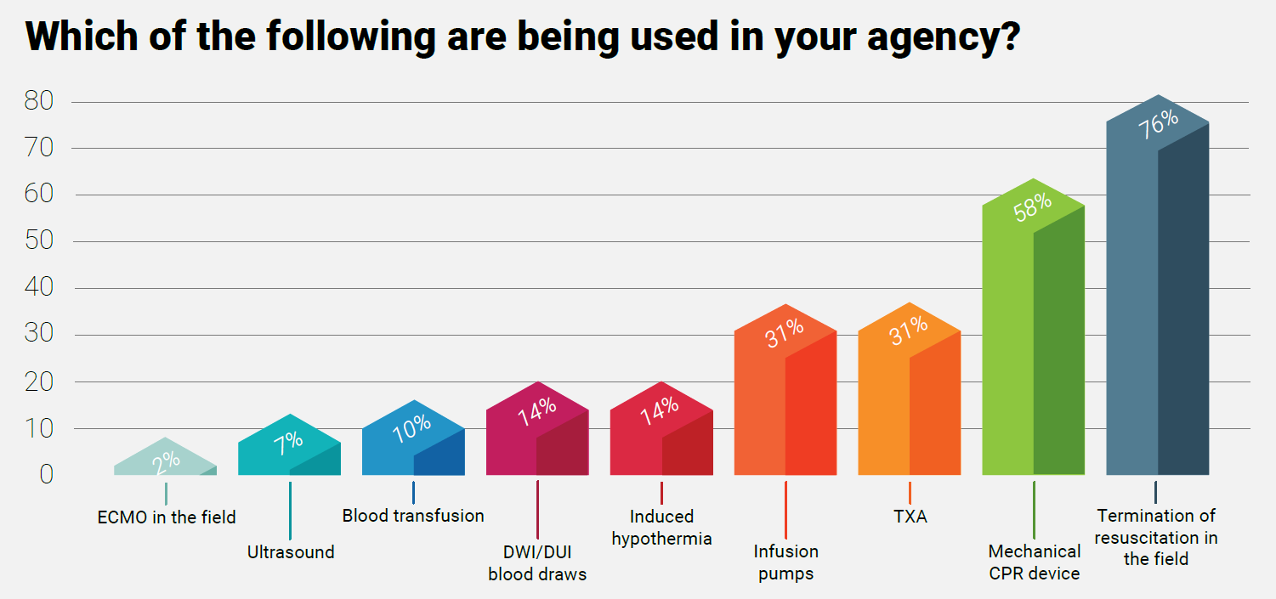

Slide 15
Which of the following best describes ECMO?
  Extracorporeal Life Support is an advanced form of support where blood is pumped outside of the body for oxygenation and the returned to circulation.
  It involves pumping blood out of the body into a machine where oxygenation takes place. Then, the blood can be pumped back into circulation in the body.
  This is a very serious type of support that should only be used in life-threatening situations where conventional forms of treatment were unsuccessful.
  All the above
    ANSWER = “d” all the above

Slide 16
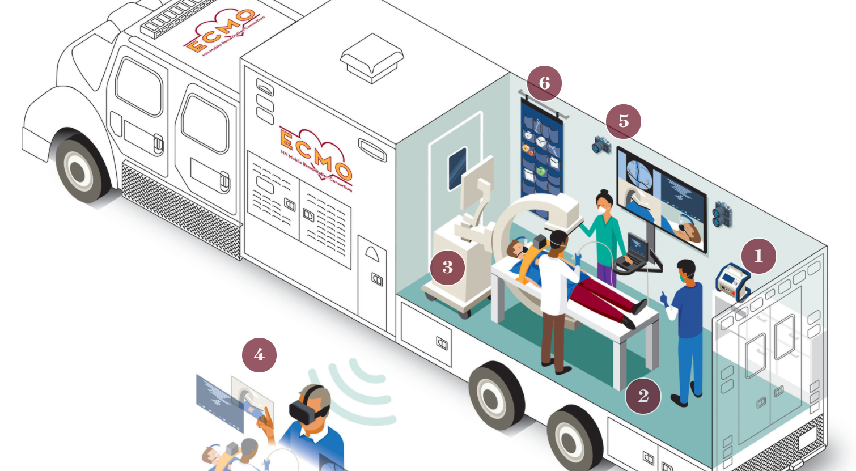
University of Minnesota working to create the country's first 'Super Ambulance'
ECMO stands for extracorporeal membrane oxygenation. The ECMO machine is similar to the heart-lung by-pass machine used in open-heart surgery.
Each Super Ambulance costs $1.8 million. This project is possible thanks to grant money from the Helmsley Charitable Trust.

Slide 17
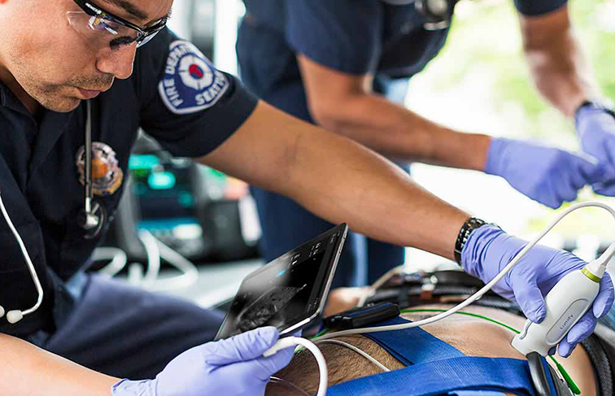
CLINICAL APPLICATIONS FOR FIELD ULTRASOUND
CAUSES OF DYSPNEA
2. RECOGNIZING OB EMERGENCIES
3. CARDIAC EVALUATION AND RESUSCITATION
4. AIRWAY PLACEMENT CONFIRMATION AND MONITORING
5. GASTRIC TUBE PLACEMENT CONFIRMATION
6. FRACTURE DETERMINATION
7. PREHOSPITAL NEEDLE THORACOSTOMY PLACEMENT
8. PERIPHERAL INTRAVENOUS ACCESS
9. STROKE DIAGNOSIS
Traditional ultrasound machines cost $300,000 or more, while the MobiUS costs only $7,500 (Stylist).

Slide 18
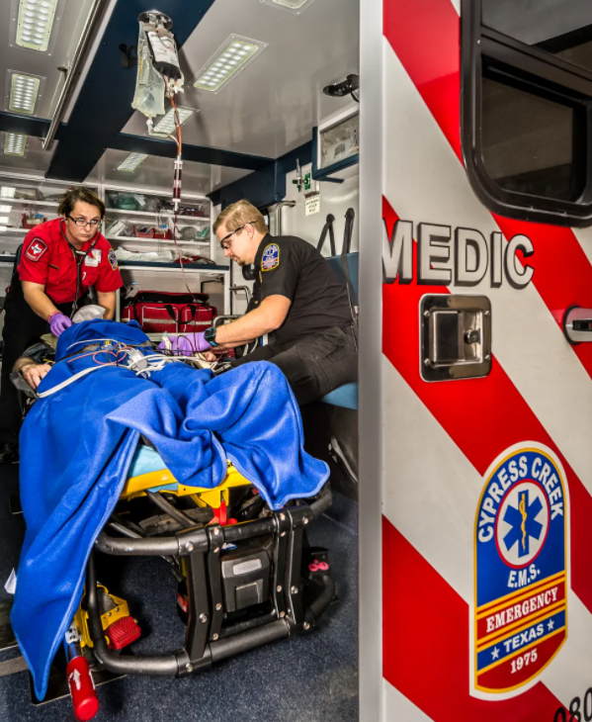
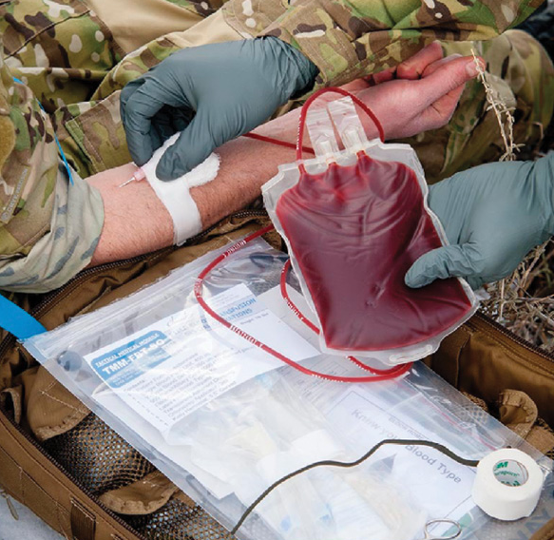
In today's EMS setting, it's uncommon for ground EMS services to carry and use blood components. Most services that carry blood components are helicopter-based. ... Even in urban areas, the role of blood transfusions is relevant. The time is now for EMS to embrace blood as the fluid of choice in trauma resuscitation.

Slide 19
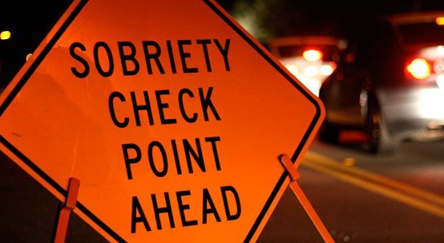
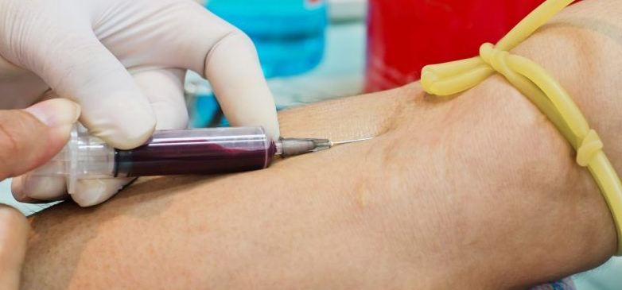
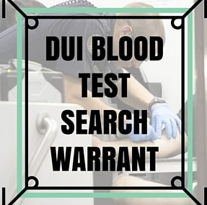
Supreme Court Allows Warrantless Blood Draws of Unconscious Drivers
SCOTUS says it is constitutional for police to draw blood from unconscious drunk driving suspects.

Slide 20
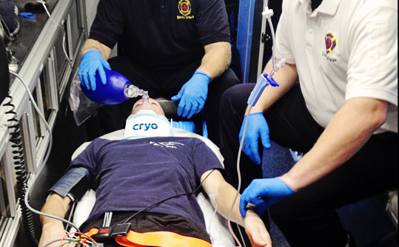
Quick, Consistent & Non-invasive Therapeutic Hypothermia during Cardiac Arrest
Once activated, the cooling element achieves a temperature of -3.0°C to -5.0°C within seconds, cooling the blood traveling through the carotid triangles.
Time to Cool
Some recent studies show an association between time to cooling and mortality (a one-hour delay in time to cooling increases the risk of death by 20%) and that therapeutic hypothermia, when combined with return of spontaneous circulation within 25 minutes of cardiac arrest, yields positive outcomes. Further, it was found that for every five-minute delay in initiating hypothermia, there was a 6% greater chance of the patient having a poor outcome.

Slide 21
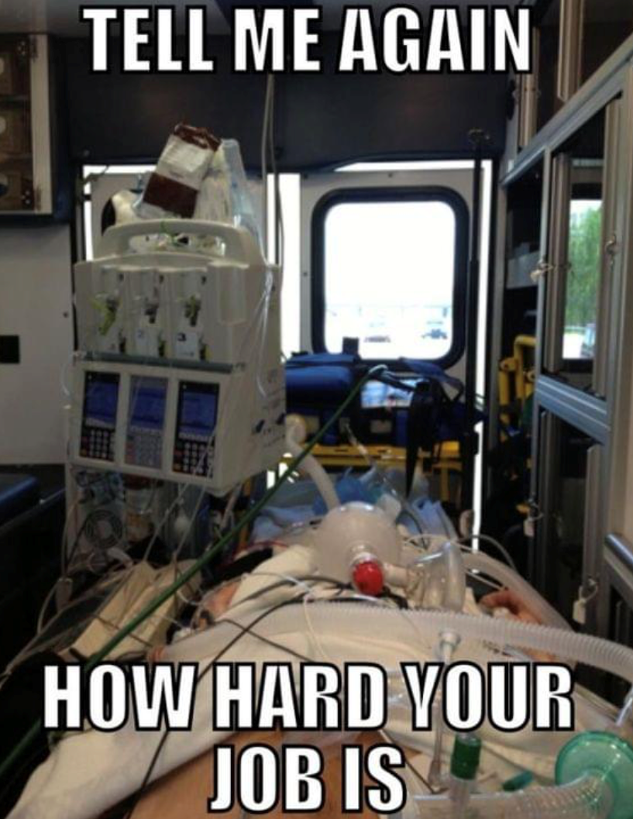
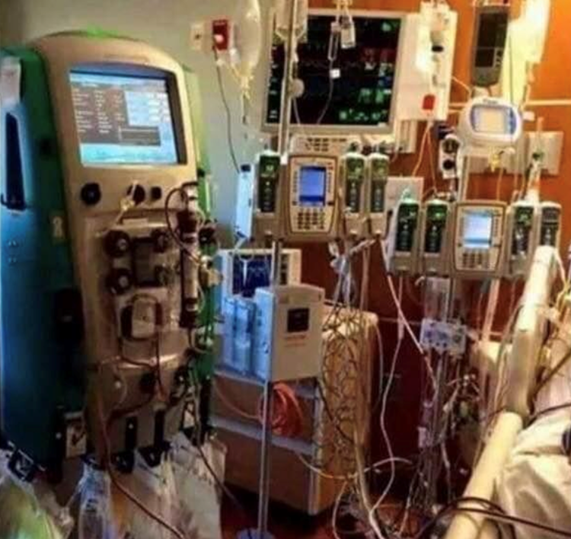
An infusion pump is a medical device that delivers fluids, such as nutrients and medications, into a patient's body in controlled amounts. ... They can deliver nutrients or medications, such as insulin or other hormones, antibiotics, chemotherapy drugs, and pain relievers.

Slide 22
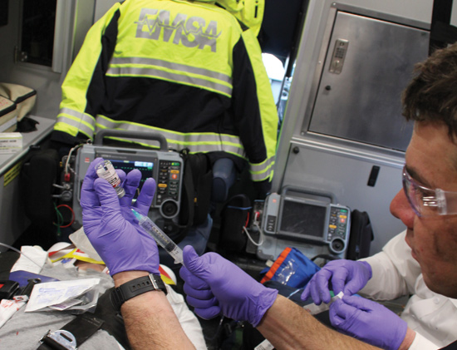
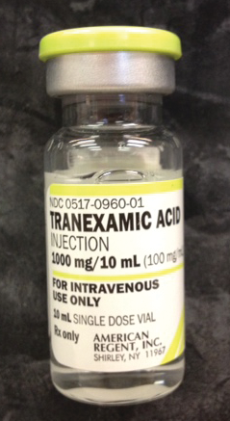
How Can Tranexamic Acid Help in EMS?
Tranexamic acid (sometimes shortened to txa) is a medicine that controls bleeding. It helps your blood to clot and is used for nosebleeds and heavy periods. If you're having a tooth taken out, using tranexamic acid mouthwash can help stop bleeding.

Slide 23
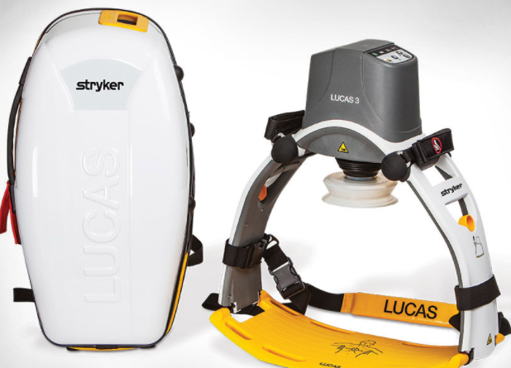
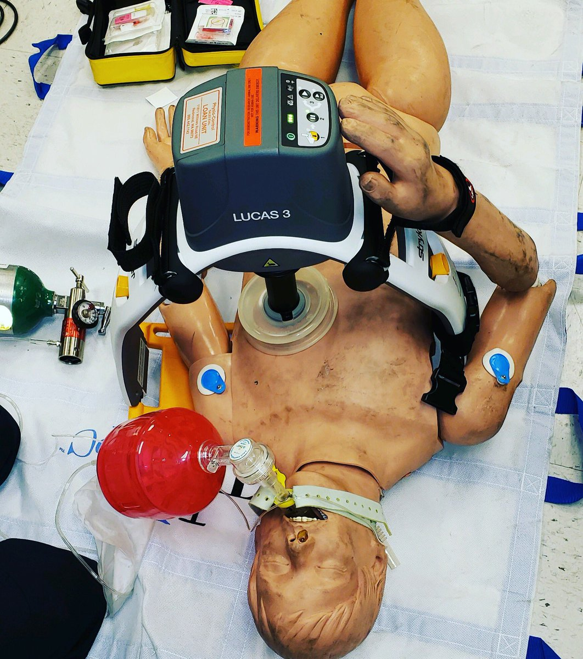
The first commercial version needed a name, and LUCAS was chosen, which stands for Lund University Cardiopulmonary Assist System.
Deliver high-performance, continuous chest compressions with less strain, micromanagement, and risk for the caregiver. The LUCAS chest compression system, provides benefits both to the cardiac arrest patient and the resuscitation team.

Slide 24
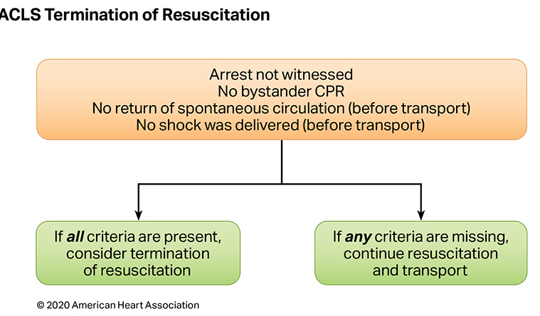
A general approach is to stop CPR after 20 minutes if there is no ROSC or viable cardiac rhythm re-established, and no reversible factors present that would potentially alter outcome.

Slide 25
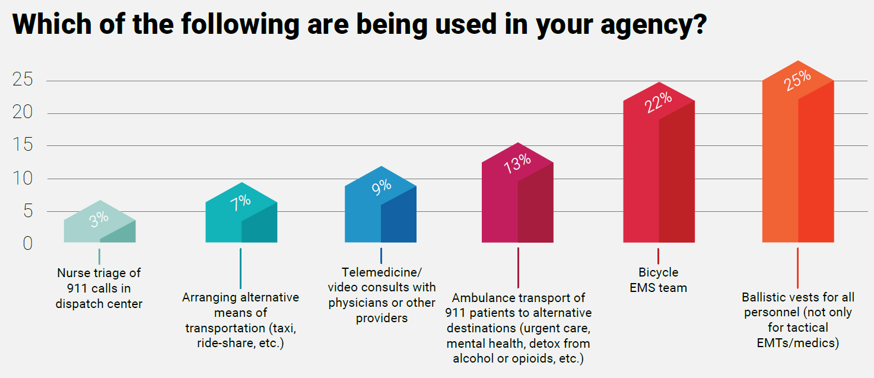

Slide 26
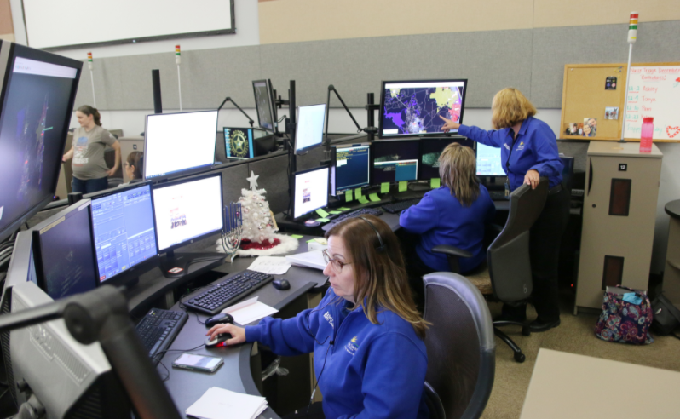
Dispatch and Triage - 911

Slide 27
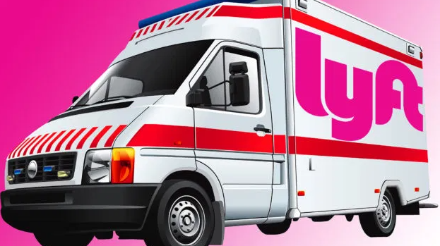
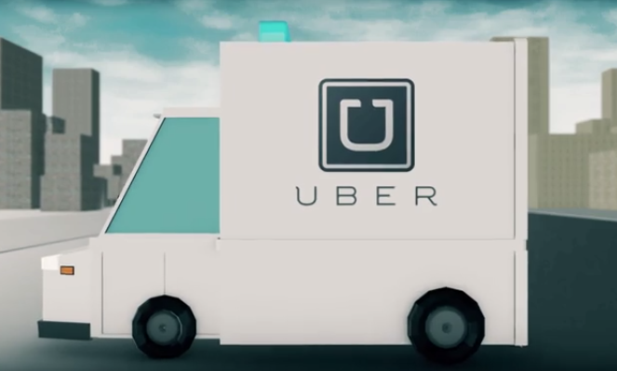

Alternative
Transportation

Slide 28

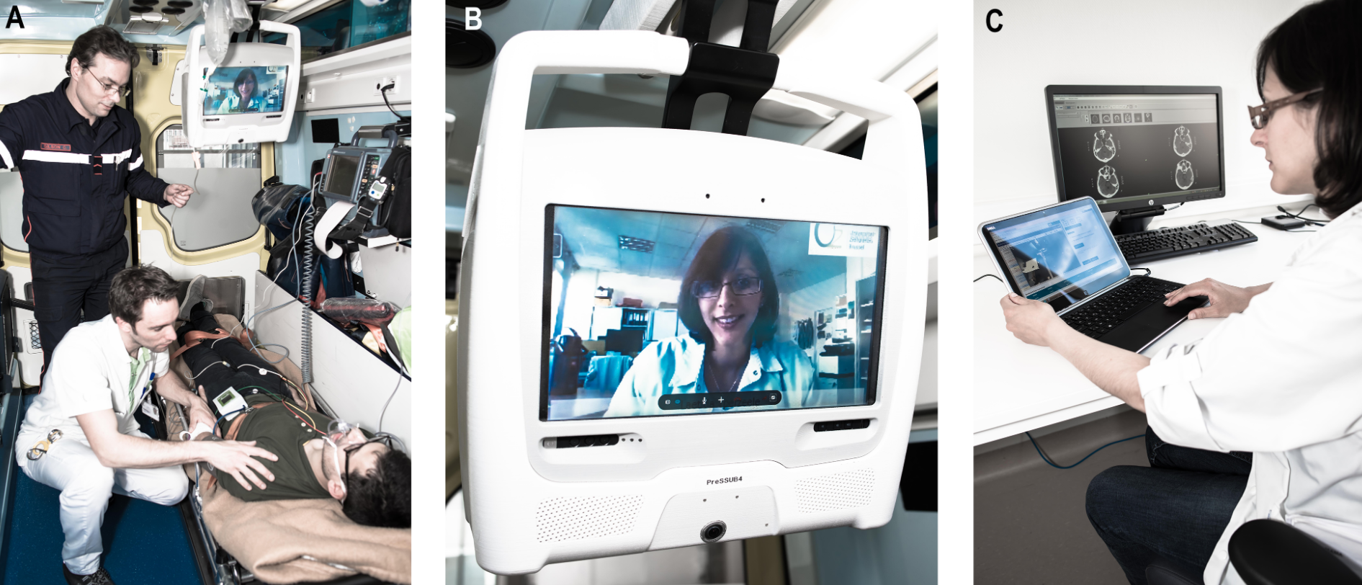
Telemedicine
Thanks to COVID-19
This process of healthcare made great strides

Slide 29
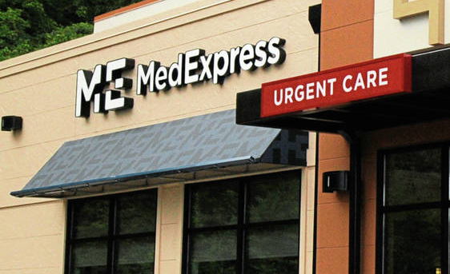
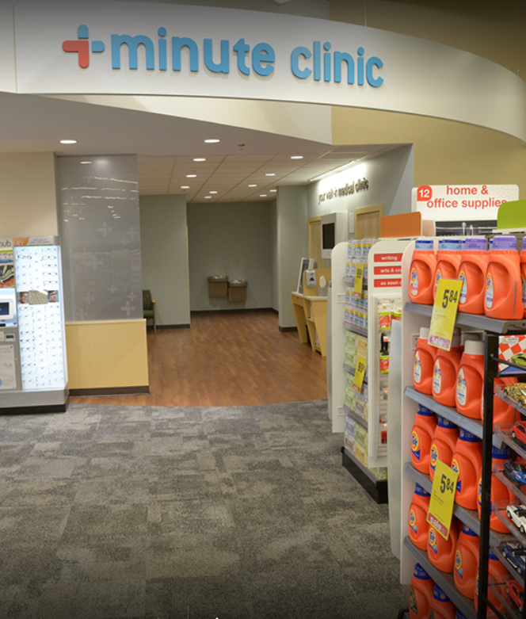
EMS Today 2019 Quick Take:
Alternative transport destinations
TOP TAKEAWAYS ON ALTERNATIVE TRANSPORT DESTINATIONS FOR EMS
1. BEND THE UTILIZATION CURVE AWAY FROM EMS TRANSPORT TO THE ED
2. EMS NEEDS ANOTHER SOLUTION FOR LOW-ACUITY PATIENTS
3. PILOT PROGRAM IN ALTERNATIVE TRANSPORT DESTINATIONS IDENTIFIES NEED FOR NARROW PROTOCOLS
Urgency and complexity.
Receiving party.
Payer issues.
4. ALTERNATE DESTINATIONS ALIGNS WITH ET3 REIMBURSEMENT MODEL
ADDITIONAL RESOURCES ON ALTERNATE DESTINATIONS AND ET3

Slide 30
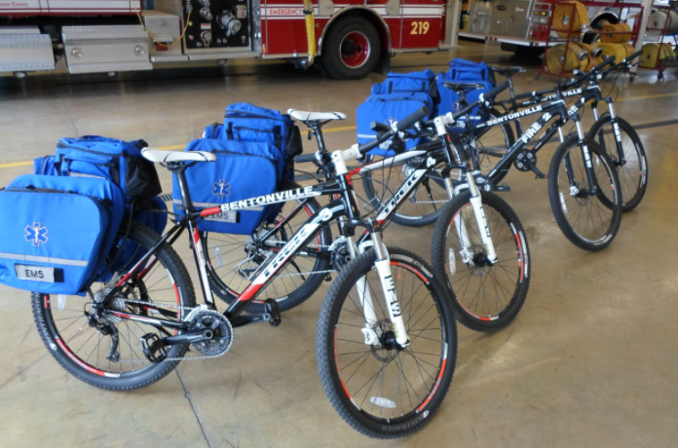

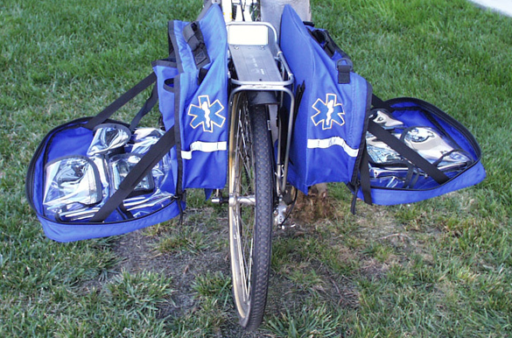
Bike EMS
A fast alternative system
In the right situations, very effective

Slide 31
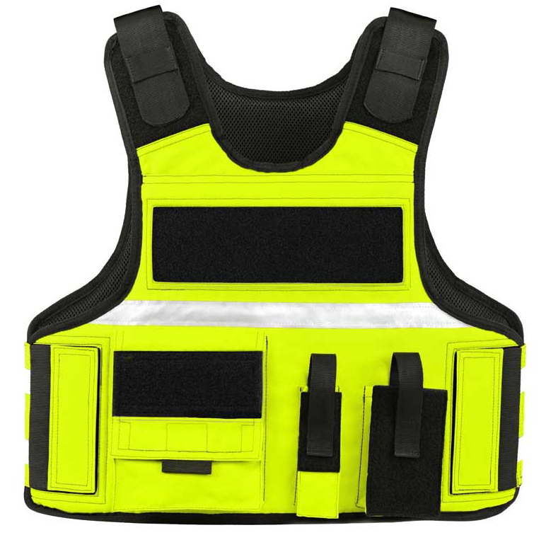
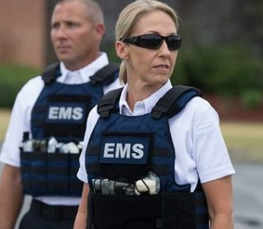
Unfortunately,
The new world we live in…
Has the ability to hold needed gear

Slide 32
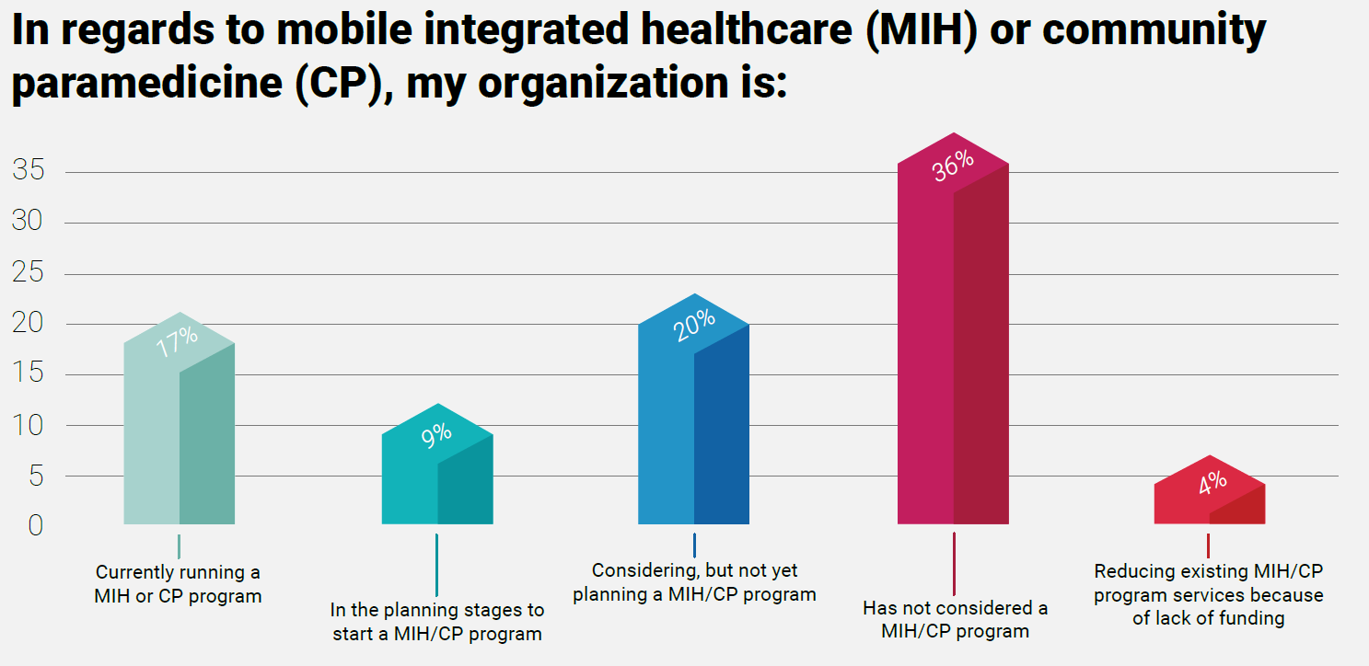

Slide 33
Which of the following best defines MIH-CP?
  Mobile Intensive Healthcare – Care Paramedic
  Mobile Integrated Healthcare – Community Paramedic
  Mobility Intensive Health – Community Provider
  Mobility Integrated Healthcare – Community Practitioner
    ANSWER = “b” Mobile Integrated Healthcare – Community Paramedic

Slide 34
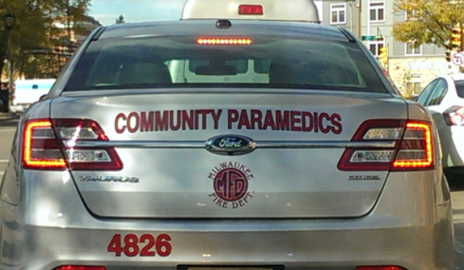
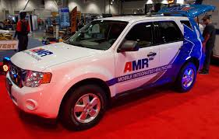

Mobile Integrated Healthcare
Community Paramedicine

Slide 35
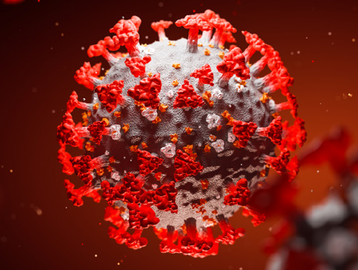
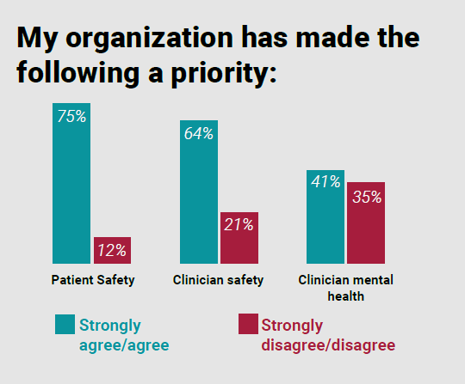
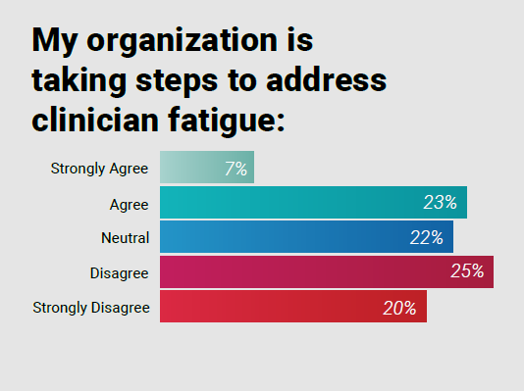
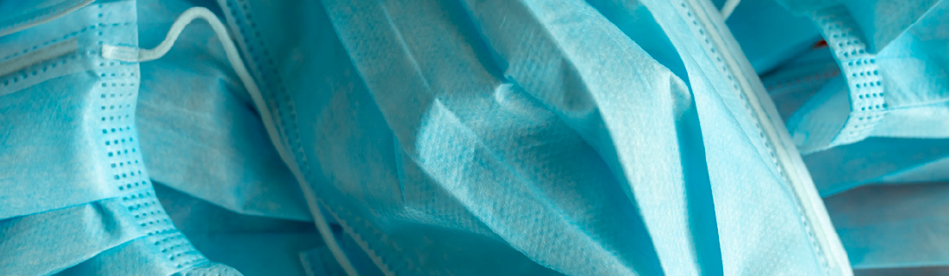

Slide 36
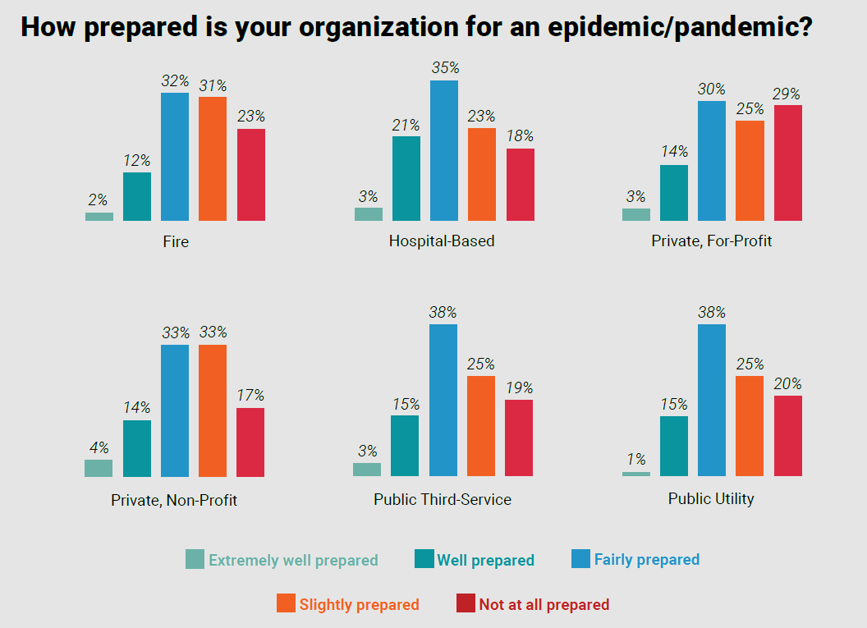

Slide 37
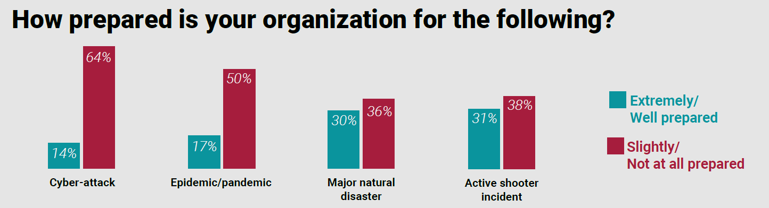

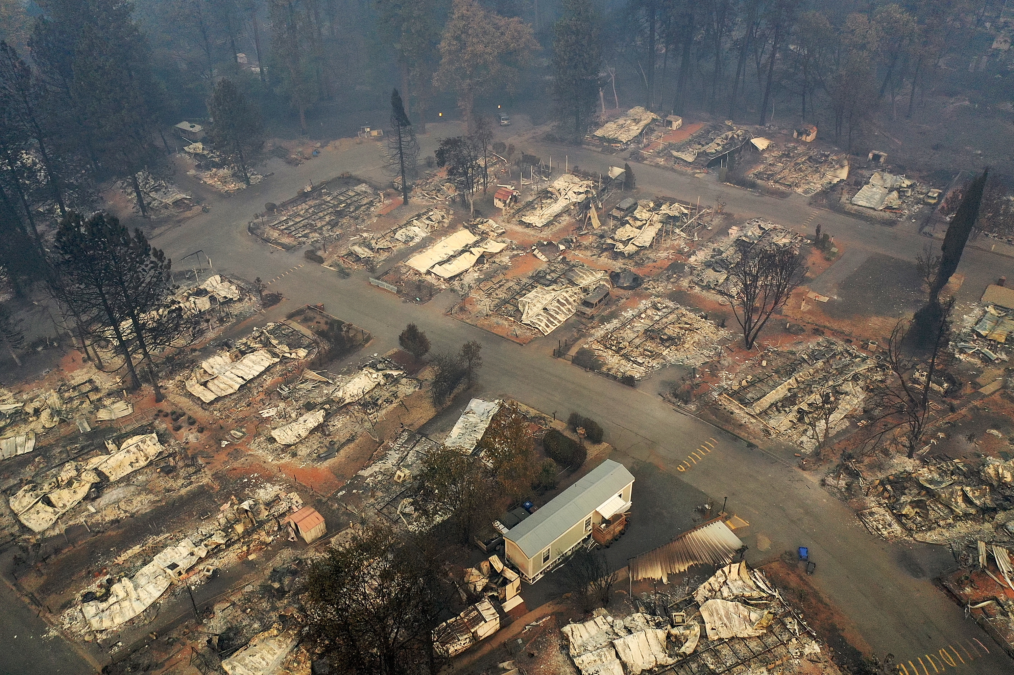



Slide 38


Slide 39


Slide 40


Slide 41


Slide 42
What percentage of EMS personnel recommend EMS as a career for their children in 2020?
  21%
  41%
  61%
  81%
    ANSWER = “c” 61%

Slide 43






Slide 44
How beneficial was this presentation on an update of Prehospital Emergency Medicine?
  Extremely beneficial
  Somewhat beneficial
  Learned some new insights
  Knew all this and learned nothing new
    ANSWER = “a,b,c,d” Answer is in the participants hands…

Slide 45


Slide 46


Slide 47


Slide 48


