Slide 1
When to Treat and When to Refer: The Continuum of Care in Musculoskeletal Medicine
James E. Eubanks, Jr. MD, DC, MS
Academic Chief Resident, Dept. of Physical Medicine and Rehabilitation
University of Pittsburgh Medical Center (UPMC)

Slide 2
Disclosures
None.

Slide 3





Educational Background
  University of Pittsburgh School of Medicine,
  Pittsburgh, PA
    Internship, Internal Medicine
    Residency, Physical Medicine and Rehabilitation
      Academic Chief Resident, 2021
  Brody School of Medicine at East Carolina University, Greenville, NC
  MD, Distinction in Clinical Research
  Logan University, St. Louis, MO
  DC
  MS, Sports Science & Rehabilitation
  Furman University, Greenville, SC
  BA, Philosophy

Slide 4



Research Training
  Medical Extern, Northwestern University Feinberg School of Medicine and the Rehabilitation Institute of Chicago, Department of Physical Medicine & Rehabilitation
    Co-Investigator: “Impact of a 4-Week Interdisciplinary Pain Program on Opioid Usage in Chronic Pain Patients”
      Won 1st place Sarah Baskin Award for Excellence in Research (2016)
  Clinical Research Scholar, Brody School of Medicine at East Carolina University, Dept. of Physical Medicine & Rehabilitation
      Medical Student Research Award (2018)
  Clinical Research Track, UPMC Dept. of Physical Medicine & Rehabilitation
  Rehabilitation Medicine Scientist Training Program (RMSTP), Association of Academic Physiatrists
    NIH funded training program

Slide 5



Clinical Background
  eviCore Healthcare, Charlotte, NC
    Clinical Policy Developer, Musculoskeletal Medicine Division
    Chiropractic, Orthopedics & Pain Management
  OrthoCarolina Spine Center, Charlotte, NC
    Clinical Fellowship, Primary Spine Care (2300 hours)
      Trained by the late Craig D. Brigham MD, Spine Section Chief
      Clinical care (2000 hrs)
      Surgical observership (100 hrs)
      Orthopedic Grand Rounds at Carolinas Medical Center-Main, M&M, Spine Journal Club (200 hrs)
      Hospital privileges at Charlotte Orthopedic Hospital & Presbyterian Hospital/Novant Health
  Priester Chiropractic, Charlotte, NC
    Associate Clinician
…and about 15,000 hours of residency training in progress.

Slide 6
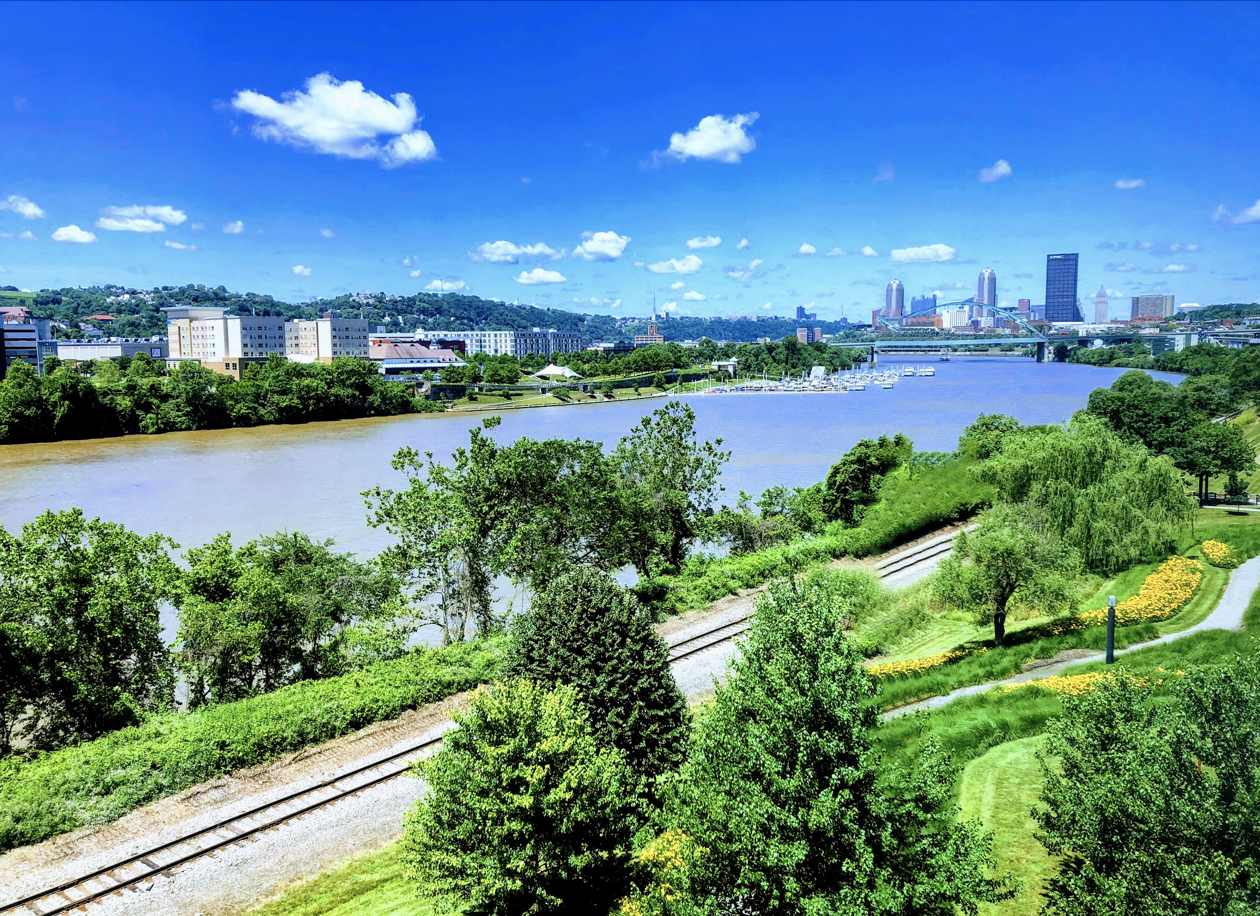
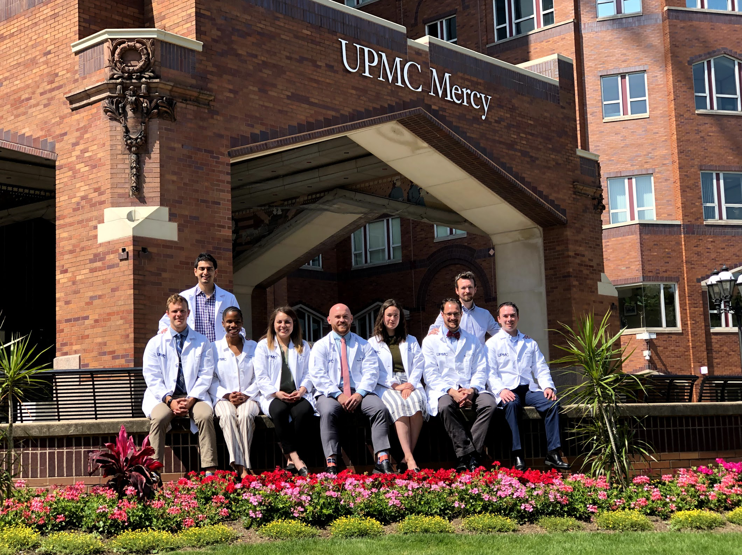
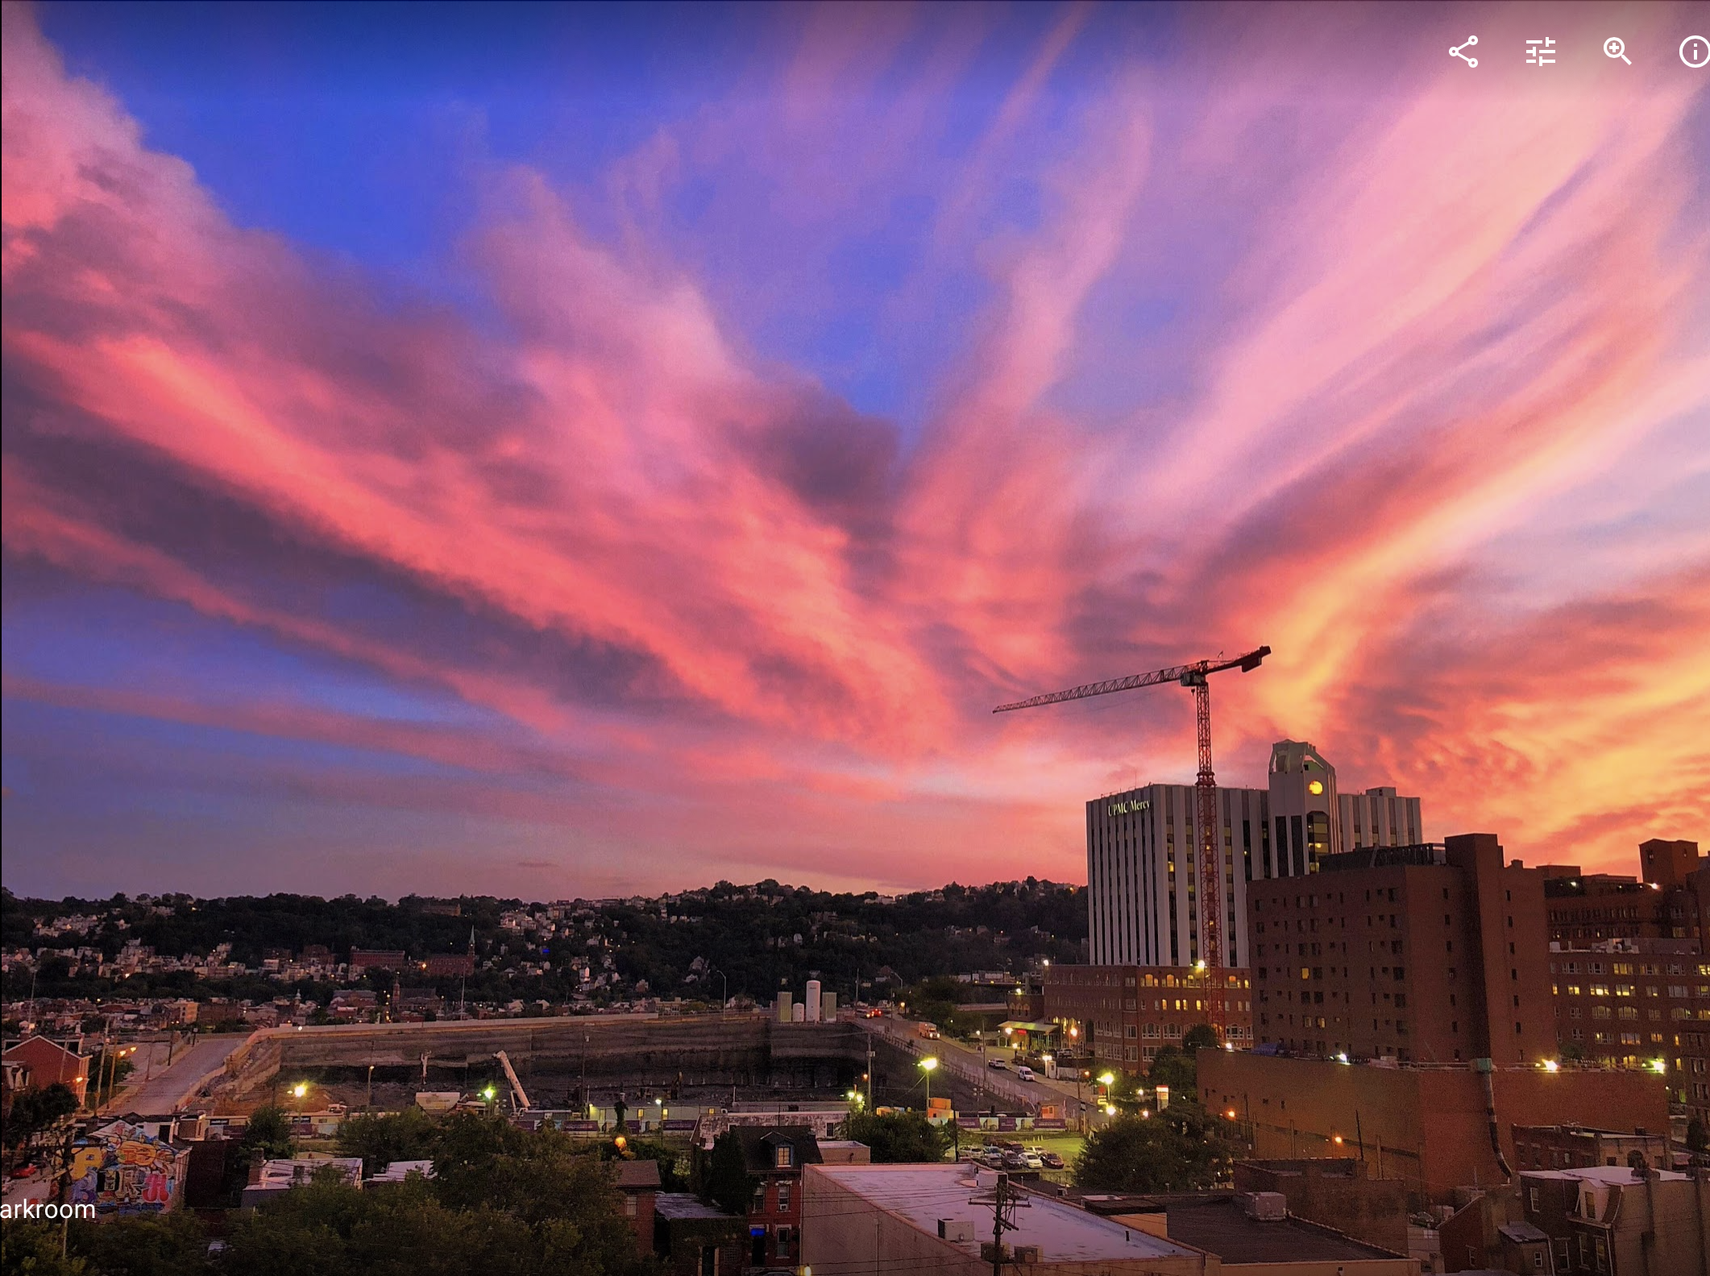
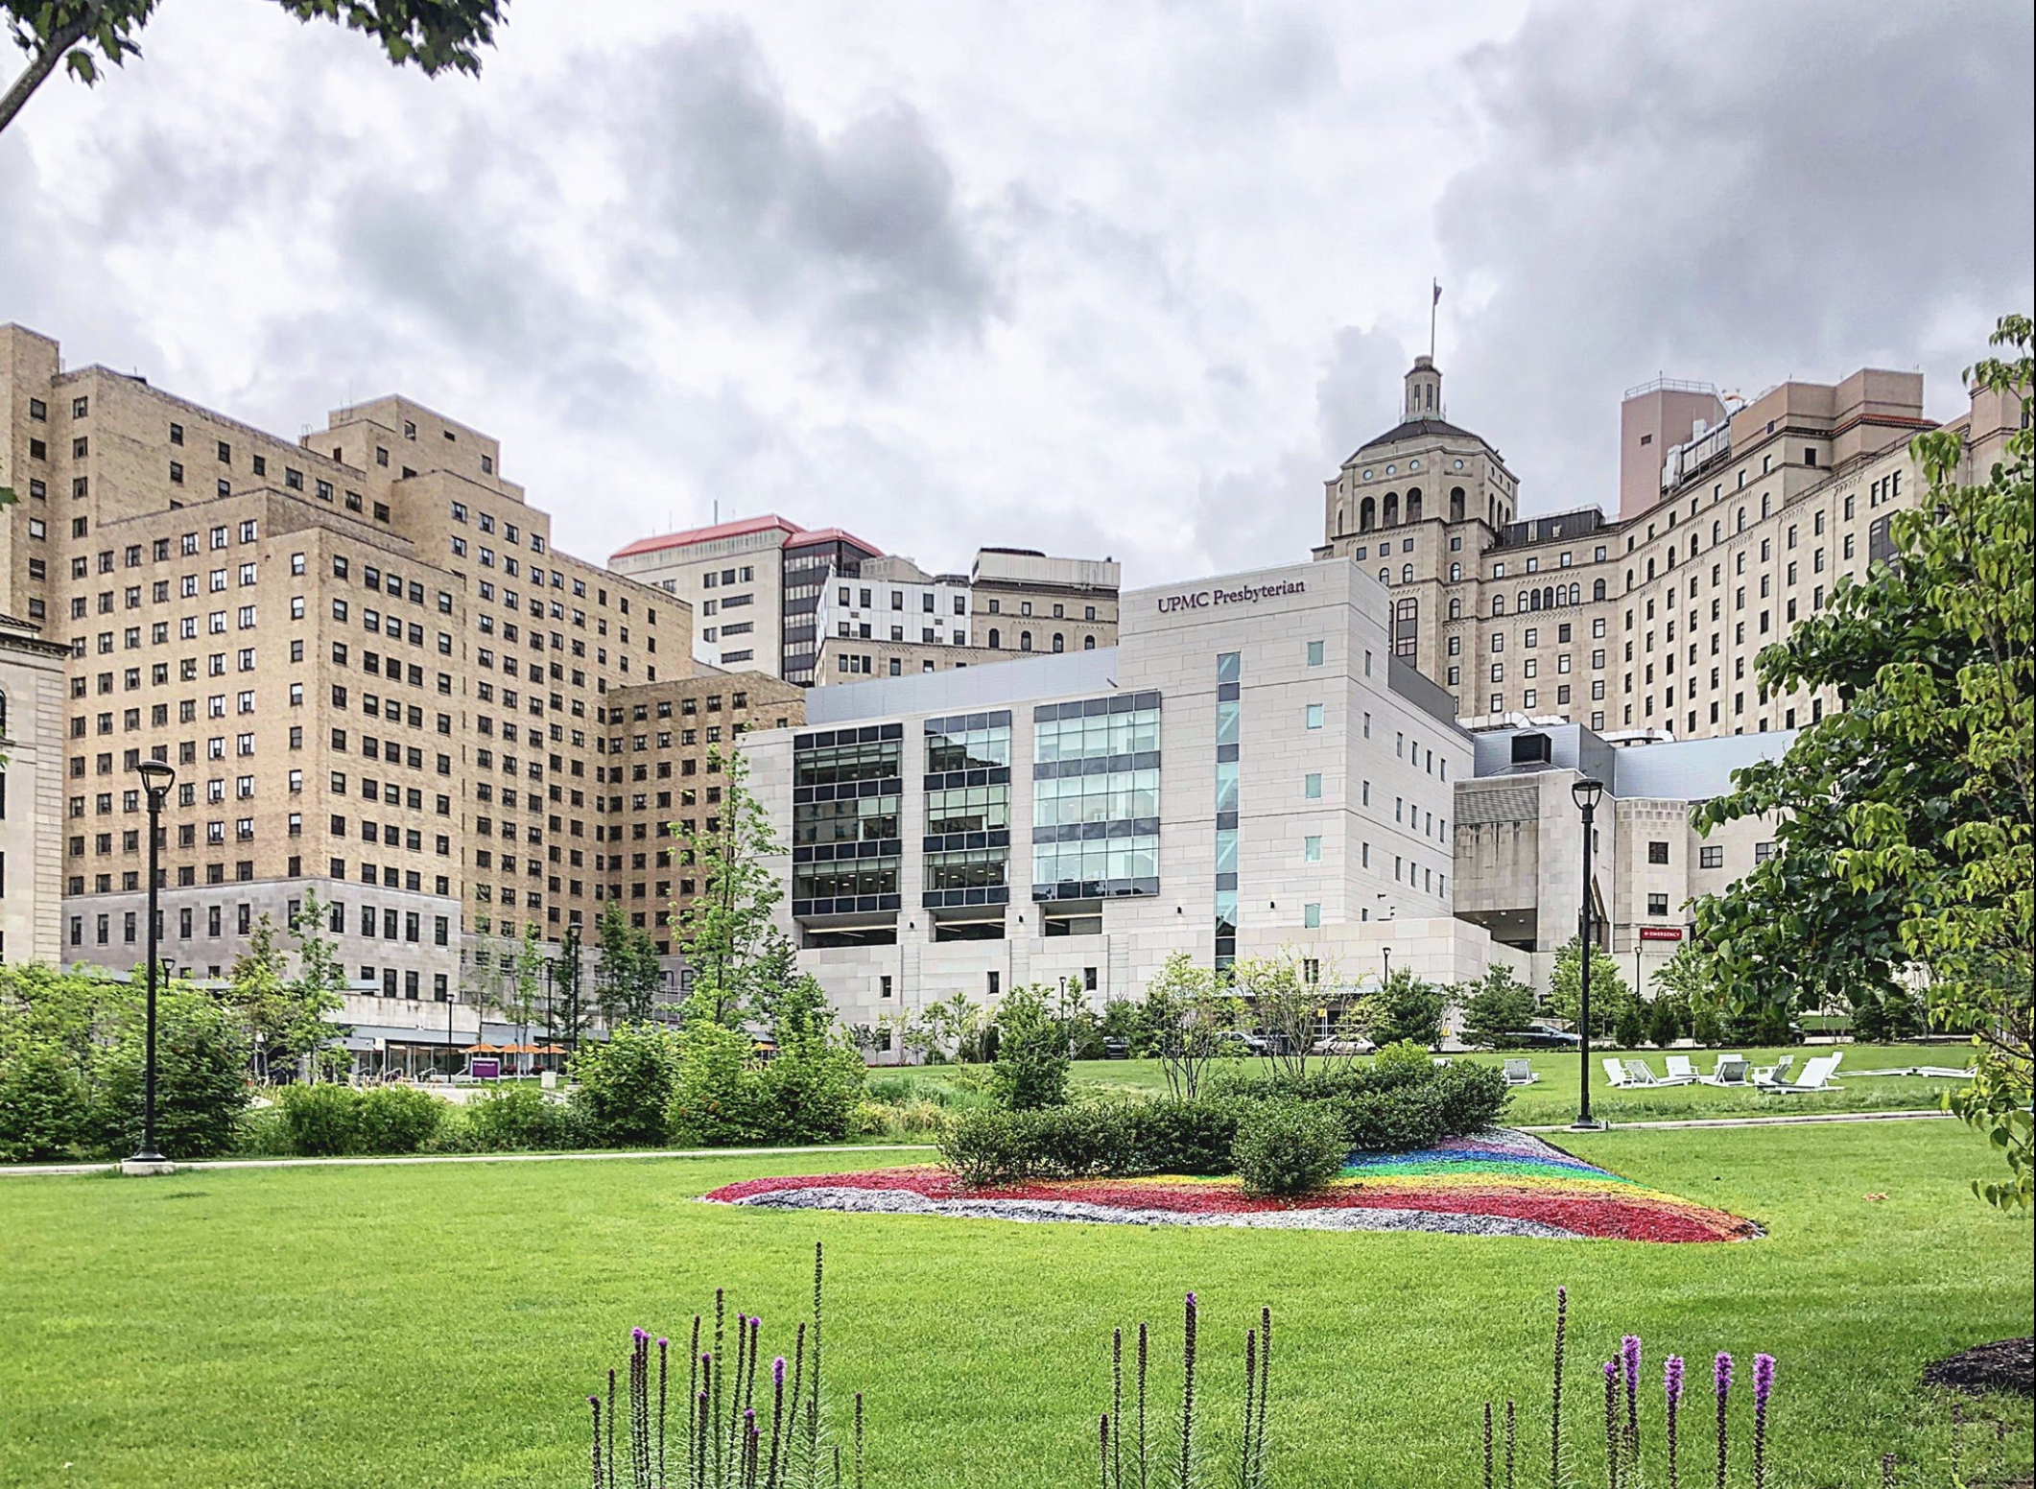
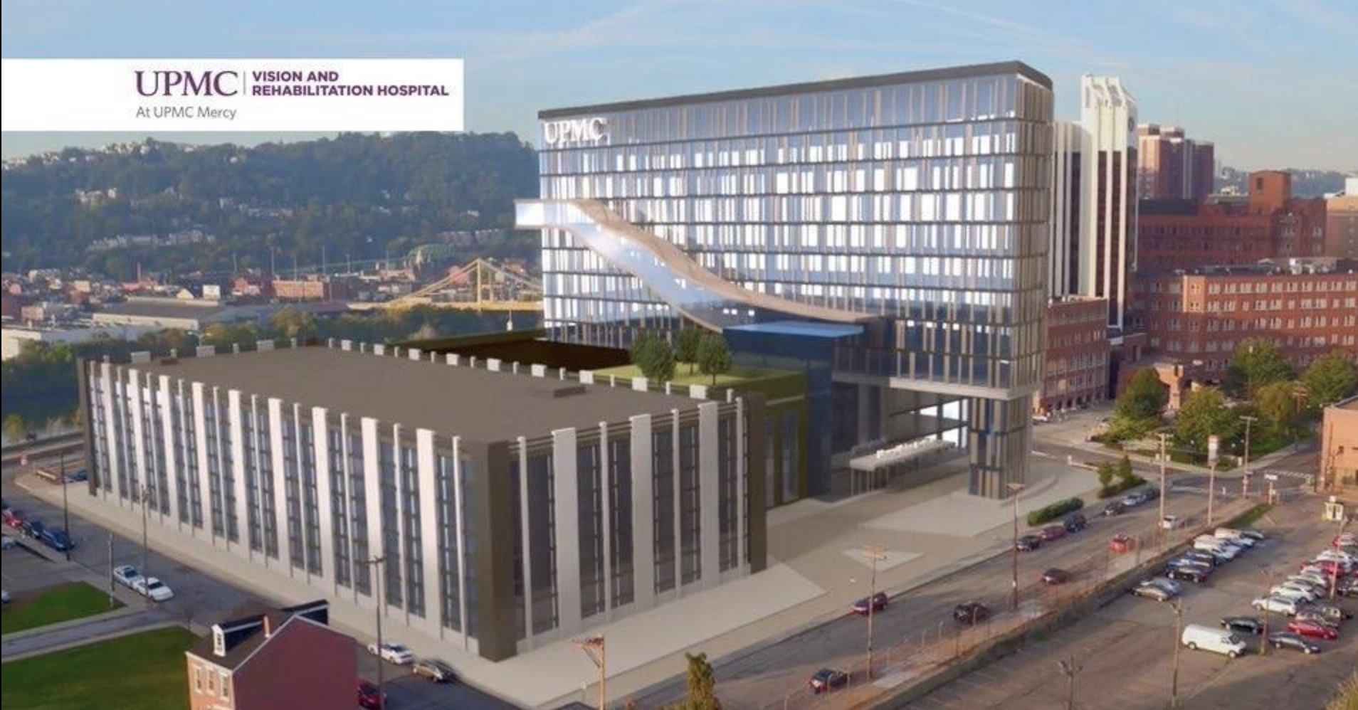
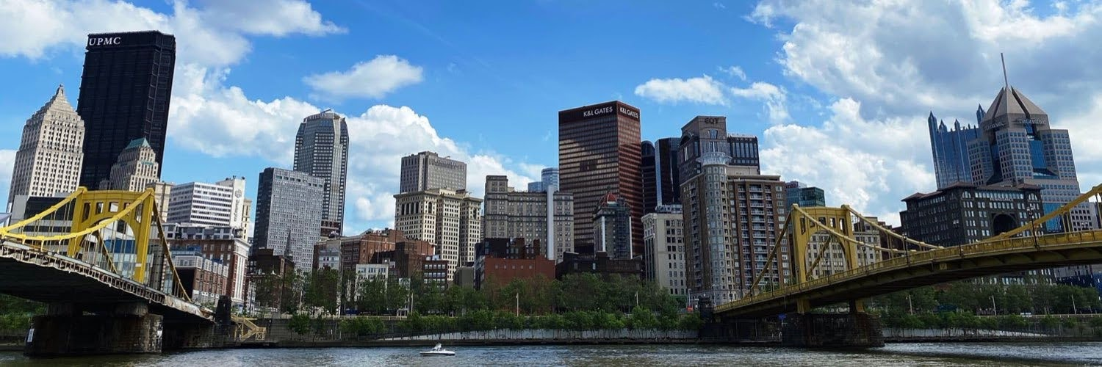
Pittsburgh

Slide 7
Outline
Principles of Musculoskeletal (MSK) Care
  What is EBM?
  Best Practice Recommendations
Sports Medicine Emergencies
  On the Field Pearls
  Red Flags Must-Knows
5 Clinical Cases
When to Refer
  Team-Based Care
  The Referral Process

Slide 8
Principles of MSK Care
Notes:
Sport is grounded in basic principles of human performance. Knowing what the human body-–including mind—does well is critical to an intelligent application of knowledge and skill to support athletes.

Slide 9
Some Advice from the late Earl Simmons…
Notes:
Always start with a framework from which you make your clinical decision. The majority of MSK conditions respond favorably to time and attention (support, education, guidance).

Slide 10
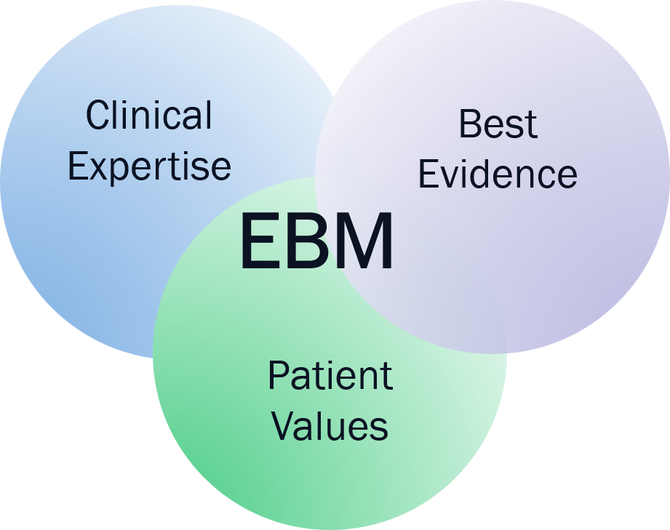
What is EBM?
(Evidence Based Medicine)
Universal standard of research quality
Promotes guidelines for:
  BEST CARE based on BEST SCIENCE
Cost-effectiveness
  If two treatments work, which costs less?

Slide 11
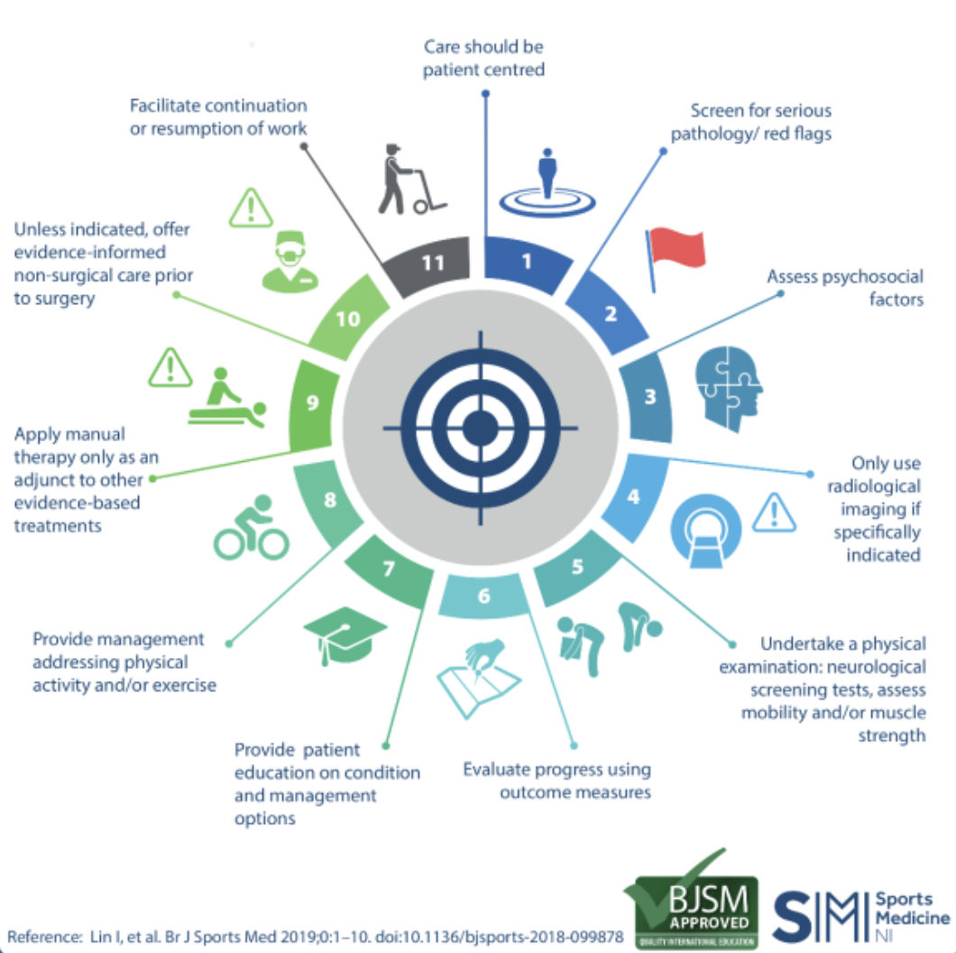
11 Best Practice Recommendations
Notes:
11 Best Practice Recommendations for Care in Musculoskeletal Pain -> infographic summary of a systematic review undertaken to identify common recommendations for high-quality care for the most common MSK pain sites encountered by clinicians in emergency and primary care settings.

Slide 12




National Guidelines and Position Statements for Sports Emergencies

Slide 13
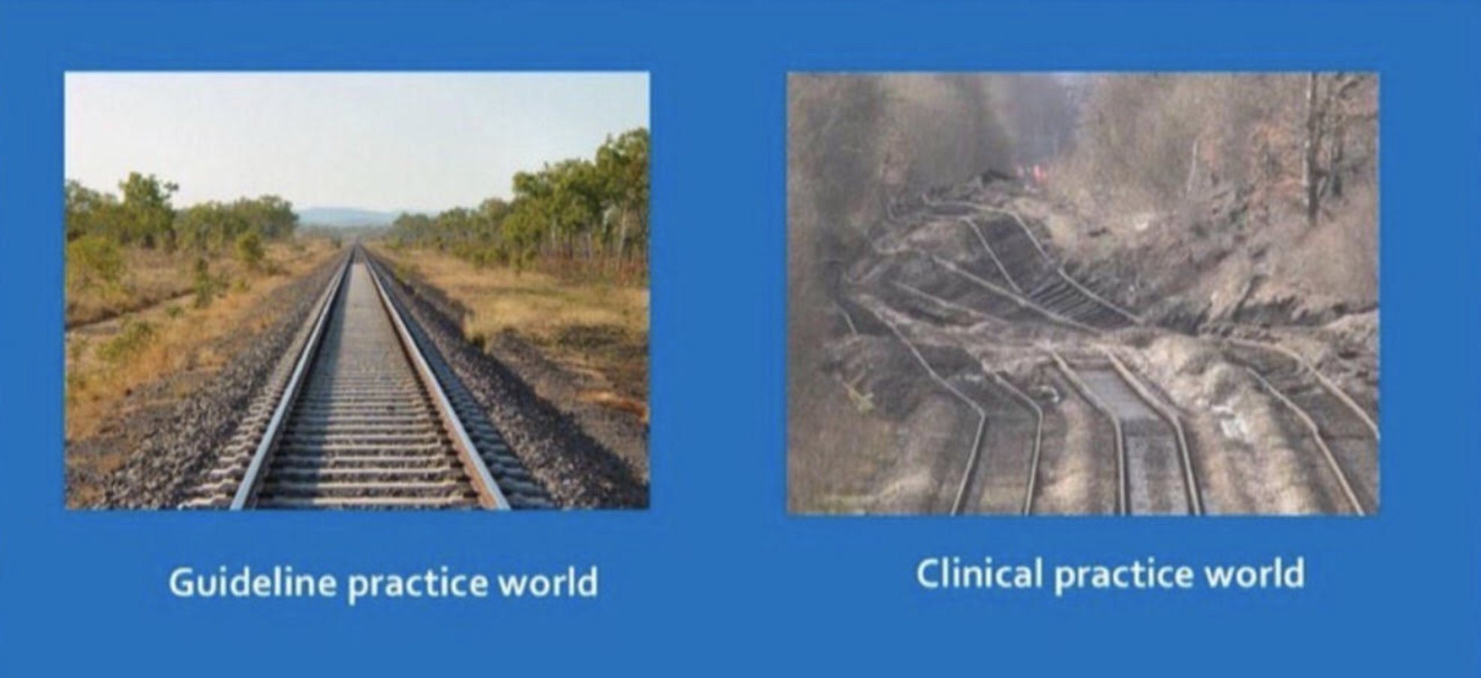

National Guidelines and Position Statements
for Sports Emergencies
@retlouping

Slide 14
Chiropractic Practice: The Reality
Surveys demonstrate that the primary reasons patients consult chiropractors are: ~90% MSK Conditions
Back pain (approximately 60%)
Other musculoskeletal pain (neck, shoulder, extremities, and arthritic pain – 20%)
Headaches, including migraine (10%)
About 10% present with a wide variety of conditions caused or aggravated by neuromusculoskeletal disorders.
(From World Federation of Chiropractic)

Slide 15
Reminders about MSK…

Slide 16
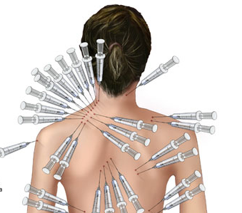
Please shade areas where you are having pain today
Diagnosis?

