Slide 1
Sport and Spine cases

Slide 2
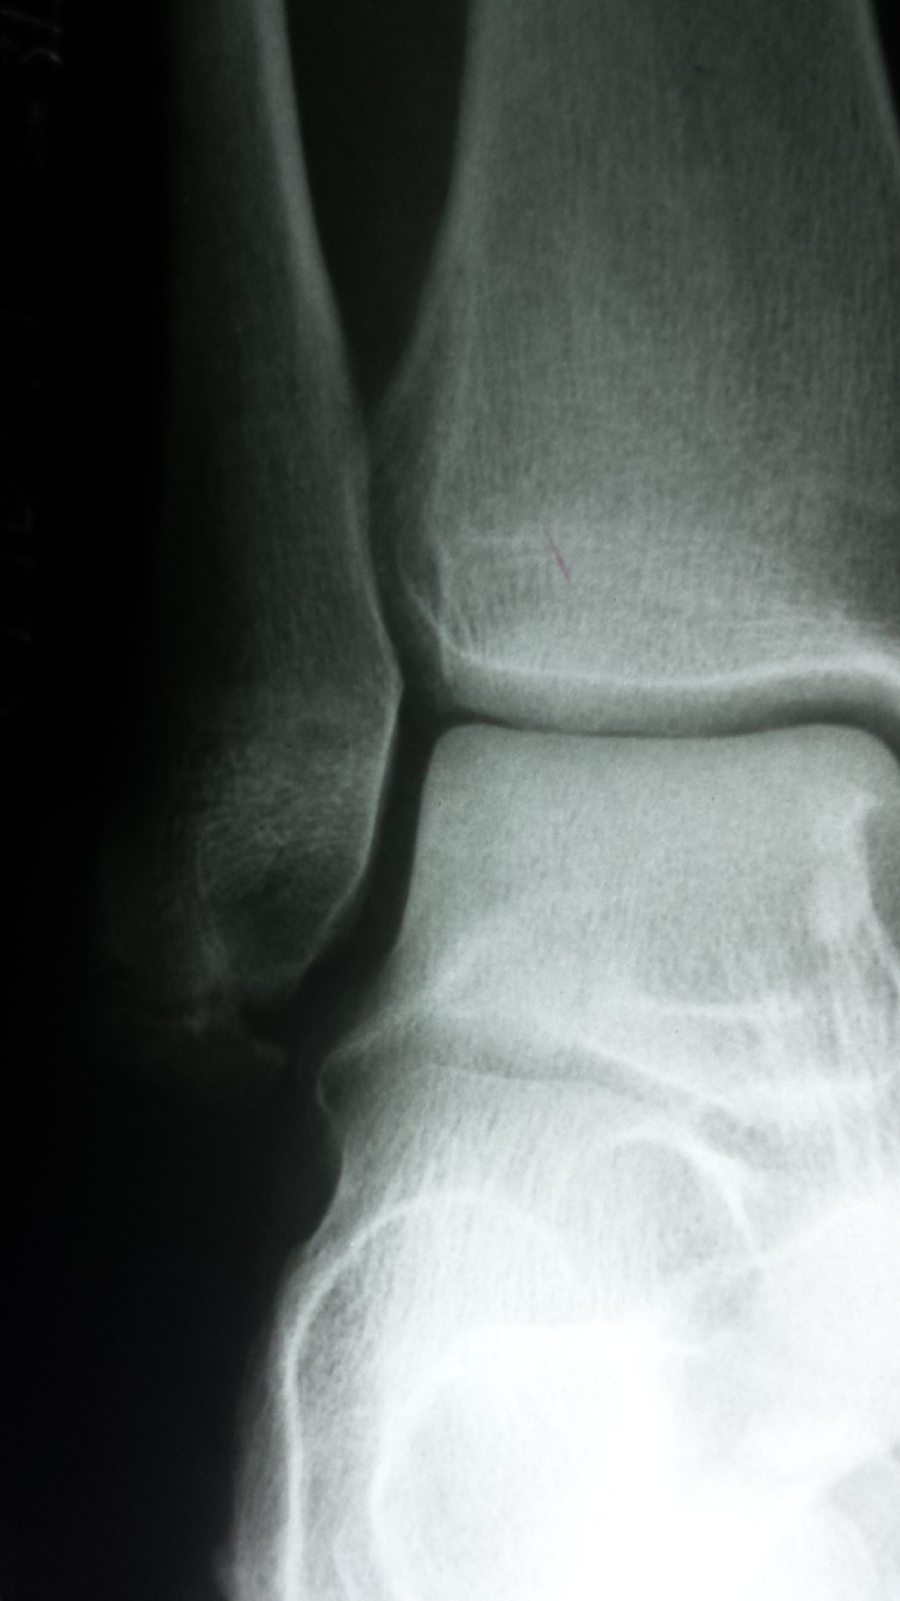
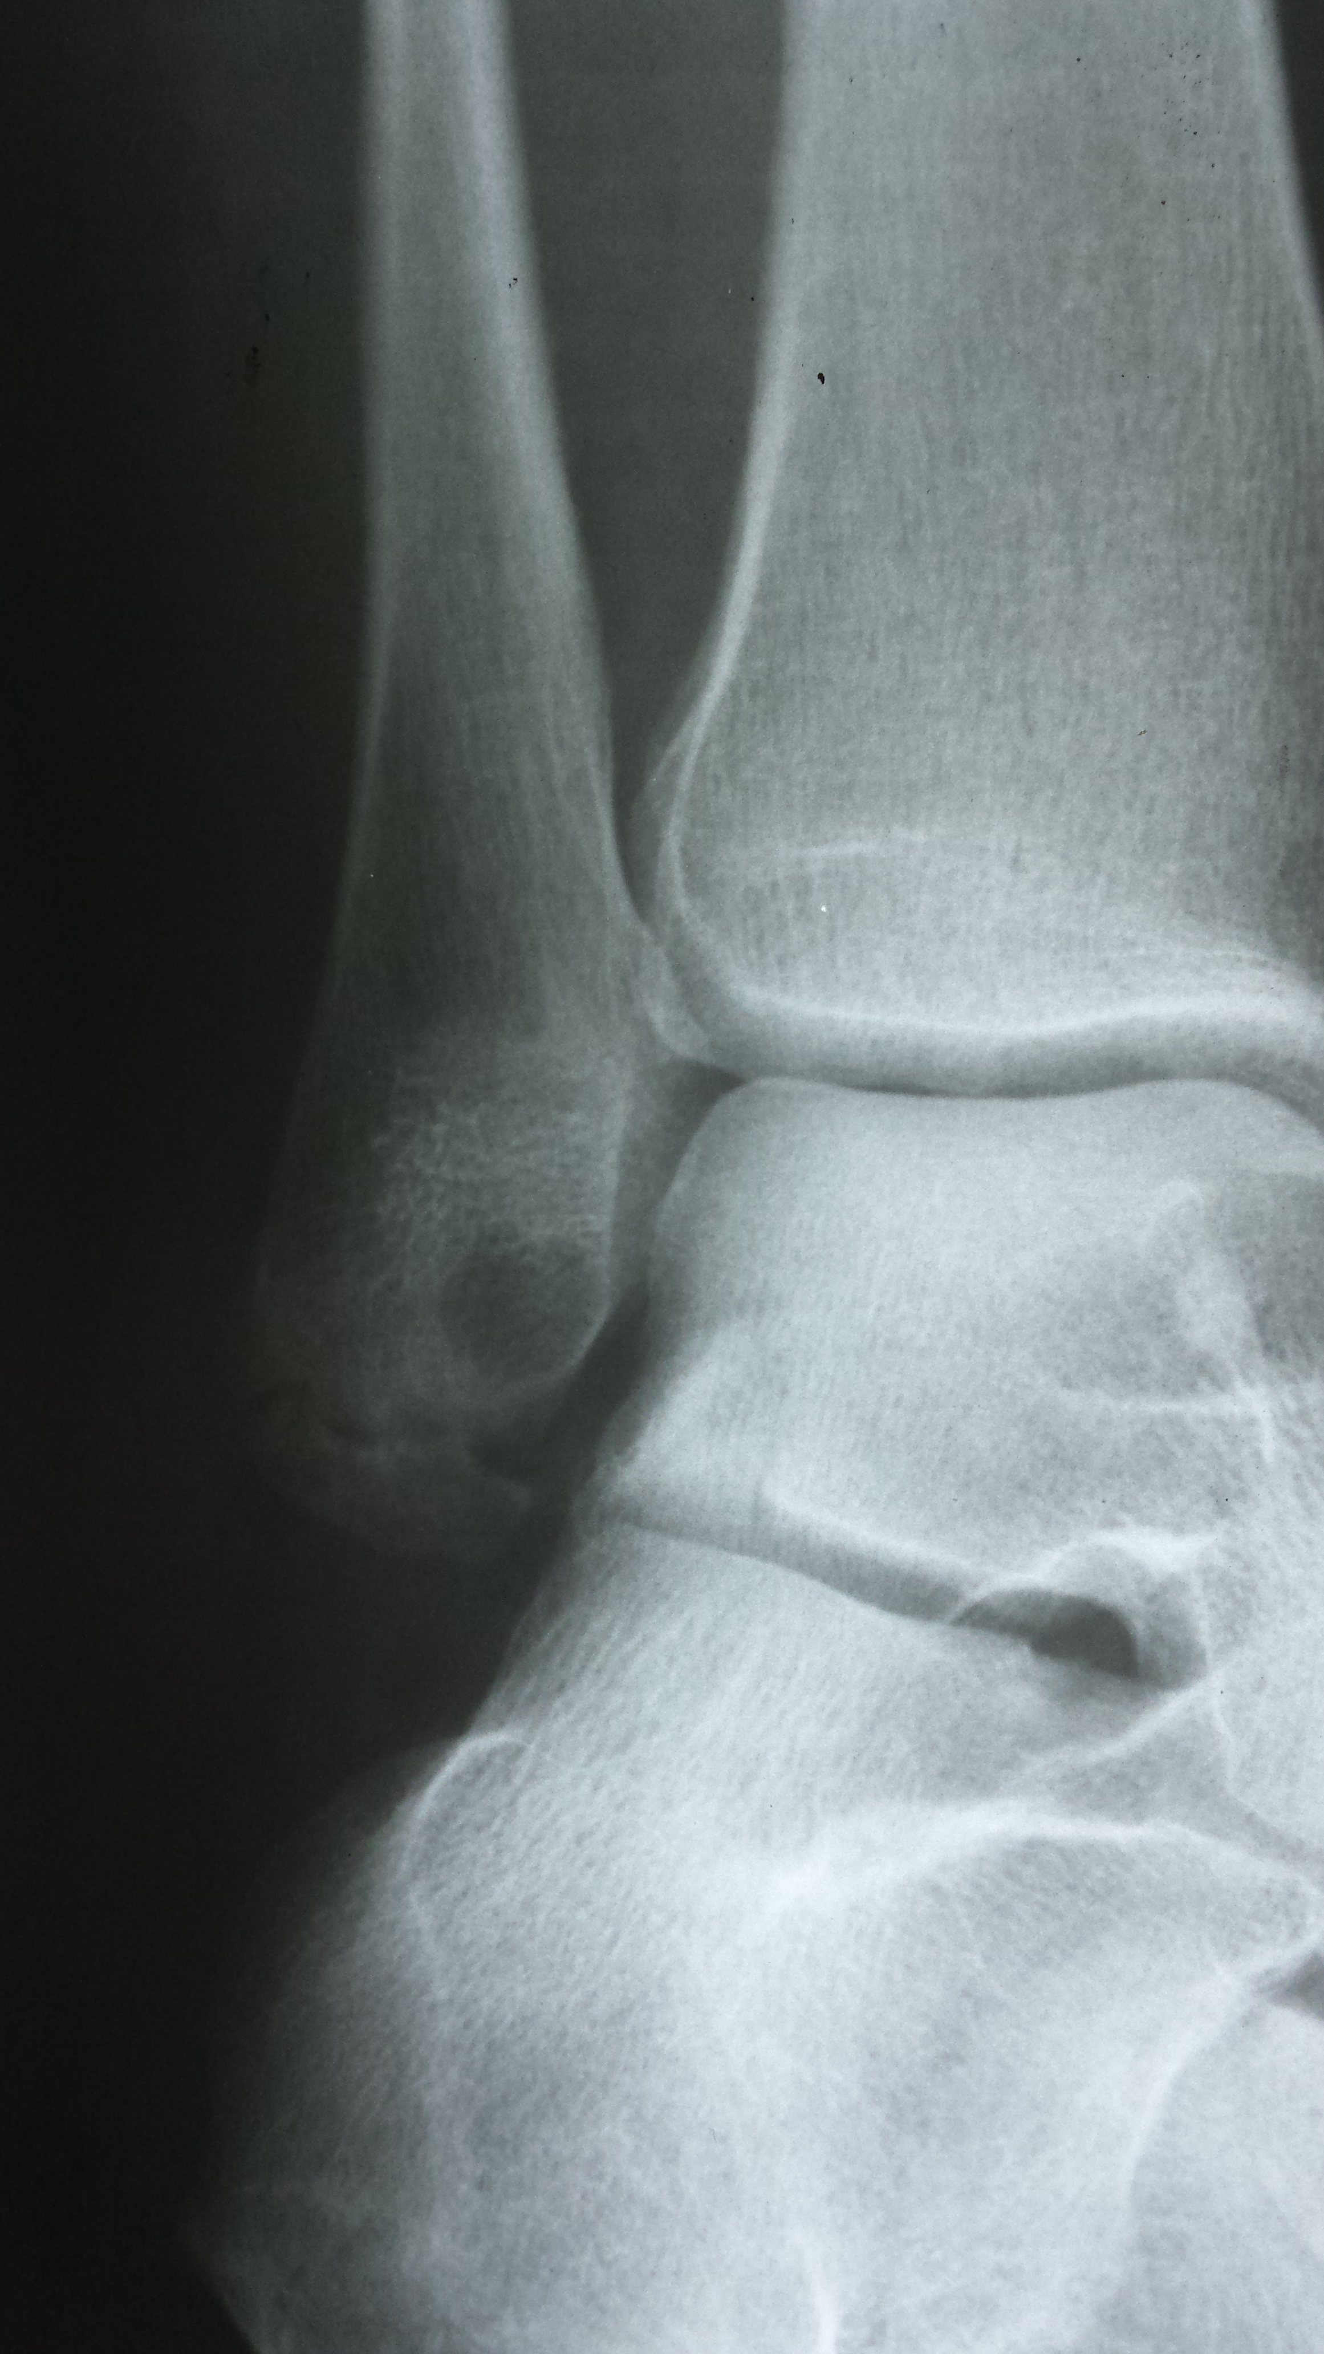
Sprain ankle in driveway
1

Slide 3
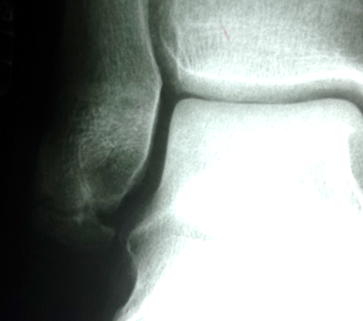
AP ANKLE

Slide 4

Medial oblique projection.

Slide 5
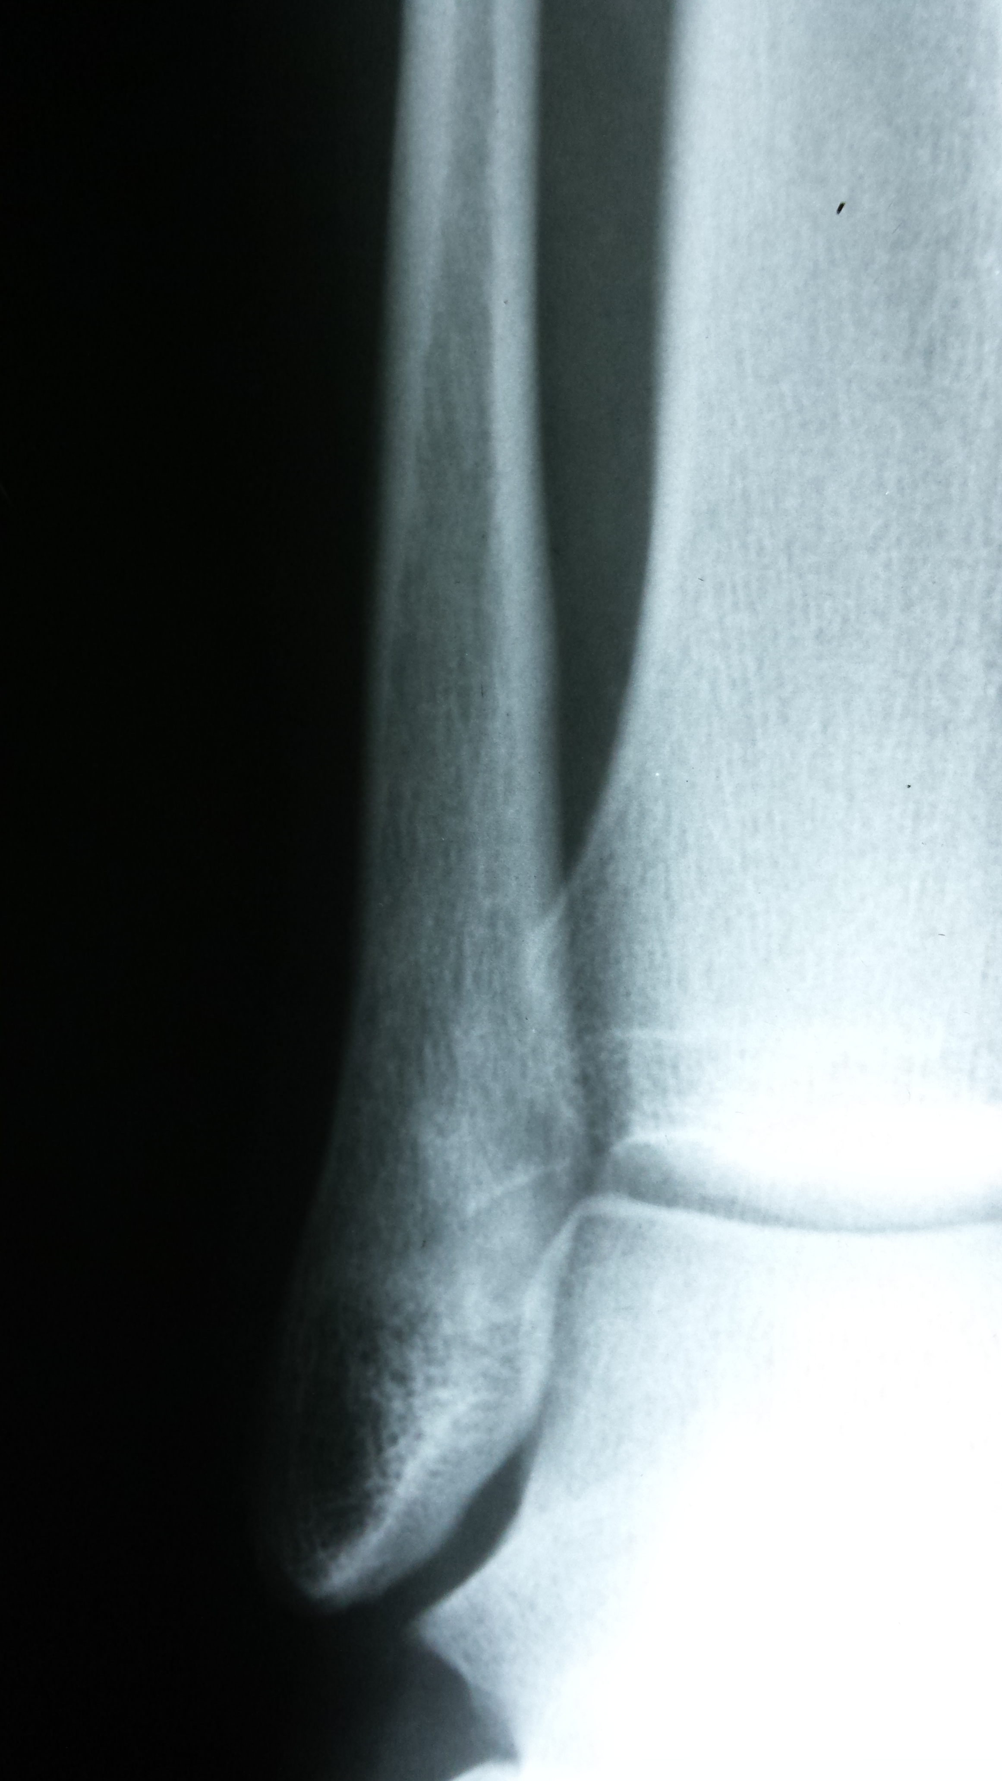
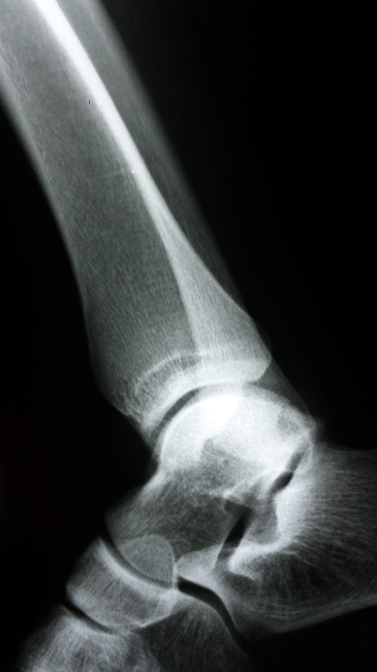
Softball sliding injury
1a

Slide 6
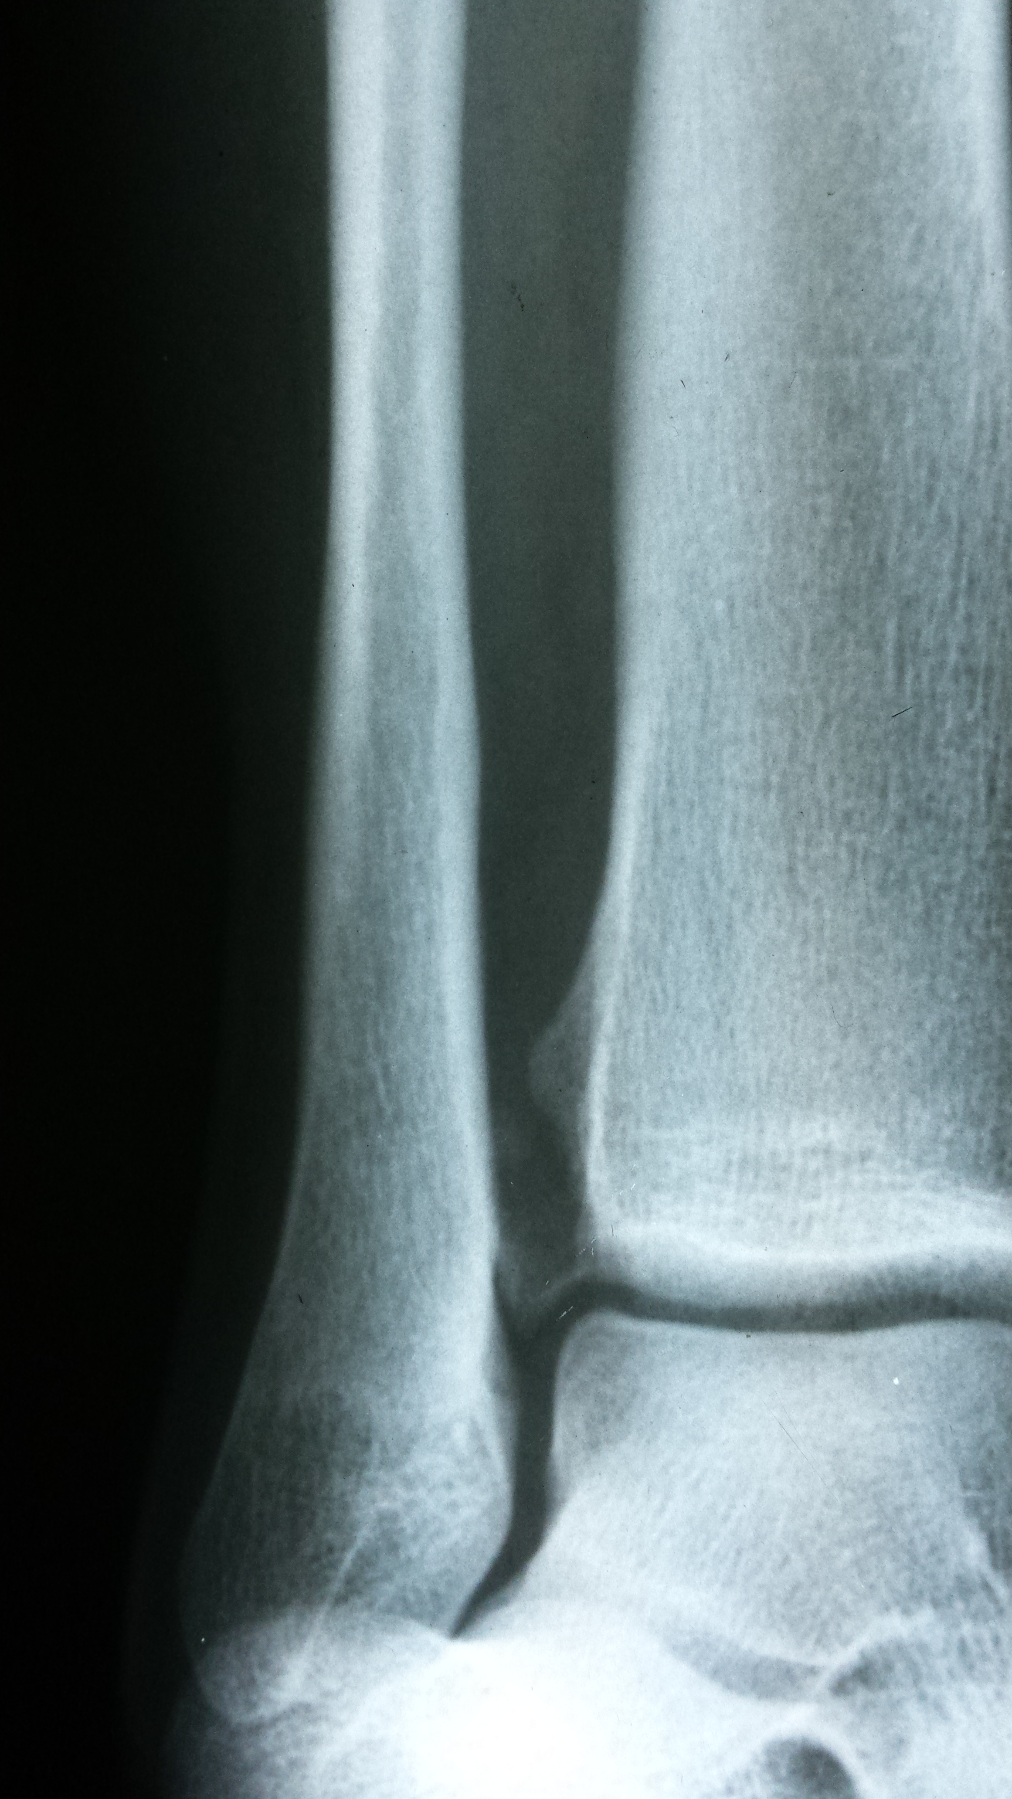
Medial oblique

Slide 7
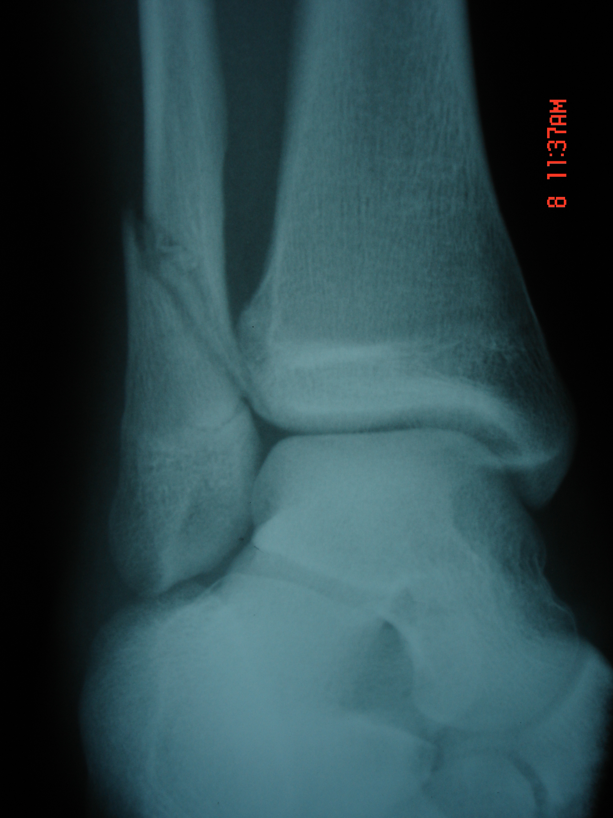
football INJURY
1b

Slide 8
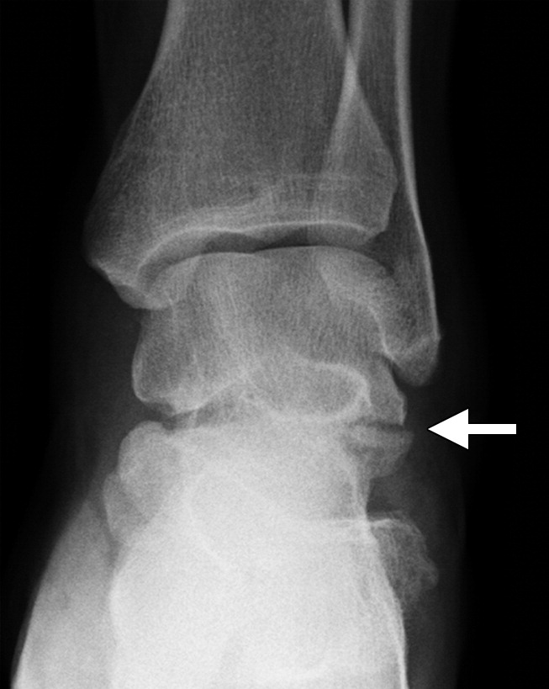
Snowboarder
Lateral process of talus fracture

Slide 9
Snowboarder:
Lateral process of the Talus fractures;
injuries result from forced dorsiflexion, axial loading, and eversion with external rotation
often seen in snowboarders
Prognosis: lateral process injuries have a favorable outcomes with prompt diagnosis and immediate treatment
Distal Tibiofibular syndesmosis injuries:

Slide 10
Lateral Process Fractures
Lateral process fractures are often occult on initial radiographs and are commonly present in the setting of persistent pain about the lateral side of the ankle after forced dorsiflexion and eversion injuries to the foot (33).
( some texts state dorsiflexion and inversion….)
The lateral process of the talus forms the anterolateral part of the posterior subtalar joint facet. Its lateral aspect articulates with the tip of the fibula. Fractures of the lateral process are best appreciated on AP ankle radiographs. This type of fracture can also be seen as an interruption of the cortex of the lateral process, since the lateral process is normally contiguous with the lateral aspect of the talar dome. Lateral process fractures are often missed on initial radiographs (33). CT is frequently necessary to both detect and appreciate the extent of the injury (34).
Talar Fractures and Dislocations: A Radiologist’s Guide to Timely Diagnosis and Classification
May-June 2015 radiographics.rsna.org

Slide 11
An unexpectedly high number of lateral process fractures are noted in snowboarders. Lateral process fractures account for 2.3% of all snowboarding injuries and 15% of all ankle injuries (35).
Snowboarders are 17 times more likely to experience lateral process fractures than the general population (36).
In addition, isolated lateral process fractures occur secondary to automobile collisions or falls. In a recent study by Dale et al (9), lateral process fractures were present in 19% of talar fractures in patients injured in motor vehicle accidents and falls from a height.

Slide 12
Lateral process fractures
Classified into three types, according to the Hawkins criteria:
Type 1 : simple - m.c. – large fragment with single fx line from tibiofibular art. Surface to the subtalar jt.
Type 2: comminuted – involves entire lateral process and both artic. Surfaces
Type 3: chip - region of the sinus tarsi and are usually visualized only on lateral radiographs.

Slide 13
Classification of lateral process fractures.
Type I (simple) fracture involves the talofibular articular surface and posterior talocalcaneal articular surface.
Type 2 (comminuted) fracture involves both articular surfaces and the entire lateral process.
Type 3 (chip) fracture involves the anterior-inferior portion of the posterior articular process and thus involves only the subtalar joint.
Type 1
Type 2
Type 3

Slide 14
Hawkins type I lateral process fracture.
(a) Lateral radiograph of the ankle shows a nondisplaced fracture of the lateral process (arrow). The posterior talocalcaneal facet is involved.
(b) AP radiograph of the ankle shows a nondisplaced fracture of the lateral process (arrow). Involvement of the talofibular articular surface is appreciated on this view of the ankle shows a simple nondisplaced lateral process fracture (arrow).
(c) Sagittal reformatted CT image of the ankle shows a simple nondisplaced lateral process fracture (arrow).

Slide 15
Osteochondral Fractures of the Talar Dome
The generally accepted mechanism of osteochondral fractures of the talar dome is an impaction injury, which damages the articular cartilage and subchondral bone.
Compression fractures of the talar dome may be radiographically occult, and patients are often given the diagnosis of an ankle sprain.
Dale et al ..found that 31% of talar dome compression fractures were not seen at radiography.

Slide 16
The terms lesion and fracture have often been used interchangeably to describe osteochondral defects (OCDs).
OCD lesions account for about 1% of all talar fractures.
The most commonly used system for classifying OCD lesions was presented by Berndt and Harty (27) in 1959, with additional staging described by Scranton and McDermott (28) in 2001.
Stage 1 is subchondral bone compression.
Stage 2 is a partially detached osteochondral fragment.
Stage 3 is a completely detached but nondisplaced osteochondral fragment.
Stage 4 is a completely detached and displaced osteochondral fragment.
Stage 5 is a large cyst below the articular surface.

Slide 17

Lateral talar dome osteochondral fracture.
AP radiograph of the ankle shows a subtle osteochondral fracture of the lateral talar dome (arrow), obscured by the overlapping fibula.
Mortise view of the ankle better shows the fracture (arrow).
Mortise Projection: 15 – 20 degrees medial rotation

Slide 18
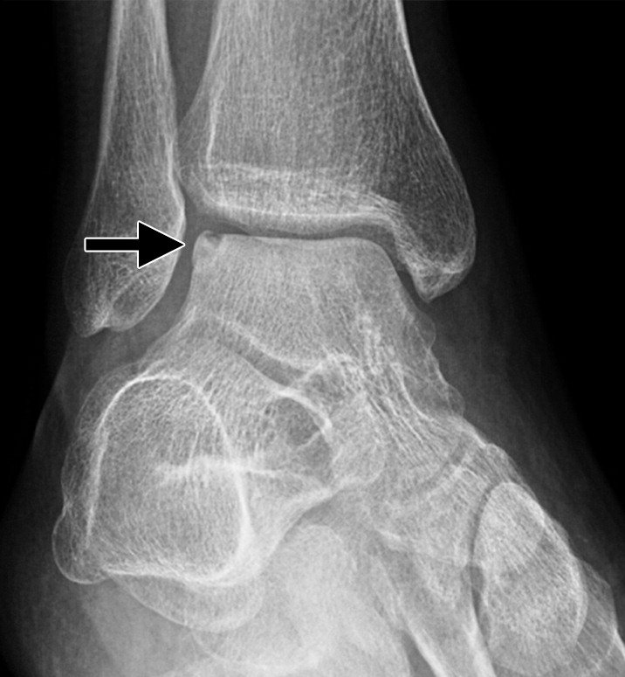
Lateral lesions tend to be shallow and wafer-shaped and occur after dorsiflexion and inversion injuries.
Figure 11b Lateral talar dome osteochondral fracture. (a) APanteroposterior radiograph of the ankle shows a subtle osteochondral fracture of the lateral talar dome (arrow), obscured by the overlapping fibula. (b) Mortise view of the ankle better shows the fracture (arrow).
Melenevsky Y. Published Online: May 13, 2015
https://doi.org/10.1148/rg.2015140156

Slide 19
Medial lesions are usually less symptomatic, (if isolated injury) typically deep and cup-shaped, and believed to result from plantar flexion and inversion injuries
AP (a) and mortise (b) radiographs of the ankle show a displaced osteochondral
fracture of the talar dome (black arrow). Also note the presence of an oblique diametaphyseal fibular fracture (arrowhead), syndesmotic widening (double-headed arrow), and medial clear space widening (white arrow in b), consistent with syndesmotic and deltoid ligament complex injury.
Figure 11a Lateral talar dome osteochondral fracture. (a) APanteroposterior radiograph of the ankle shows a subtle osteochondral fracture of the lateral talar dome (arrow), obscured by the overlapping fibula. (b) Mortise view of the ankle better shows the fracture (arrow).
Melenevsky Y. Published Online: May 13, 2015
https://doi.org/10.1148/rg.2015140156

Slide 20
In stable and nondisplaced OCD fragments, capillary budding can occur across the fracture line and assist in healing the defect, whereas displaced unstable fragments often undergo avascular necrosis.
Melenevsky Y. Published Online: May 13, 2015
https://doi.org/10.1148/rg.2015140156

Slide 21
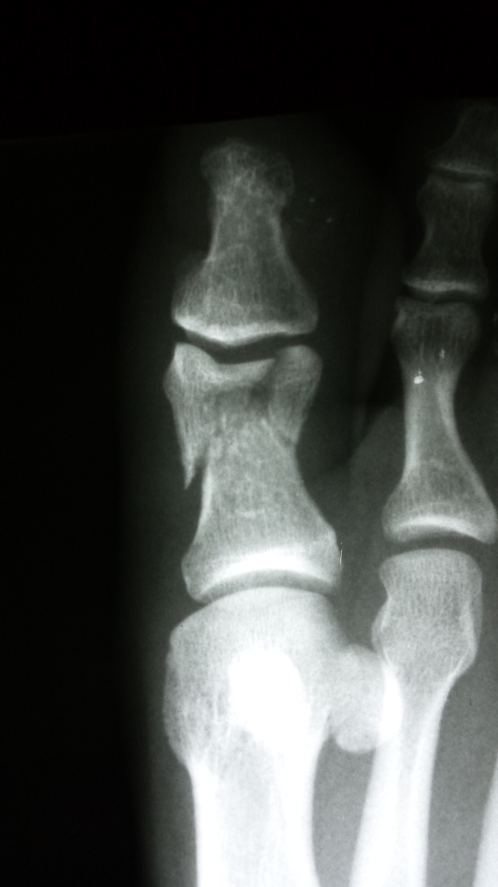
Stepped on by horse
2

Slide 22
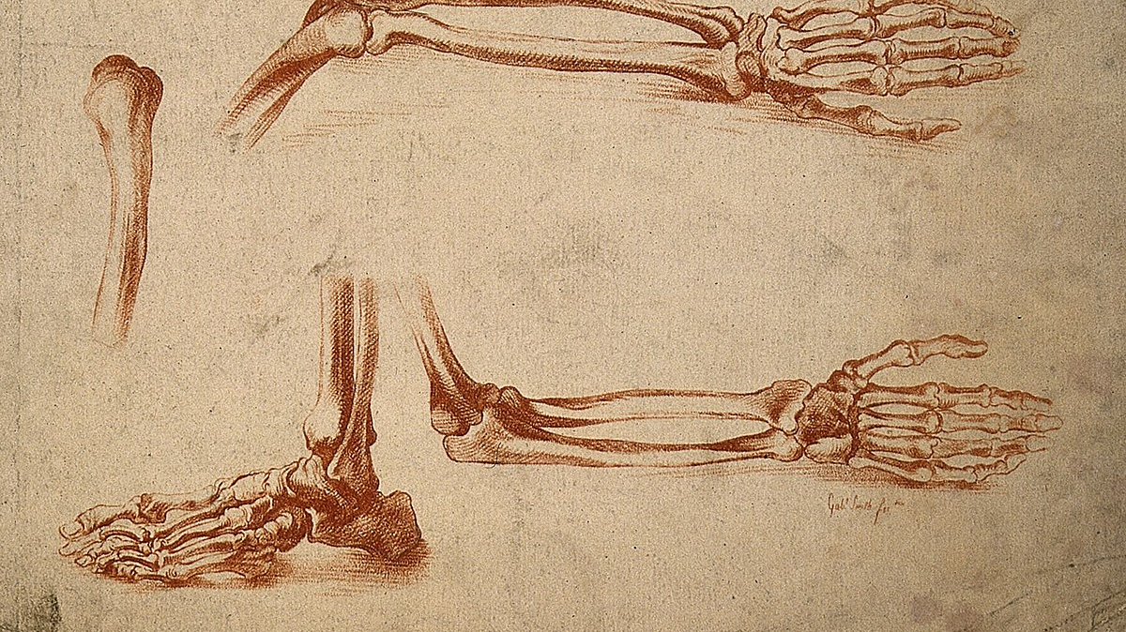
From Feet to Hands
This Photo by Unknown Author is licensed under CC BY-SA

Slide 23
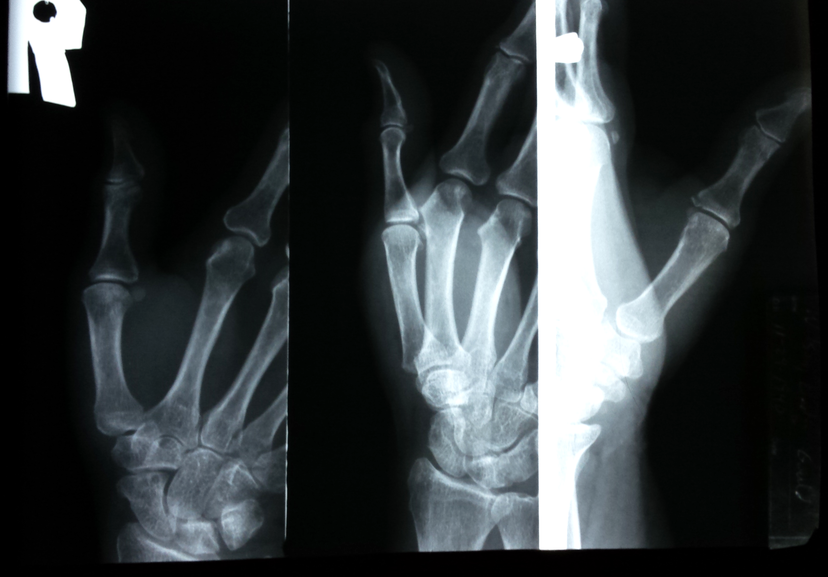
Fell in driveway on ice
3
3 view series
3 views on 1 film

Slide 24
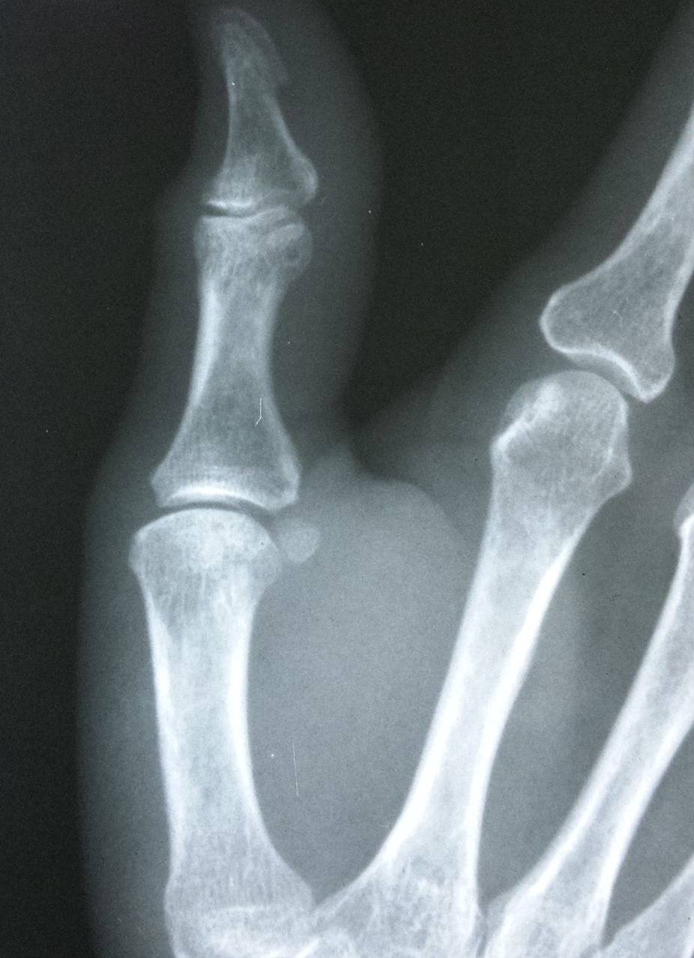
Oblique thumb

Slide 25
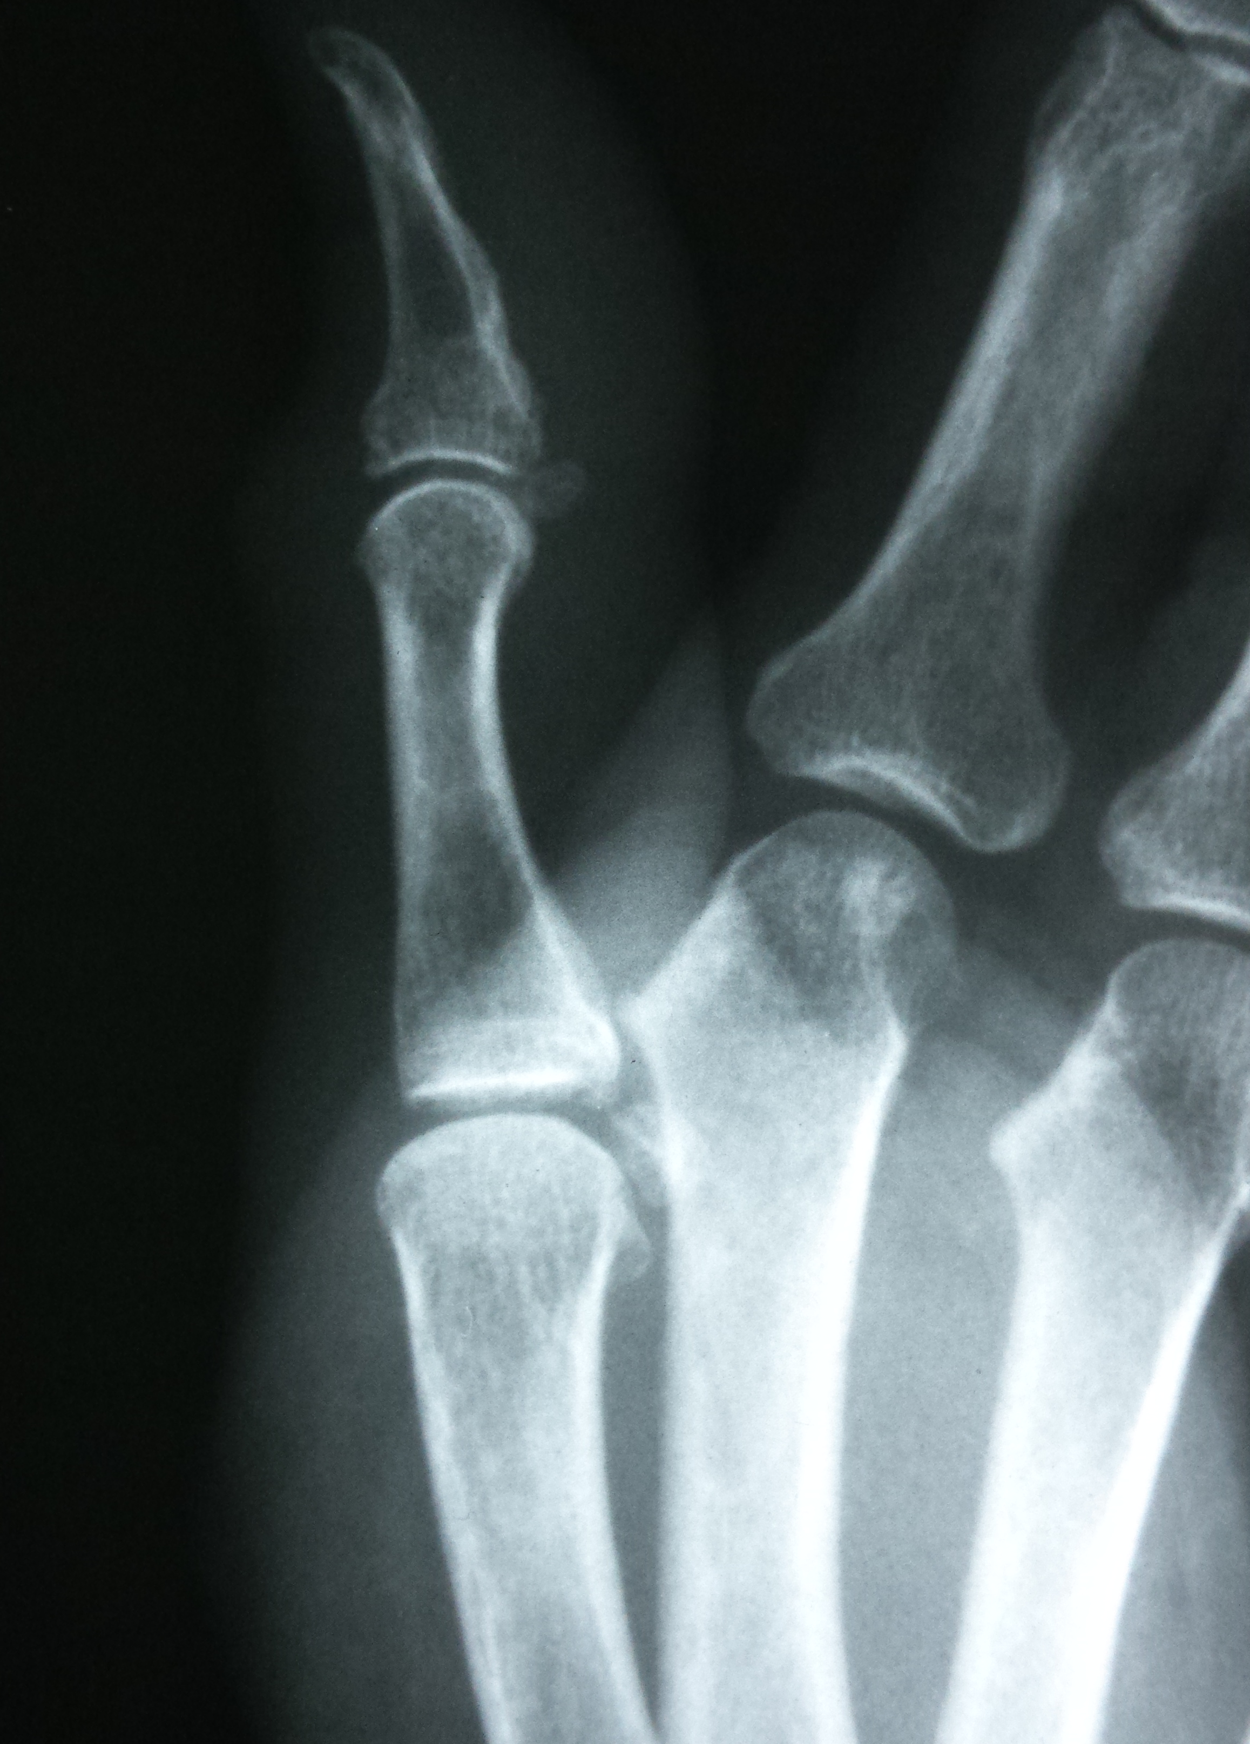
Lateral thumb

Slide 26
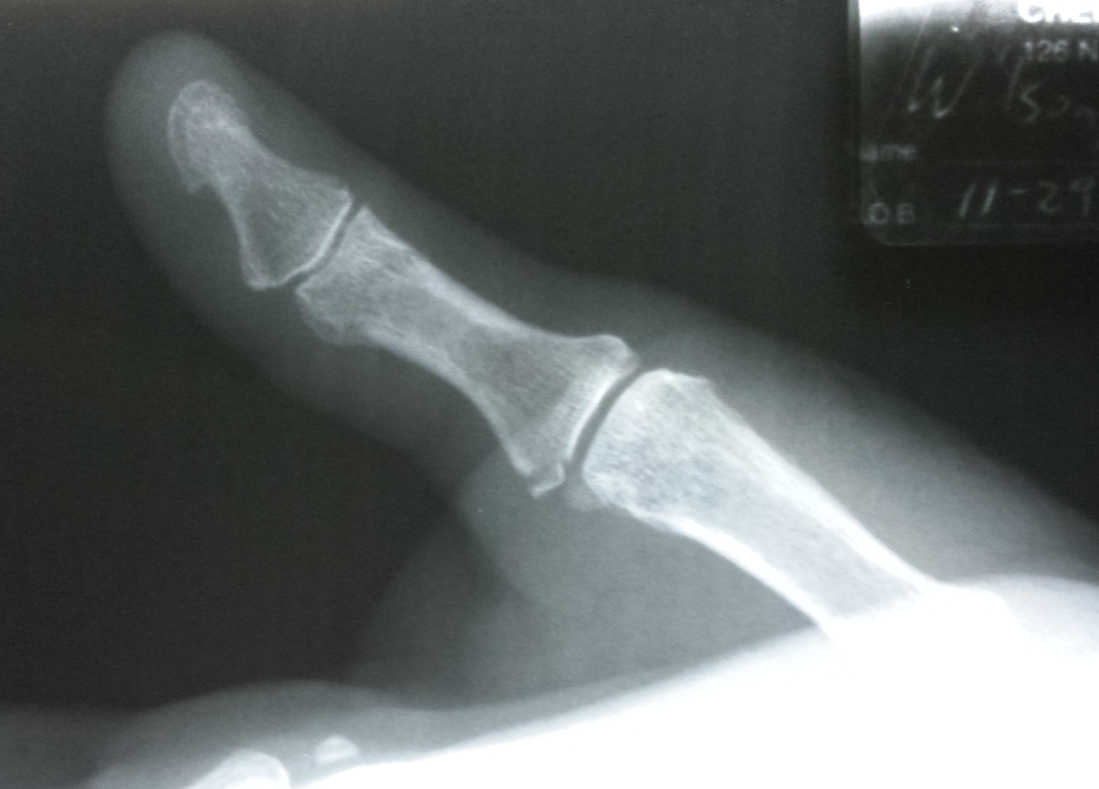
AP THUMB
LATERAL COLLATERAL LIG AVULSION / GAMEKEEPER’S / SKI POLE INJURY

Slide 27
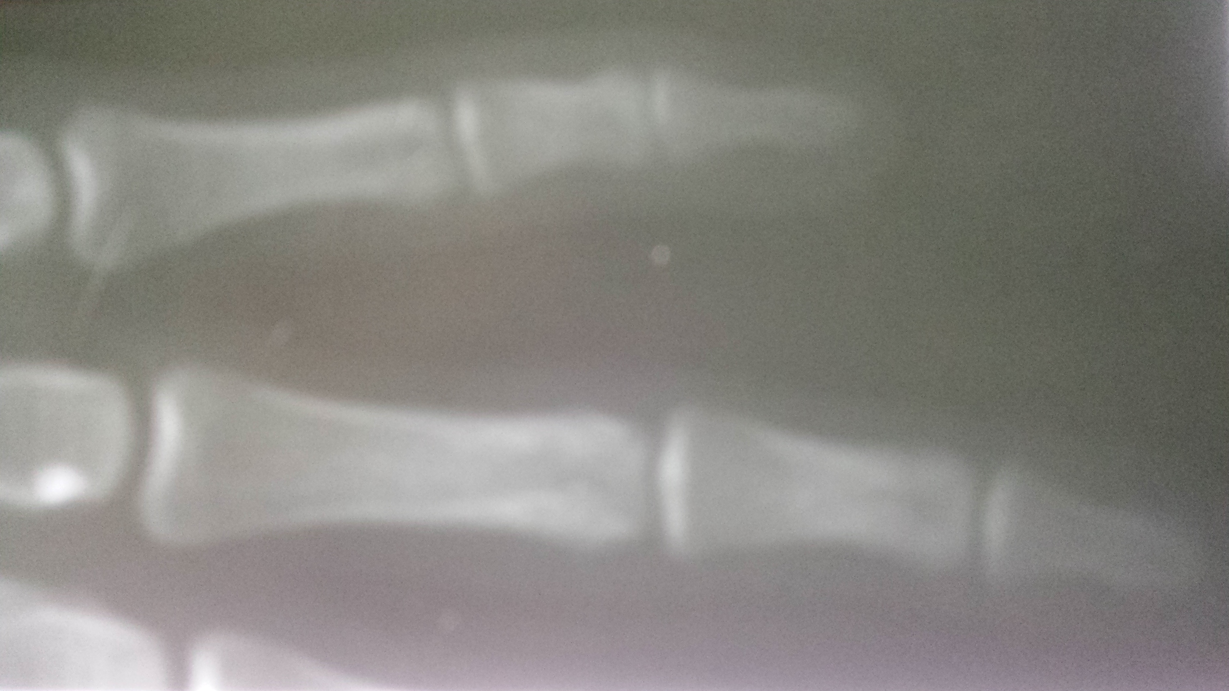
Jammed finger
4

Slide 28
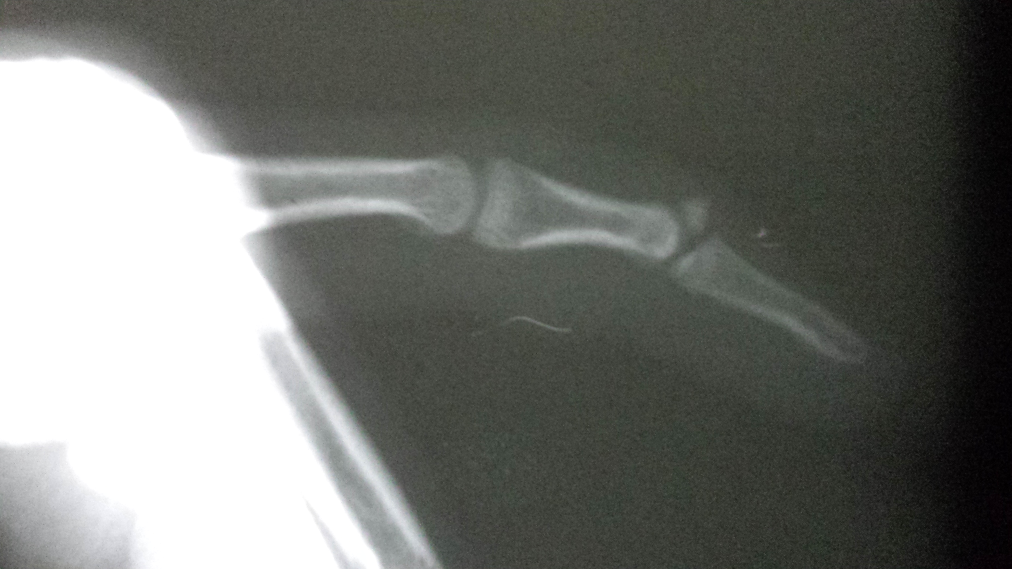
Mallet Finger / Baseball finger/ Extensor avulsion

Slide 29
Mallet finger
Mallet finger refers to injuries of the extensor mechanism of the finger at the level of the distal interphalangeal joint (DIP).
M.C. finger tendon injury in sport.
They may represent an isolated tendinous injury or occur in combination with an avulsion fracture of the dorsal base of the distal phalanx.
Inability to extend the finger at the distal interphalangeal (DIP) joint. There is slight flexion at this joint, which is where the term "mallet" comes from - the finger position resembles a mallet (for example, a piano key mallet).
The terminal extensor tendon inserts on the DIP joint capsule, and so injurious force may also result in intra-articular avulsion fracture of the base of the distal phalanx. This may represent an epiphyseal injury in skeletally-immature children .
https://radiopaedia.org/articles/mallet-finger?lang=us

Slide 30
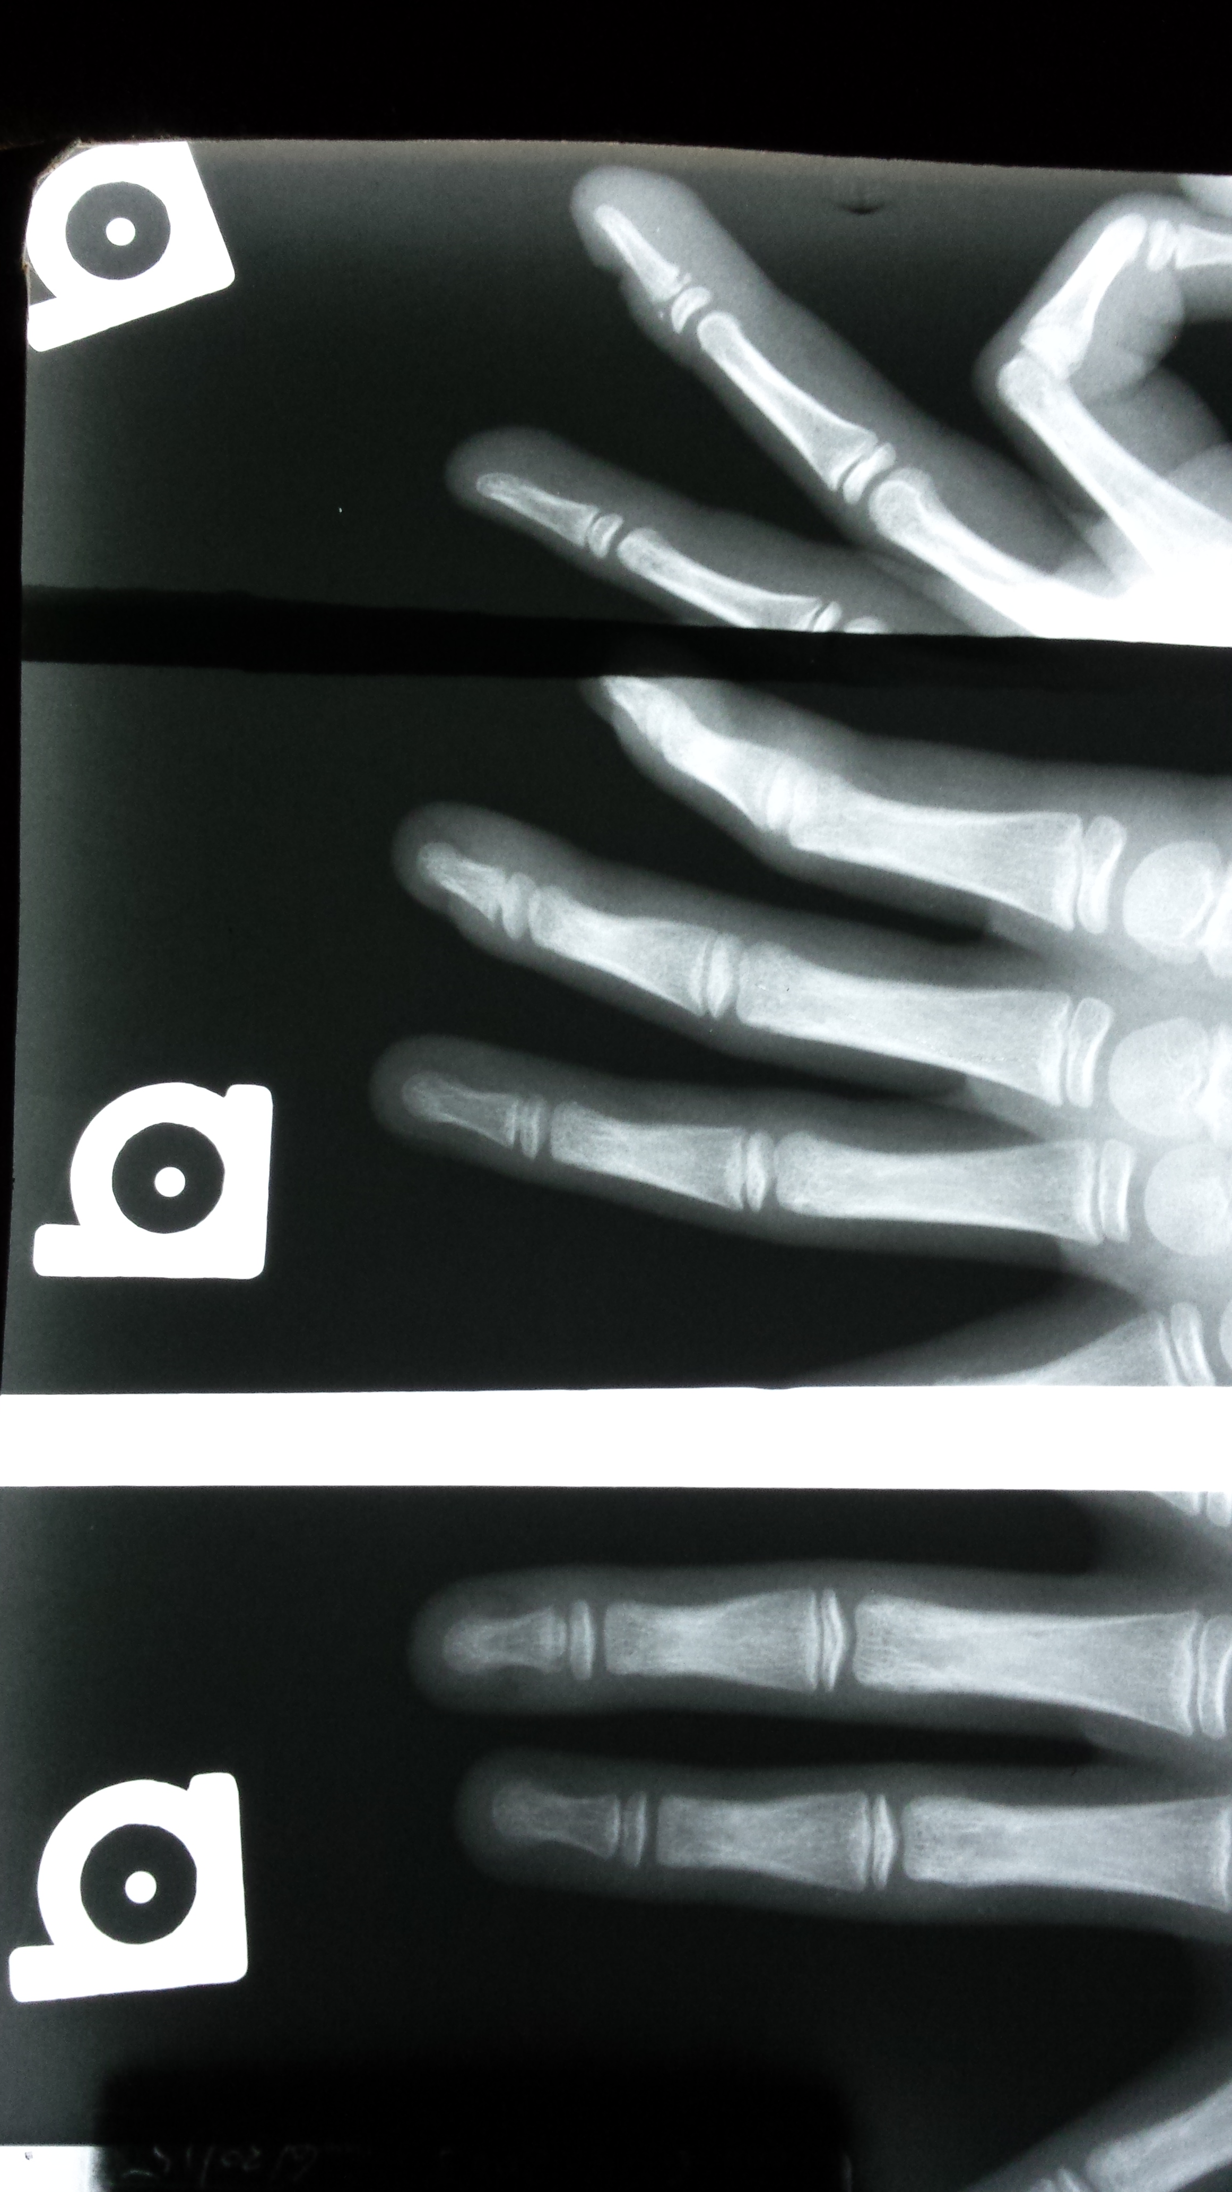
Football injury
5

Slide 31
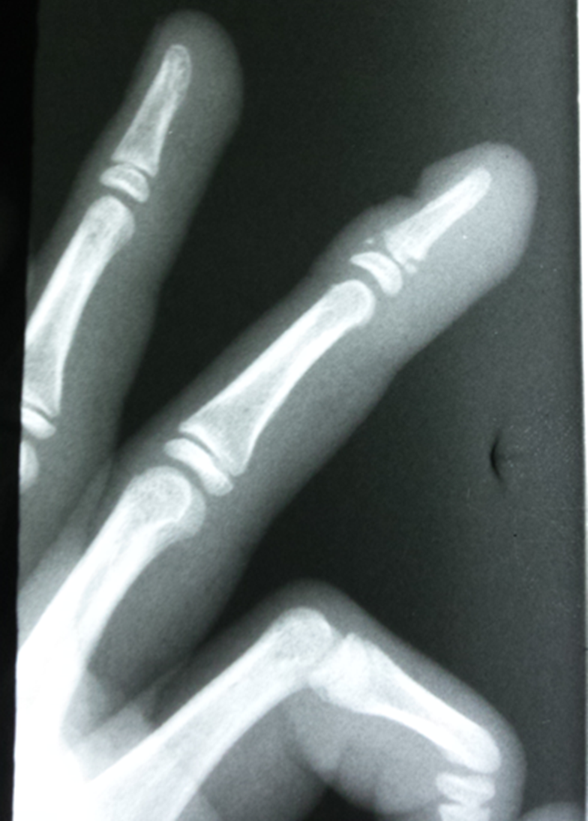
Seymour FX
Looks similar to Mallet Fx.
However, open growth plates….

Slide 32
Seymour FX
Pediatric Fractures of the Distal Phalanx (Seymour Fracture) A hyperflexion injury to the fingertip in a child is frequently mistaken for a mallet finger.
In reality, the extensor tendon is still attached to the proximal dorsal metaphysis of the distal phalanx.
The deformity is caused by an “open book” flexion fracture of the physis at the proximal end of the distal phalanx.
In preadolescents, the fracture is either a Salter-Harris Type 1 or 2; in adolescents, it is generally a Type 3 pattern.
The diagnosis can be tricky in very small children, younger than 3 years, whose epiphysis may not be calcified.
Because the FDP inserts on the distal phalanx distal to the fracture, it acts as a deforming force flexing the distal fragment.
http://www.leohanddoc.com/pdf/distal-phalangeal-fingertip-injuries.pdf

Slide 33
http://www.boneandjoint.org.uk/content/jbjsbr/48-B/2/347.full.pdf

Slide 34
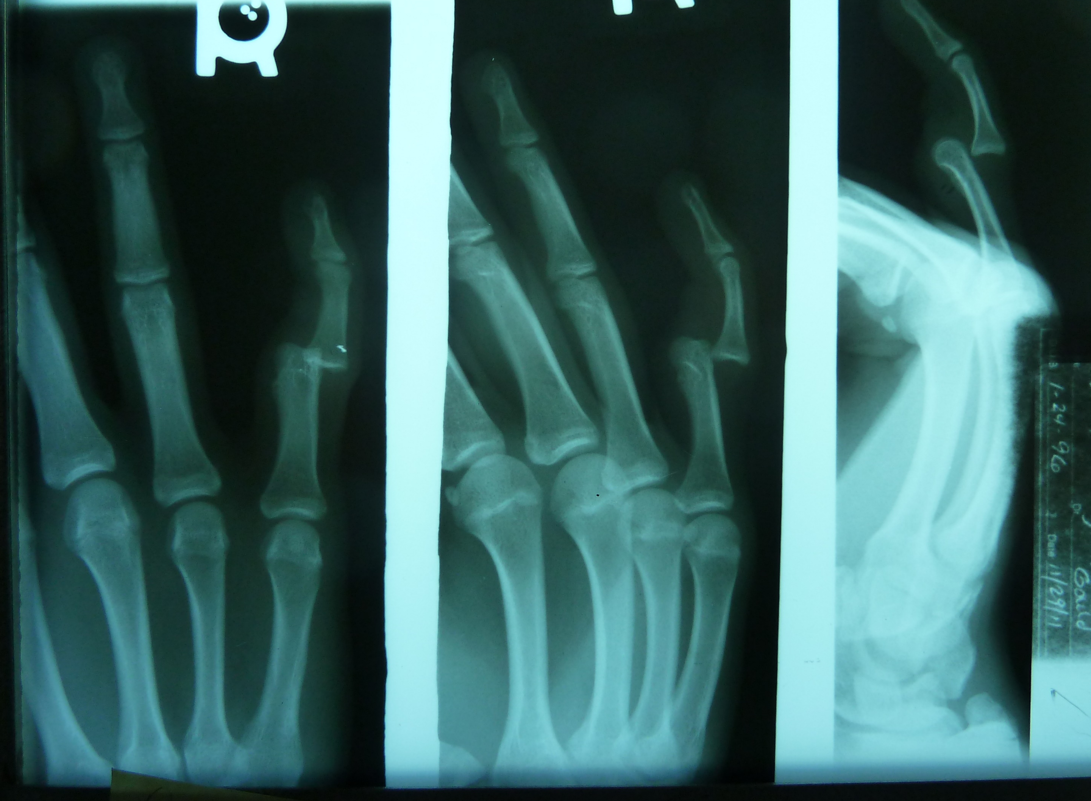
Basketball injury

Slide 35
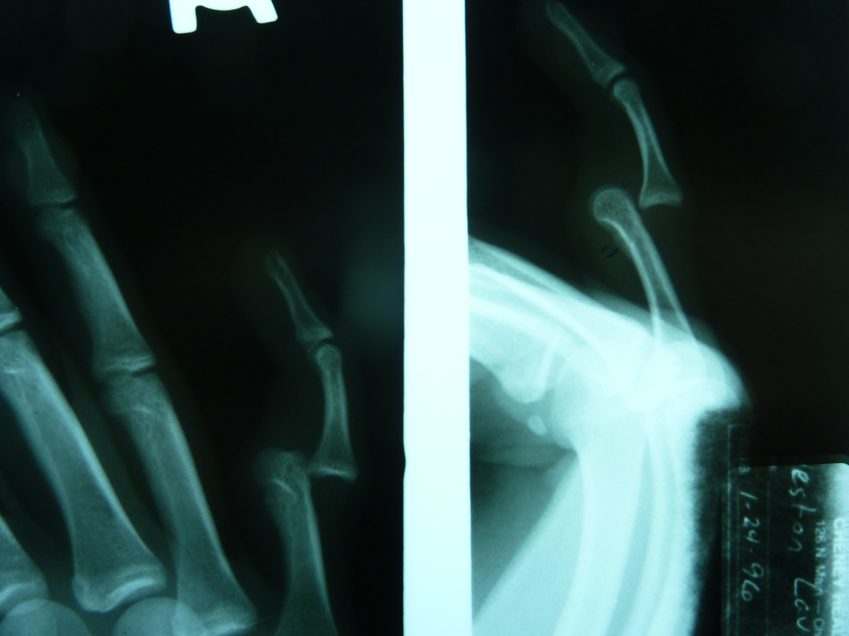

Slide 36
Dislocations:
If in the office setting, obtain pre- and post- reduction films to insure proper reduction and documentation of any fractures at the time before and after reduction.
Verify neurologic and vascular status pre- and post- reduction.

Slide 37
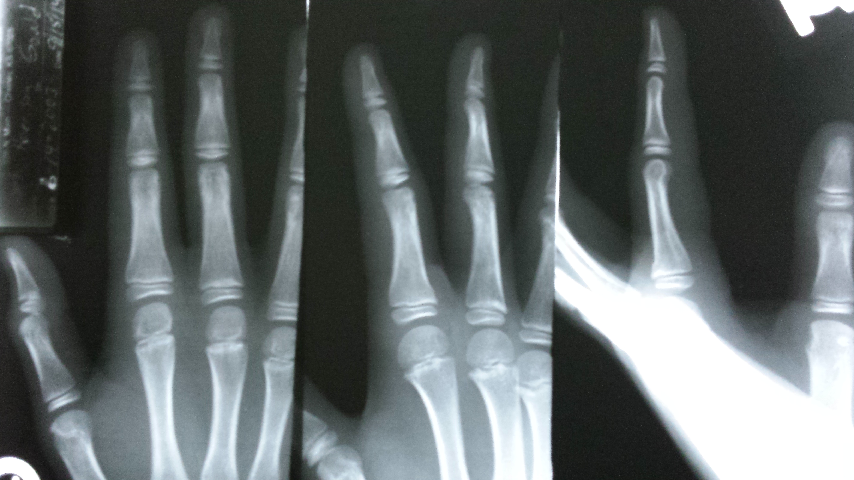
Football Injury
7

Slide 38
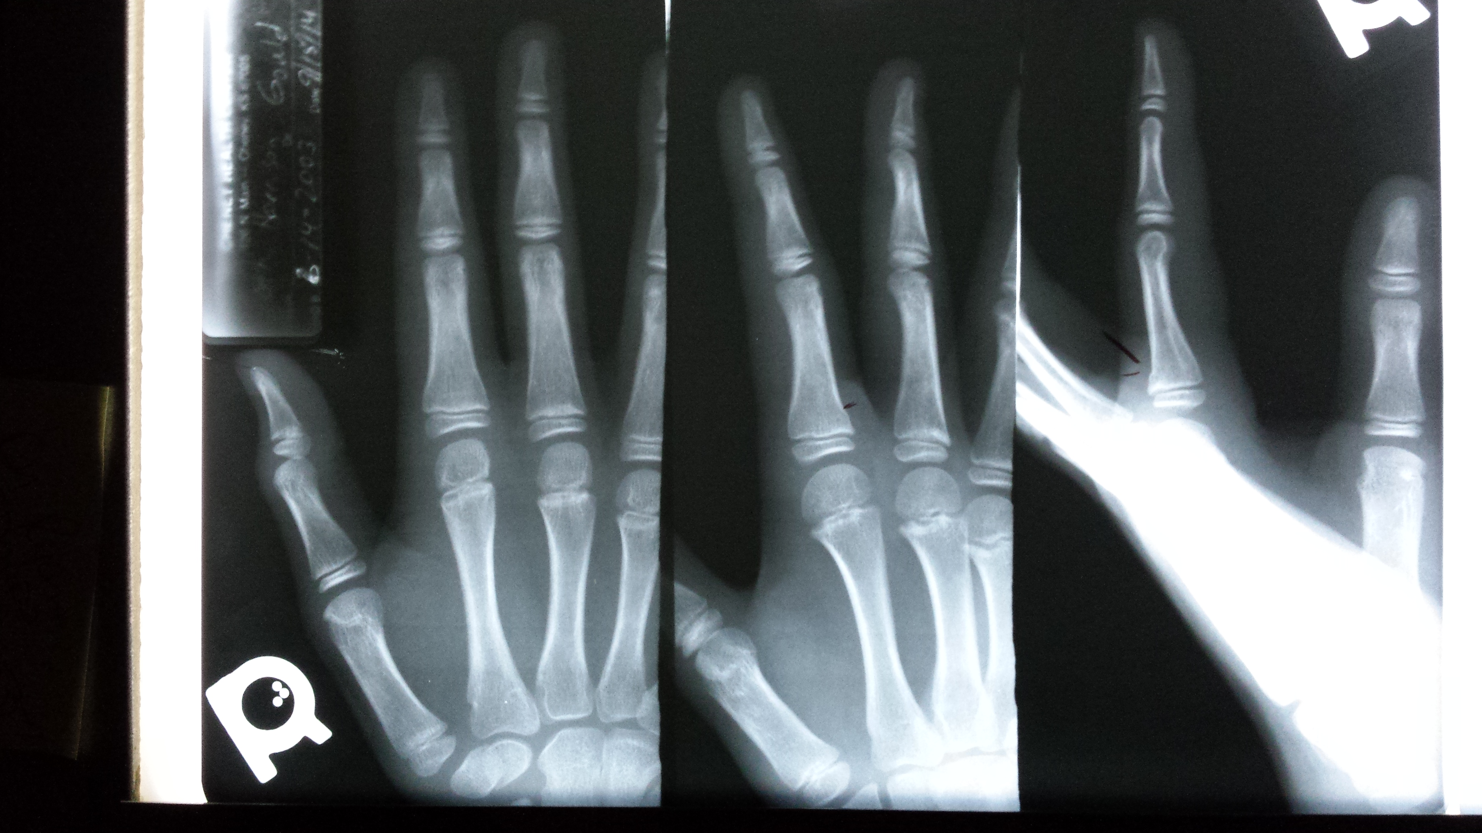
Salter-Harris Type II

Slide 39
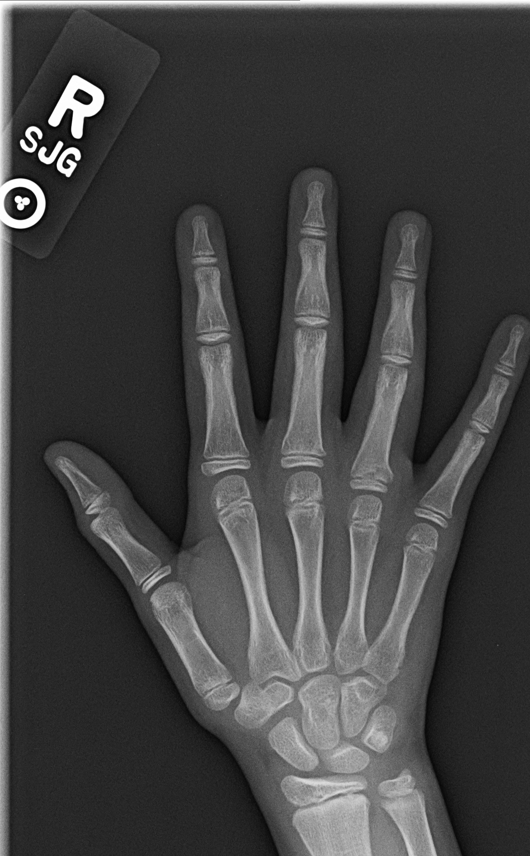
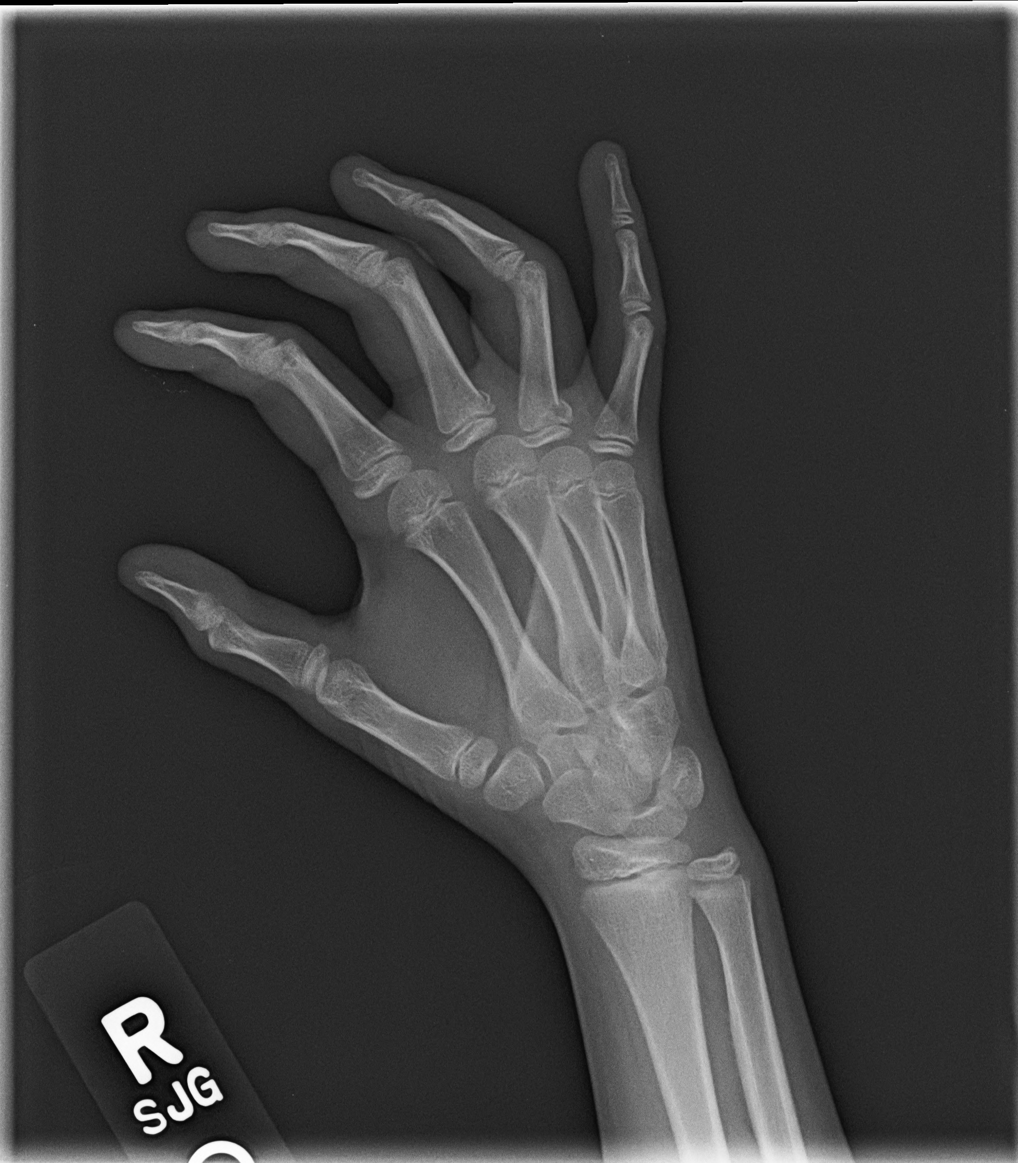
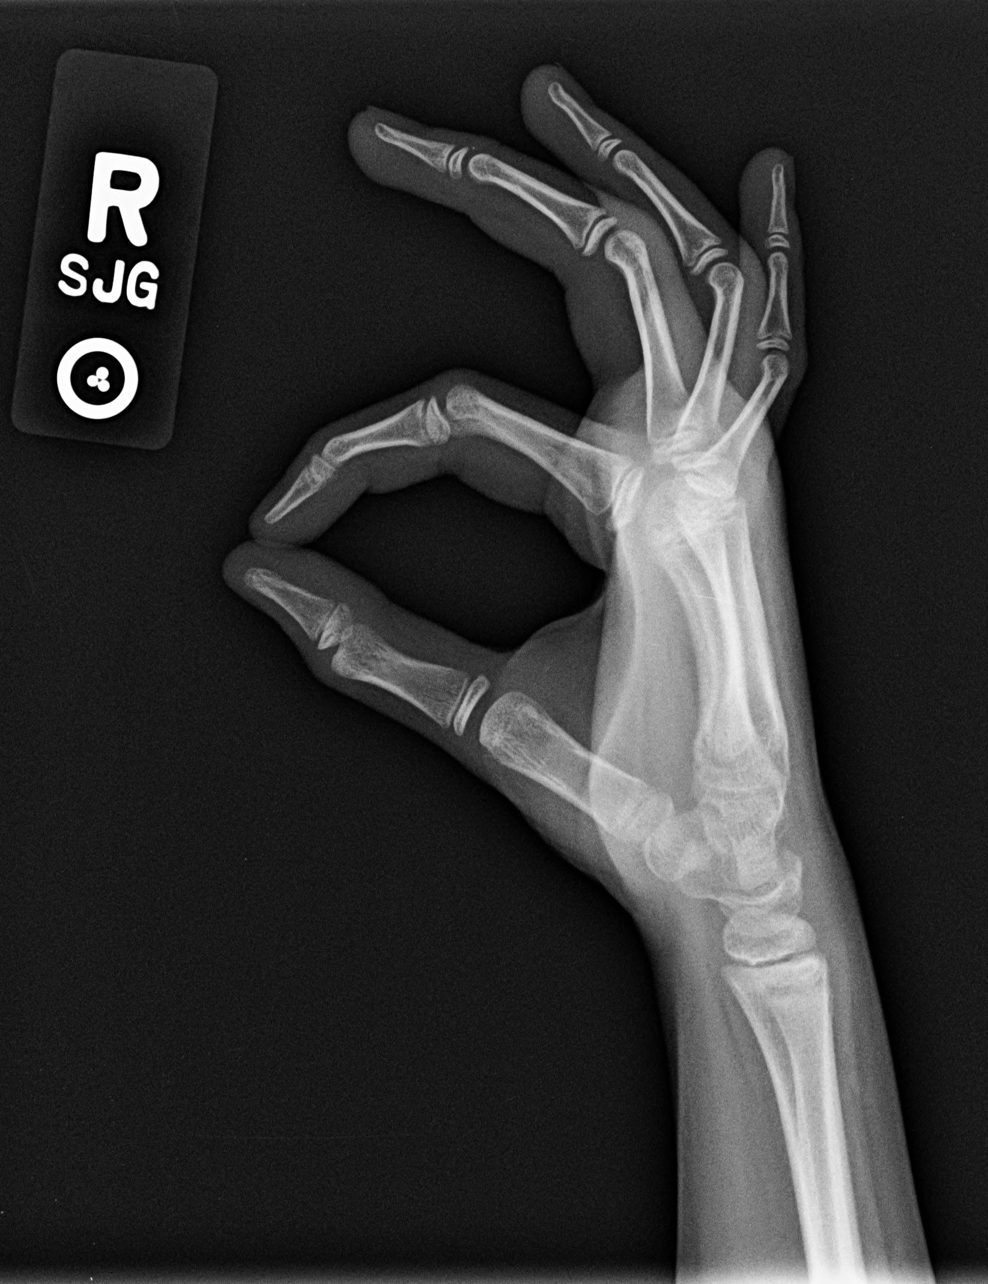
More proximal phalangeal fxs

Slide 40
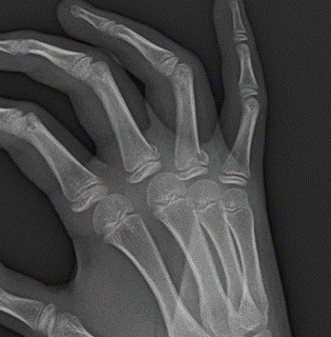
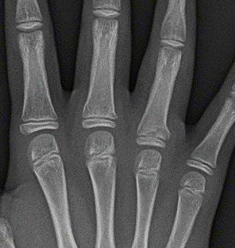
3rd and 4th proximal phal. Fx tx with splint…

Slide 41
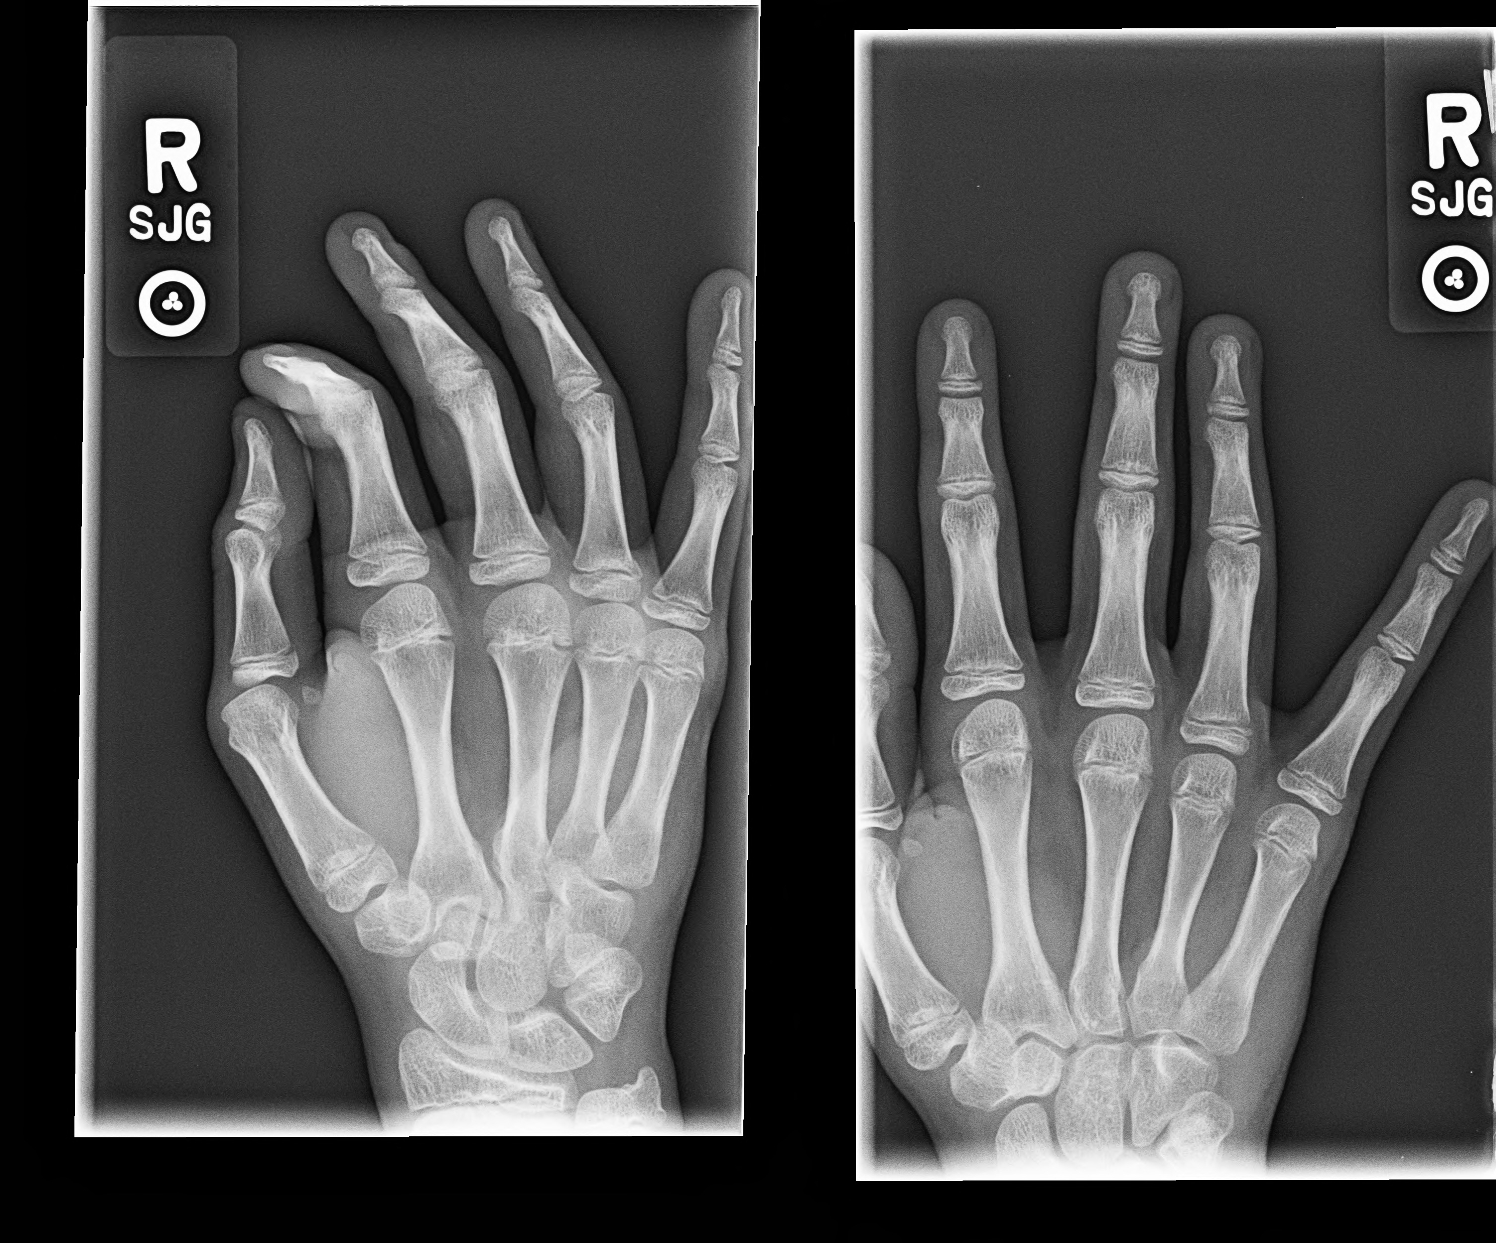
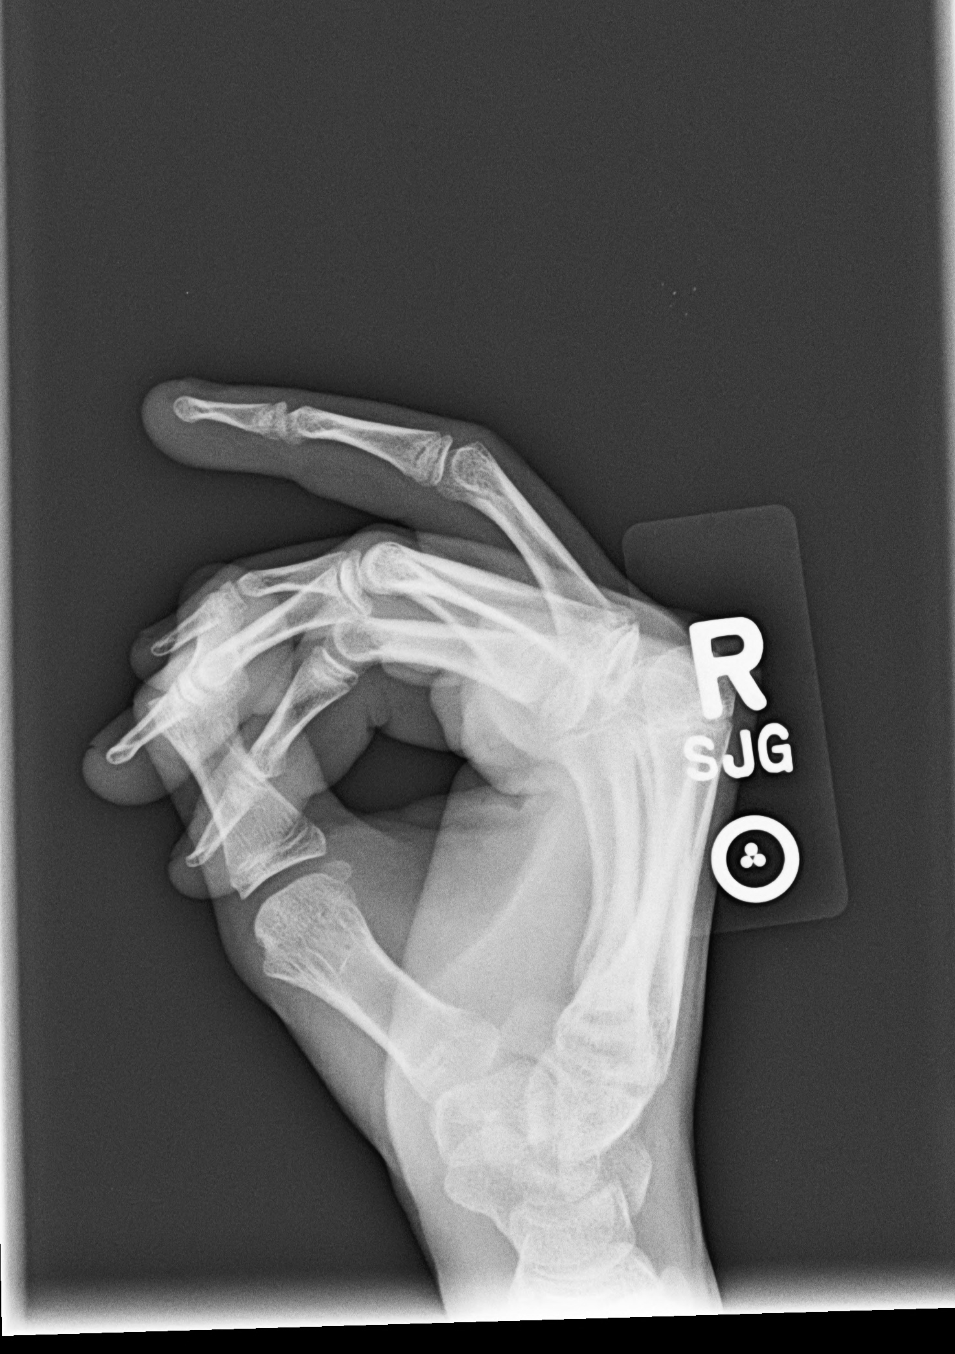
another pt: 4th prox phal.

Slide 42
4th prox phal fx tx with Pinning: due to rotation

Slide 43
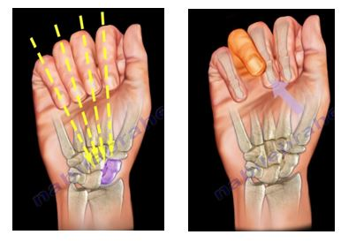
fing
Remember to assess finger orientation/alignment when evaluating finger injuries
https://nabilebraheim.wordpress.com/2017/07/13/finger-fractures/

Slide 44
Before we leave the Fingers……

Slide 45
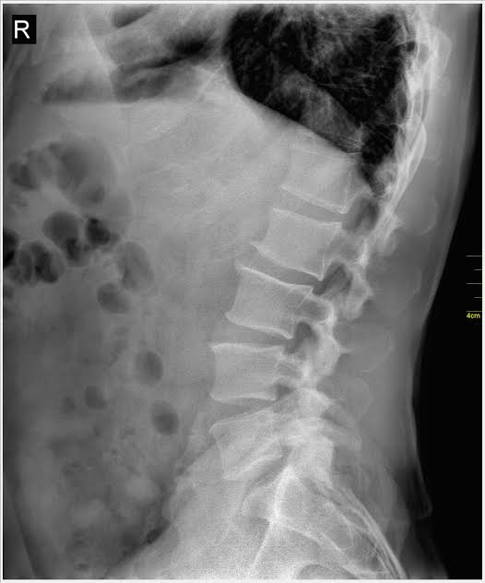
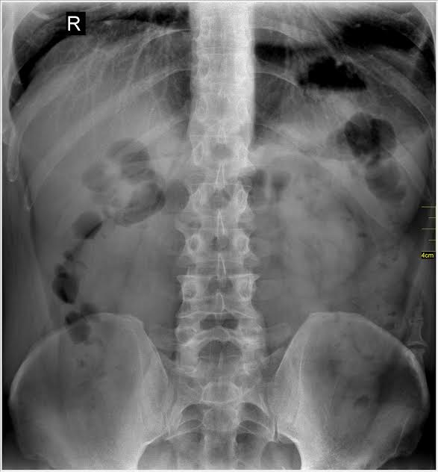
8

Slide 46


The pelvic Digit

Slide 47
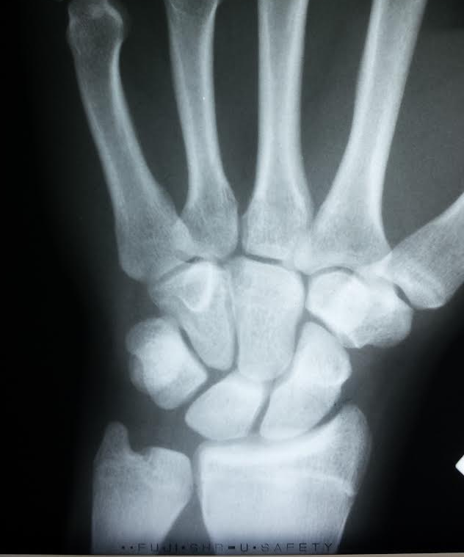
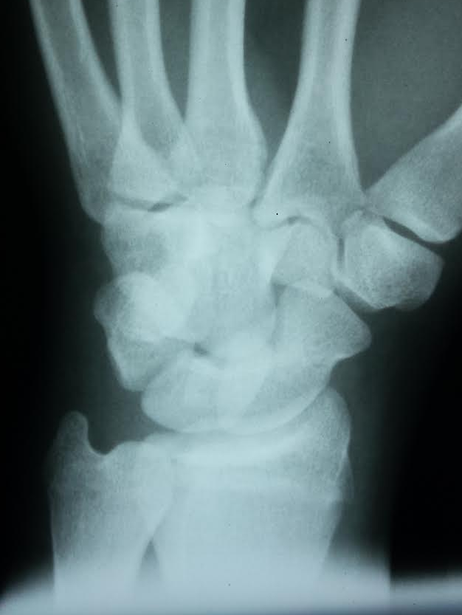
WRISt pain with blocking in footbALL
9

Slide 48
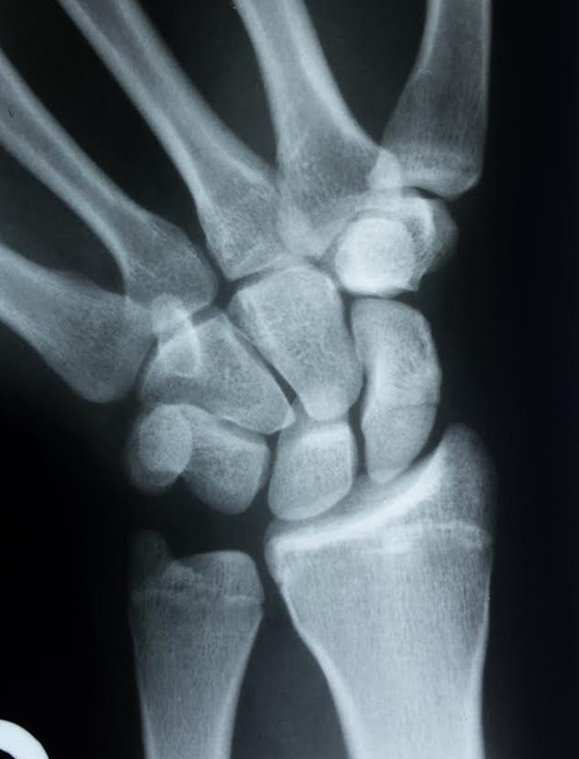
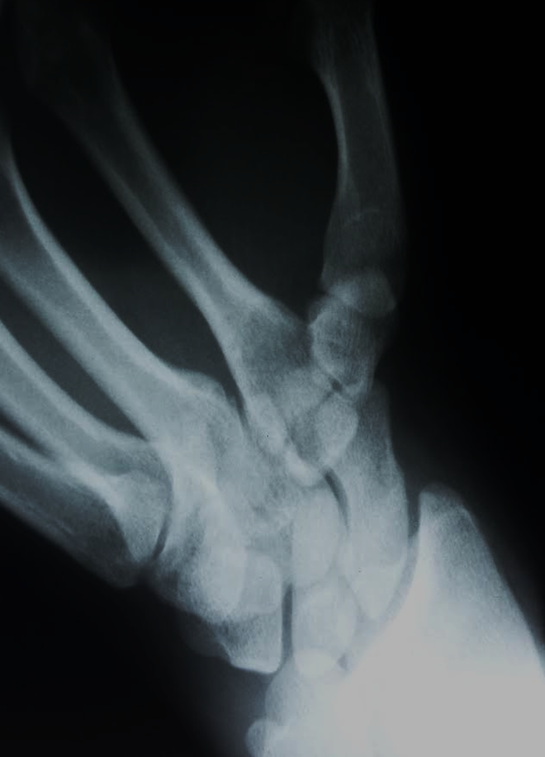
Scaphoid projections:
Even with special projections, x-ray beam must travel through the fracture line

Slide 49
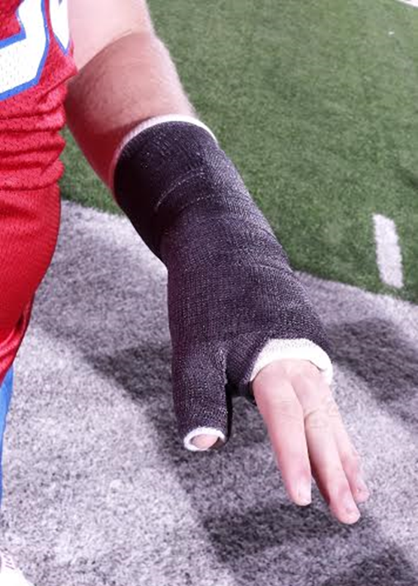
Scaphoid fx. cast

Slide 50
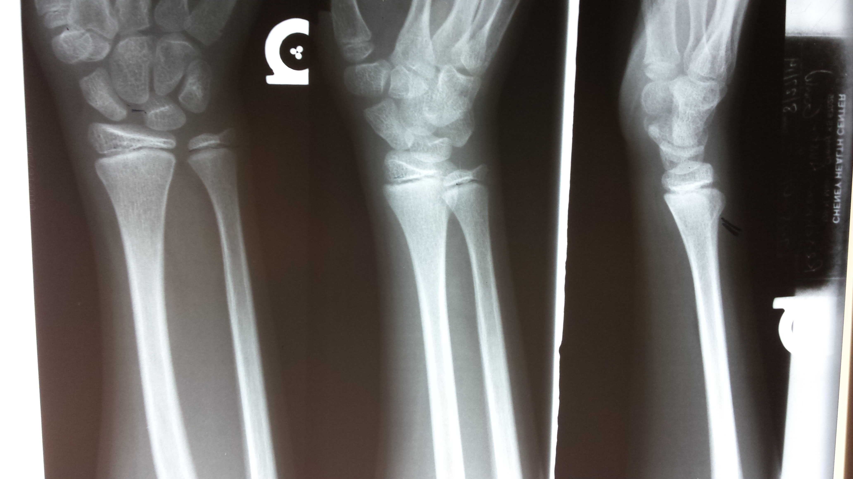
Fell on outstretched hand
10

