Slide 1
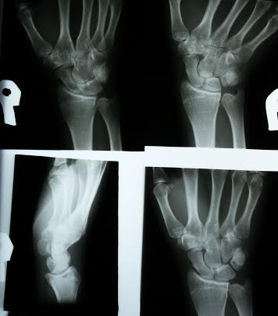
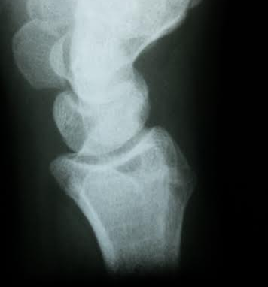
Lister’s Tubercle fx
10b

Slide 2
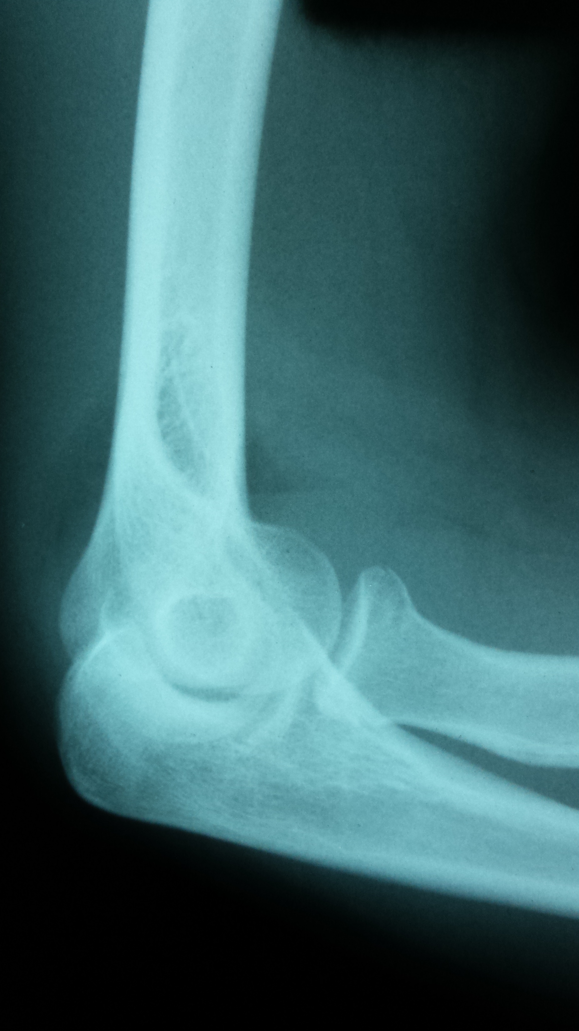
Just healed and released from P.T. for
Labral tear and surgery for shoulder.
Now trips on garage steps and falls on concrete floor
11
Now - Elbow pain

Slide 3
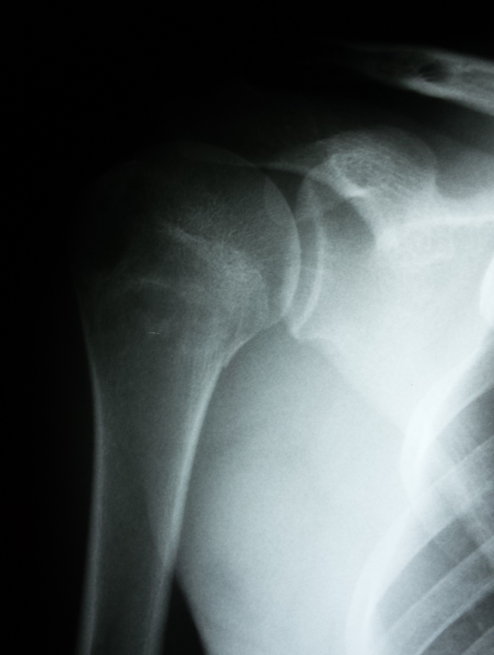
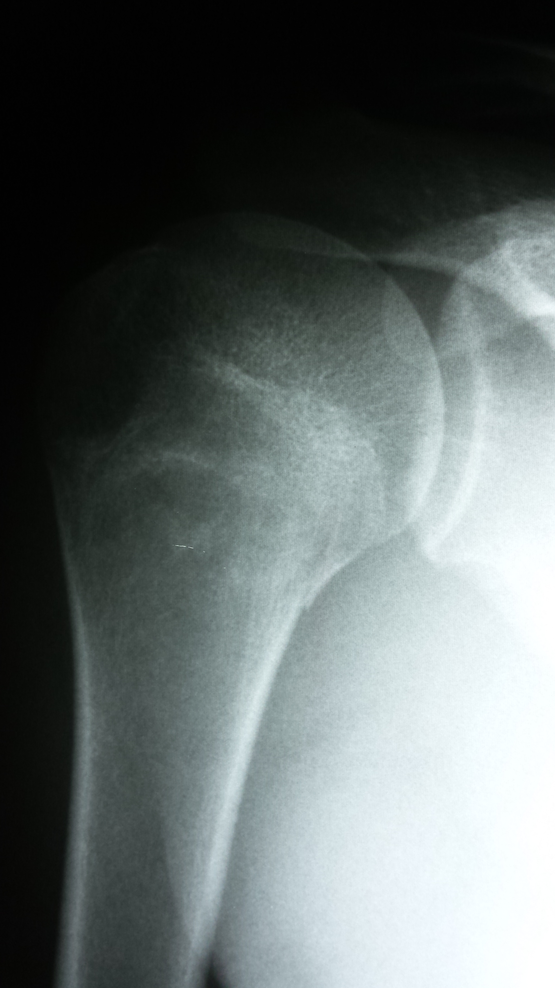
And shoulder pain

Slide 4
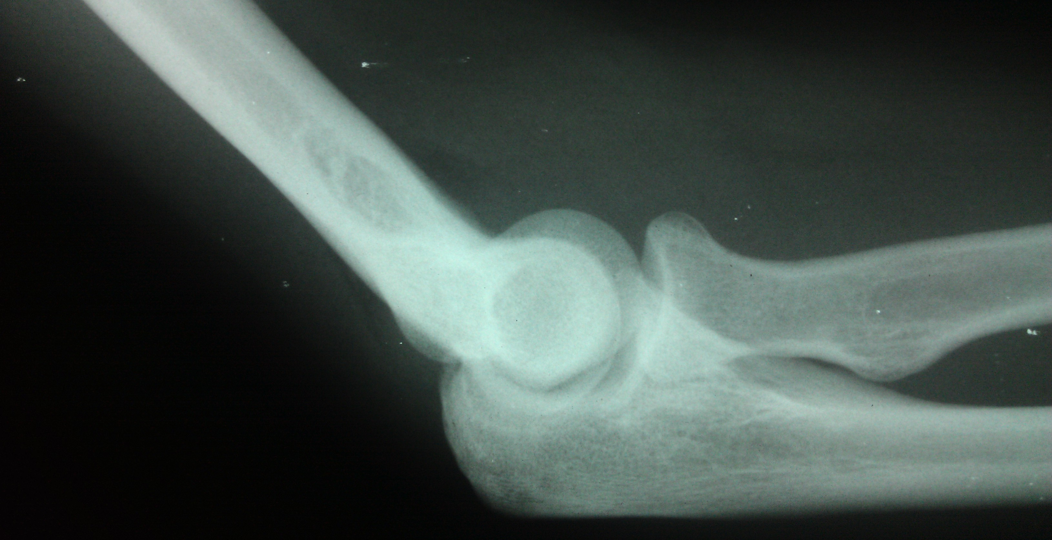
12
Football. Tackled with hand on ground and elbow hyperextended.

Slide 5
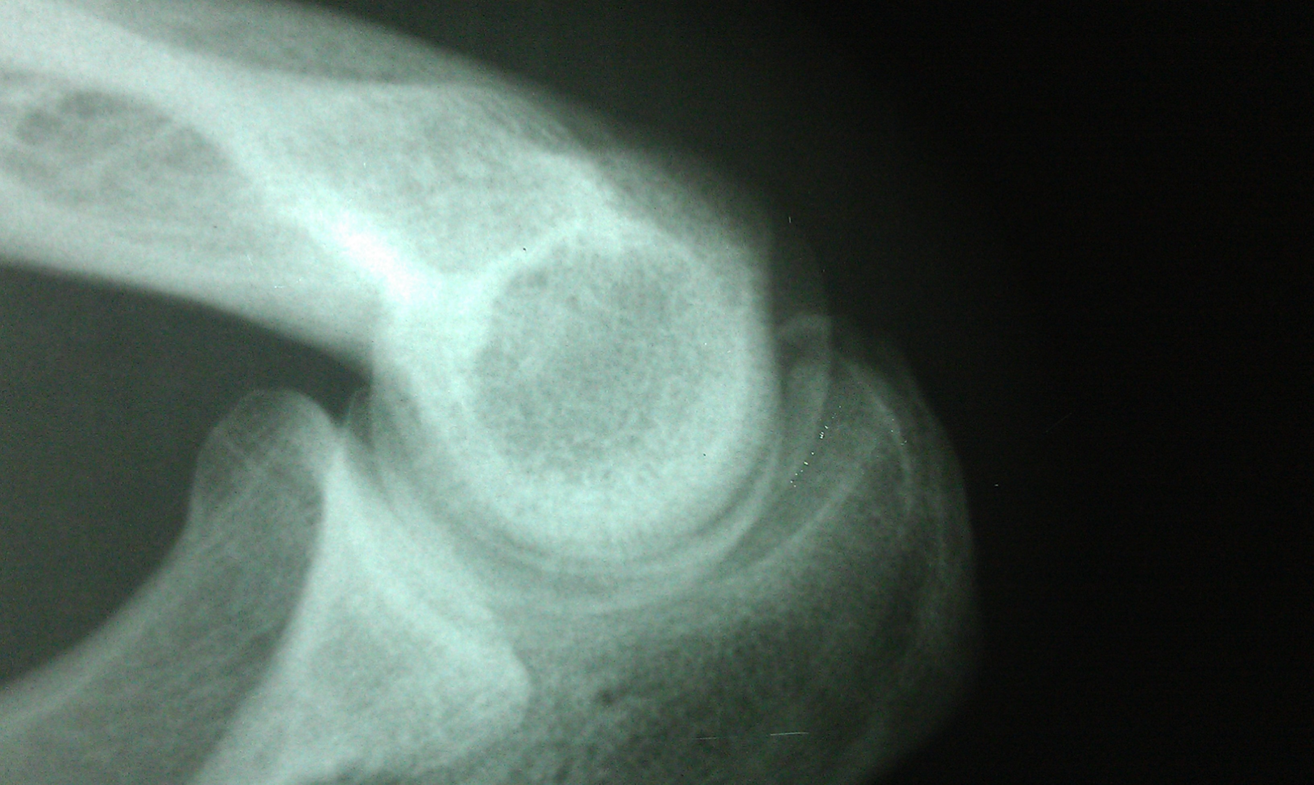

Slide 6
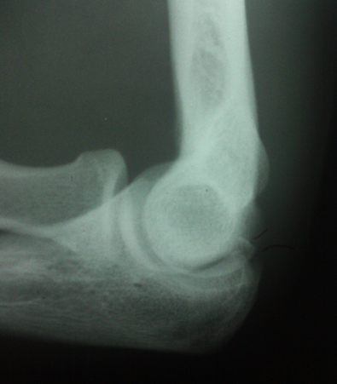

Slide 7
T. Alstrom
Chronic shoulder pain - off and on. Increased pain lately with weight training.

Slide 8
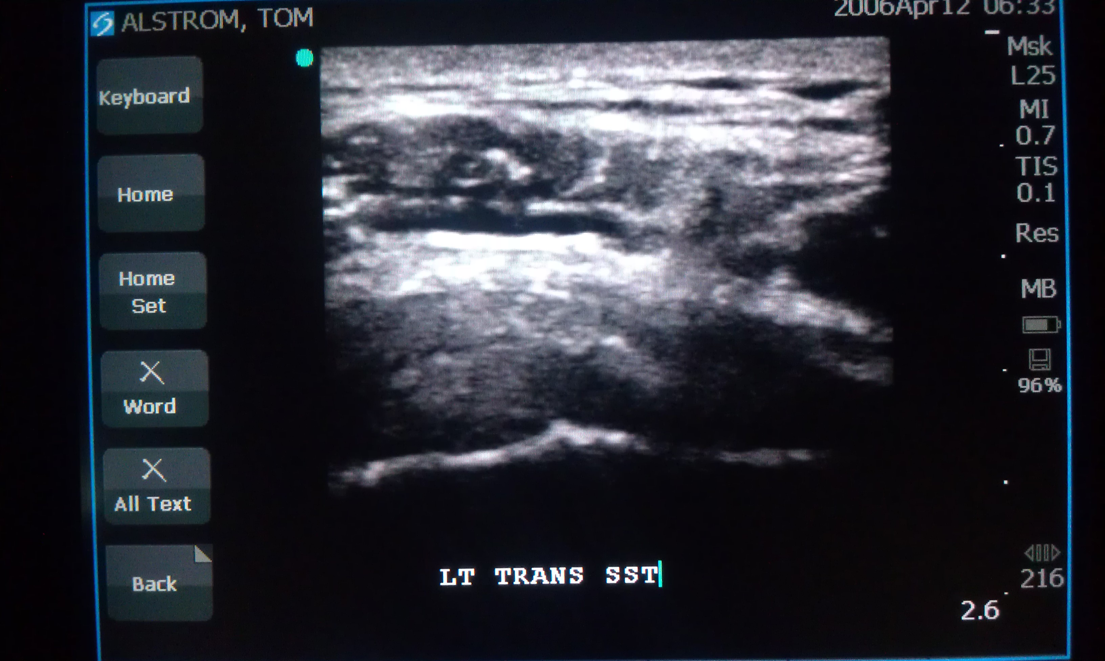

Slide 9
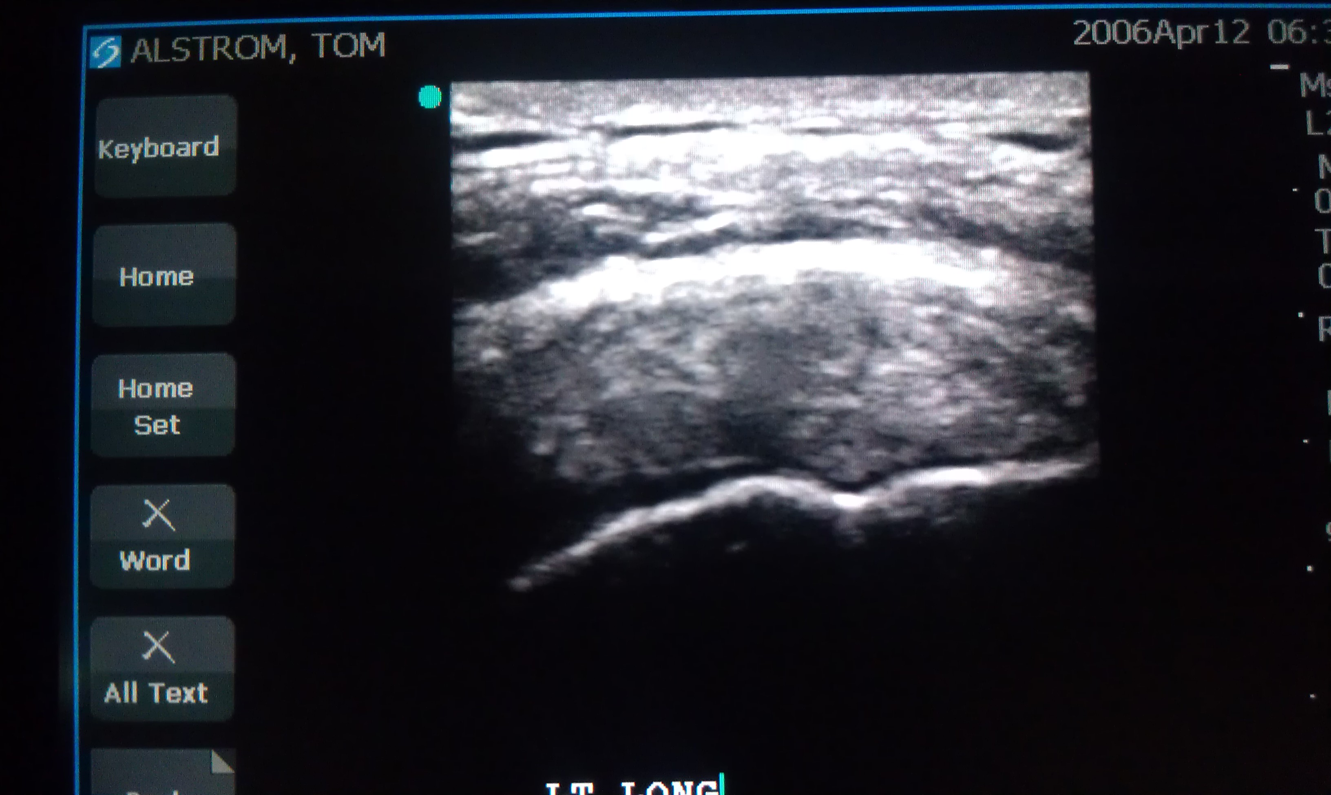


Slide 10
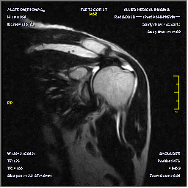
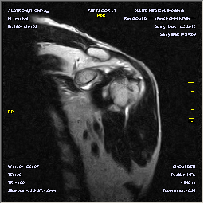

Slide 11
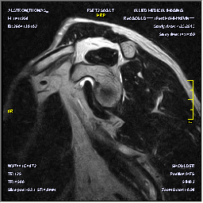
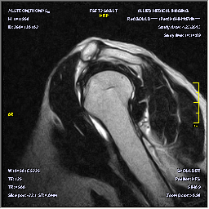

Slide 12
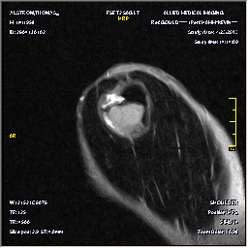
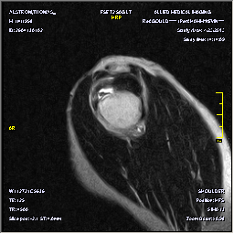

Slide 13

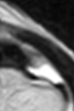
Close up of MRI compared to Sono.

Slide 14
D. Young
Knee injury.
Planted foot and twisted to reach back and catch a baseball thrown behind him. Cannot extend past ~30 degrees flexion. Non-weightbearing, on crutches.

Slide 15
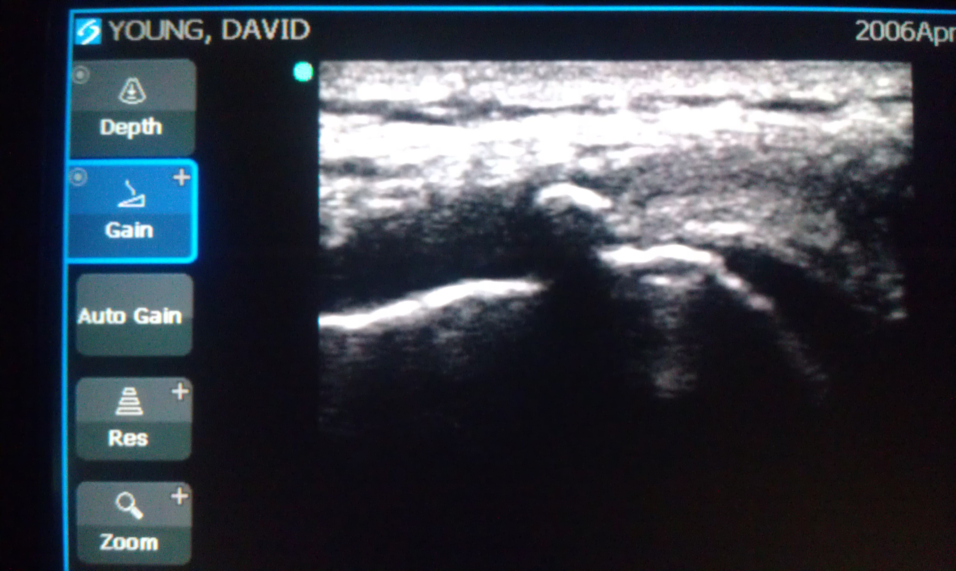
Shadowing calcific loose body noted in MCL

Slide 16
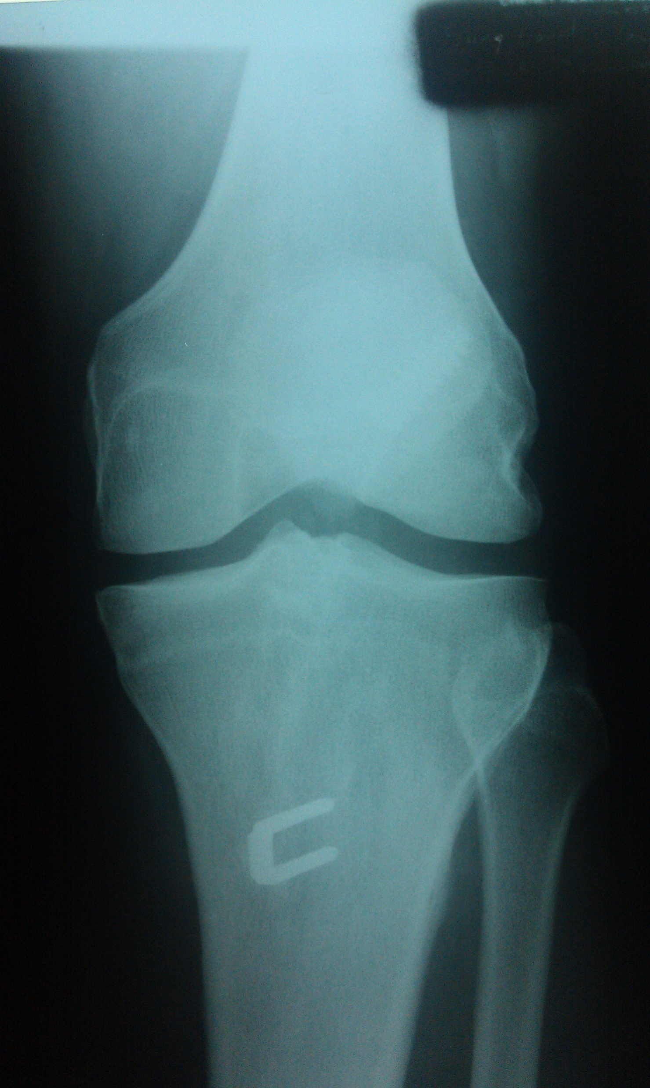
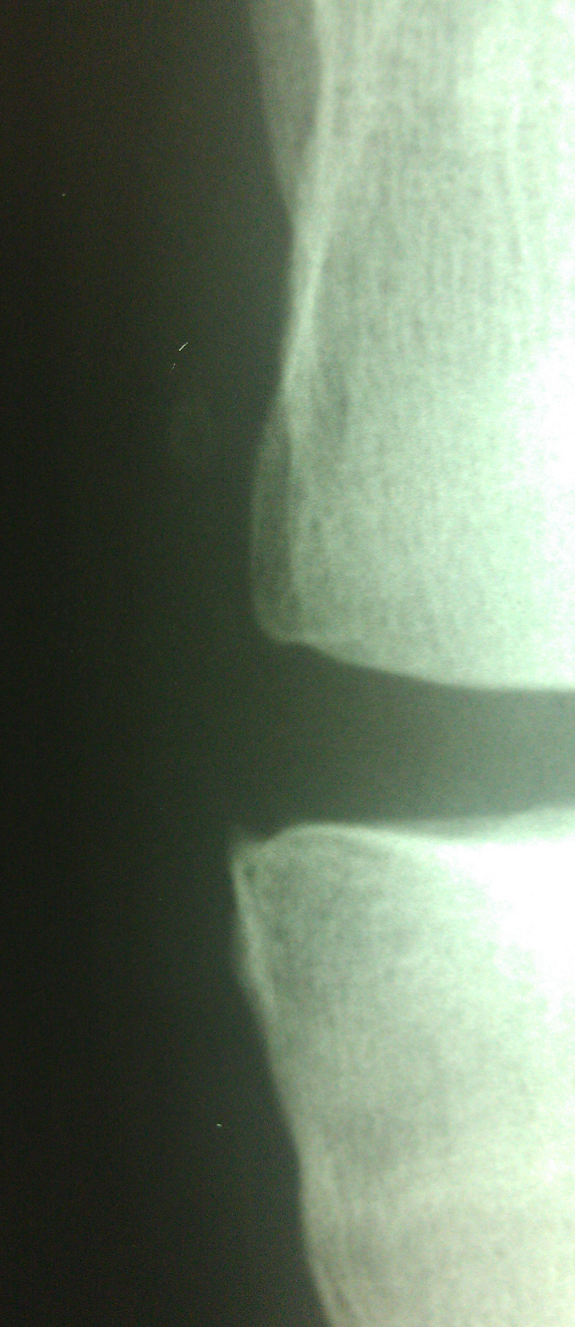

Slide 17
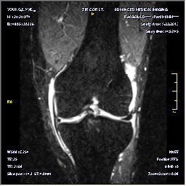
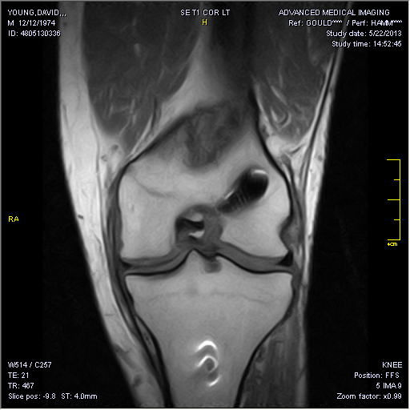

Slide 18
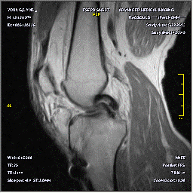
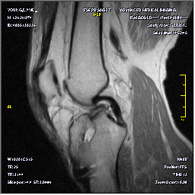

Slide 19
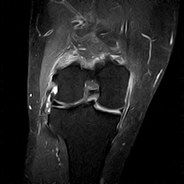
Another knee: Soccer Injury
Knee pain
Injury
Prior knee surgery
Coronal T2 fat sat

Slide 20
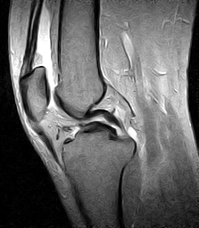
Double PCL sign
Bucket handle tear of meniscus
T2 sagittal

Slide 21
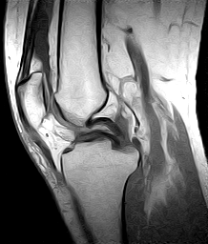

Slide 22
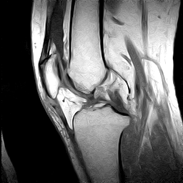
T1 sagittal
ACL tear
Joint effusion

Slide 23
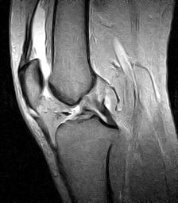
T2 sagittal
ACL Tear
Joint effusion

Slide 24
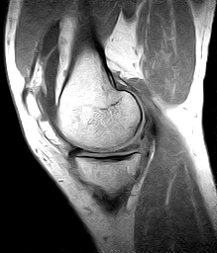
T1 sagittal
Loss of meniscus
Tissue, consistent
with tear

Slide 25
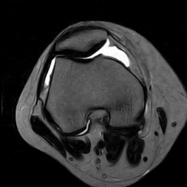
T2 axial
Joint effusion

Slide 26
Findings
Large joint effusion
ACL Tear
Medial meniscus tear with “double PCL sign”

Slide 27
Differentials
New vs. old injuries / previous surgery
  ACL tear
  Meniscus tear
    Double PCL is result of meniscus tissue that has been displaced to reside within the intercondylar notch, beneath the intact PCL.

Slide 28
Discussion
Types of Meniscal tears
  Oblique or horizontal
  Vertical
    Flap
    Bucket handle
  Peripheral
  Medially flipped flap tear
  Radial (parrot beak tear)
  Meniscocapsular separation
  Musculoskeletal MRI: Kaplan, Helms, Dussault, Anderson, Major, 2001 pg. 367 Saunders co.

Slide 29
Discussion
Bucket Handle Tear
  Displaced meniscal fragment may migrate to lie in front of the PCL, producing the appearance of a “double PCL”.
  Thanks to Dr. Ray Conley for this case

Slide 30
The double posterior cruciate ligament sign.
Camacho MA., Radiology. 2004 Nov;233(2):503-4.
Early identification of bucket-handle tears is critical because, any delay can compromise the chances for repair.
If the tear is not reduced, the meniscal fragment risks further maceration. These lesions cause substantial symptoms, including knee locking or a lack of full extension.
The prevalence of bucket-handle tears in symptomatic patients is 9%–19%
~2:1 ratio of medial-to-lateral involvement in bucket-handle tears.

Slide 31
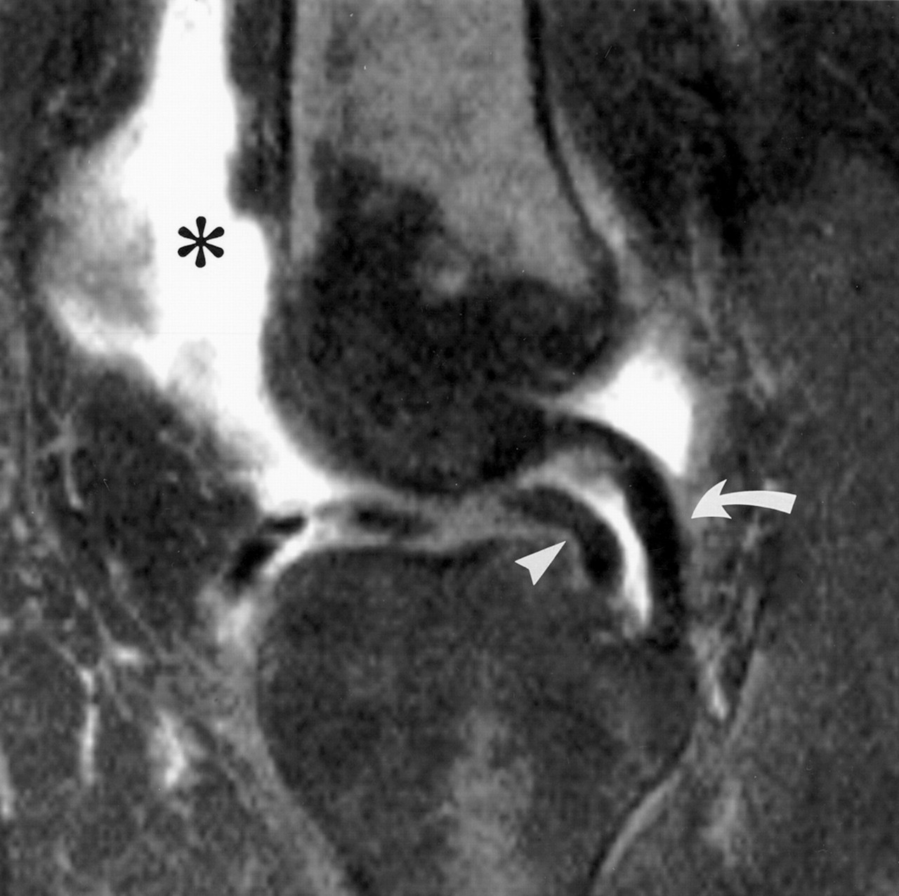
The double posterior cruciate ligament sign.
Camacho MA., Radiology. 2004 Nov;233(2):503-4.
Sensitivity of MR imaging for bucket-handle tears;
~ 60%–88%
The double PCL sign remains a highly specific indicator of a bucket-handle tear, with a specificity range of 98%–100% and a positive predictive value of 93%.

Slide 32
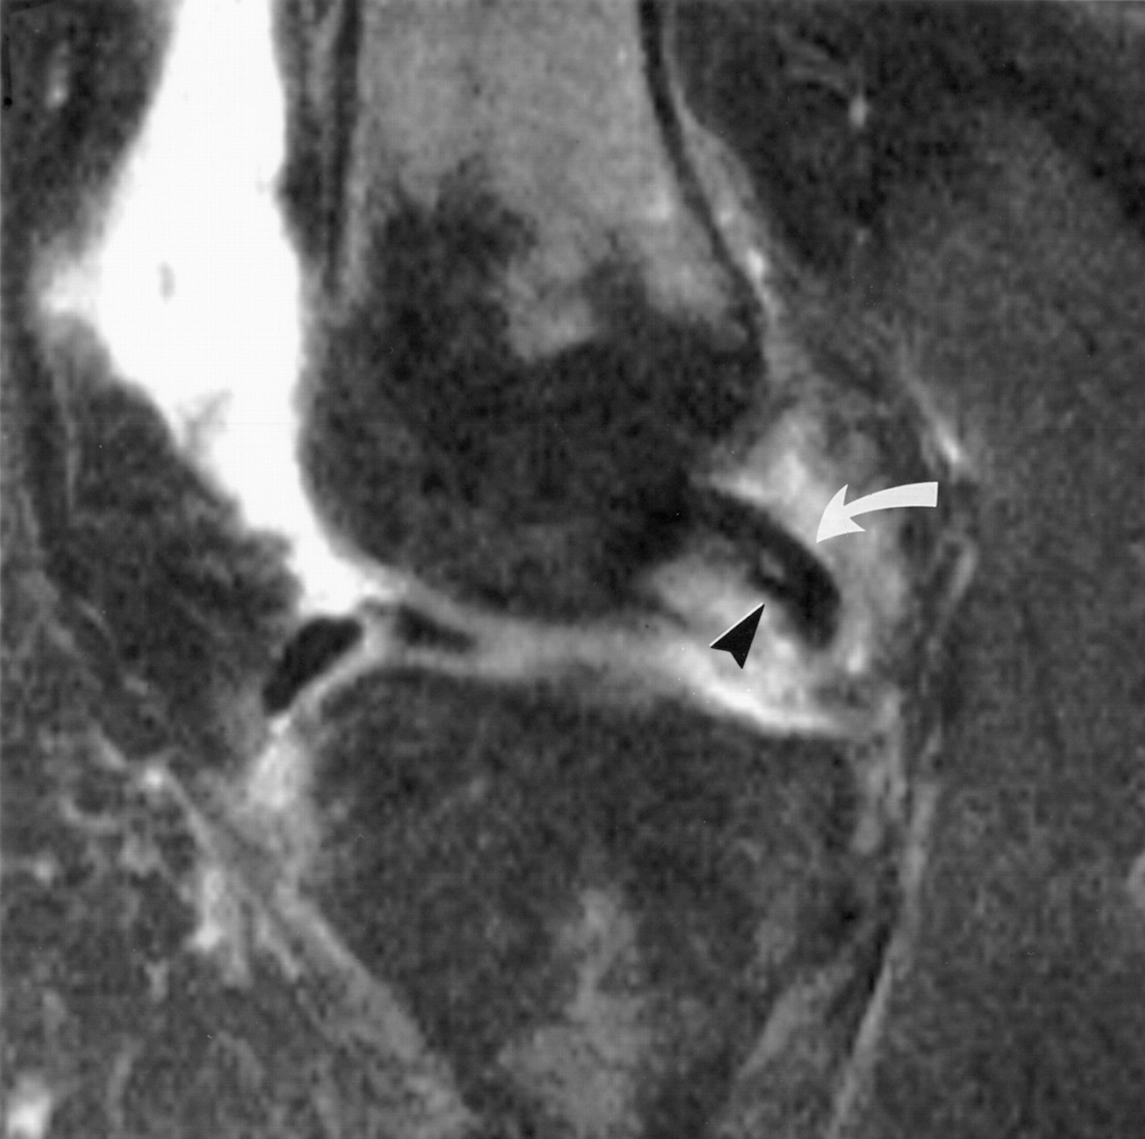
The double posterior cruciate ligament sign.
Camacho MA., Radiology. 2004 Nov;233(2):503-4.
A pitfall of the double PCL sign
Normal accessory meniscofemoral ligament
(ligament of Humphry), extends from the posterior horn of the lateral meniscus to the lateral aspect of the medial femoral condyle
The ligament of Humphry is smaller and thinner than the meniscus fragment usually is and ligament is in extremely close proximity to the PCL

Slide 33
Another potential pitfall
  Oblique meniscomeniscal ligament.
  frequency of 1%–4% of general population.
Two variants: noted by their attachment site;
  Medial oblique meniscomeniscal ligament originates from the anterior horn of the medial meniscus and inserts into the posterior horn of the lateral meniscus.
  Lateral oblique meniscomeniscal ligament originates from the anterior horn of the lateral meniscus and inserts into the posterior horn of the medial meniscus.
These ligaments traverse the intercondylar fossa, passing between the ACL and PCL, and, may mimic the double PCL sign
To avoid this pitfall, one must trace the course of these ligaments entirely from origin to insertion, as well as confirm the normal morphologic features of the adjacent menisci

Slide 34
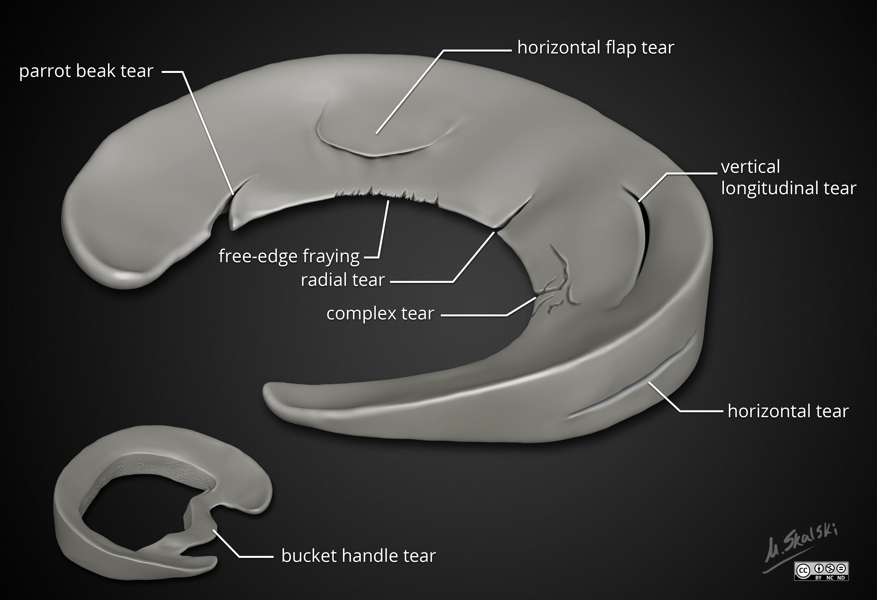
Case courtesy of Dr Matt Skalski, Radiopaedia.org, rID: 55569

Slide 35
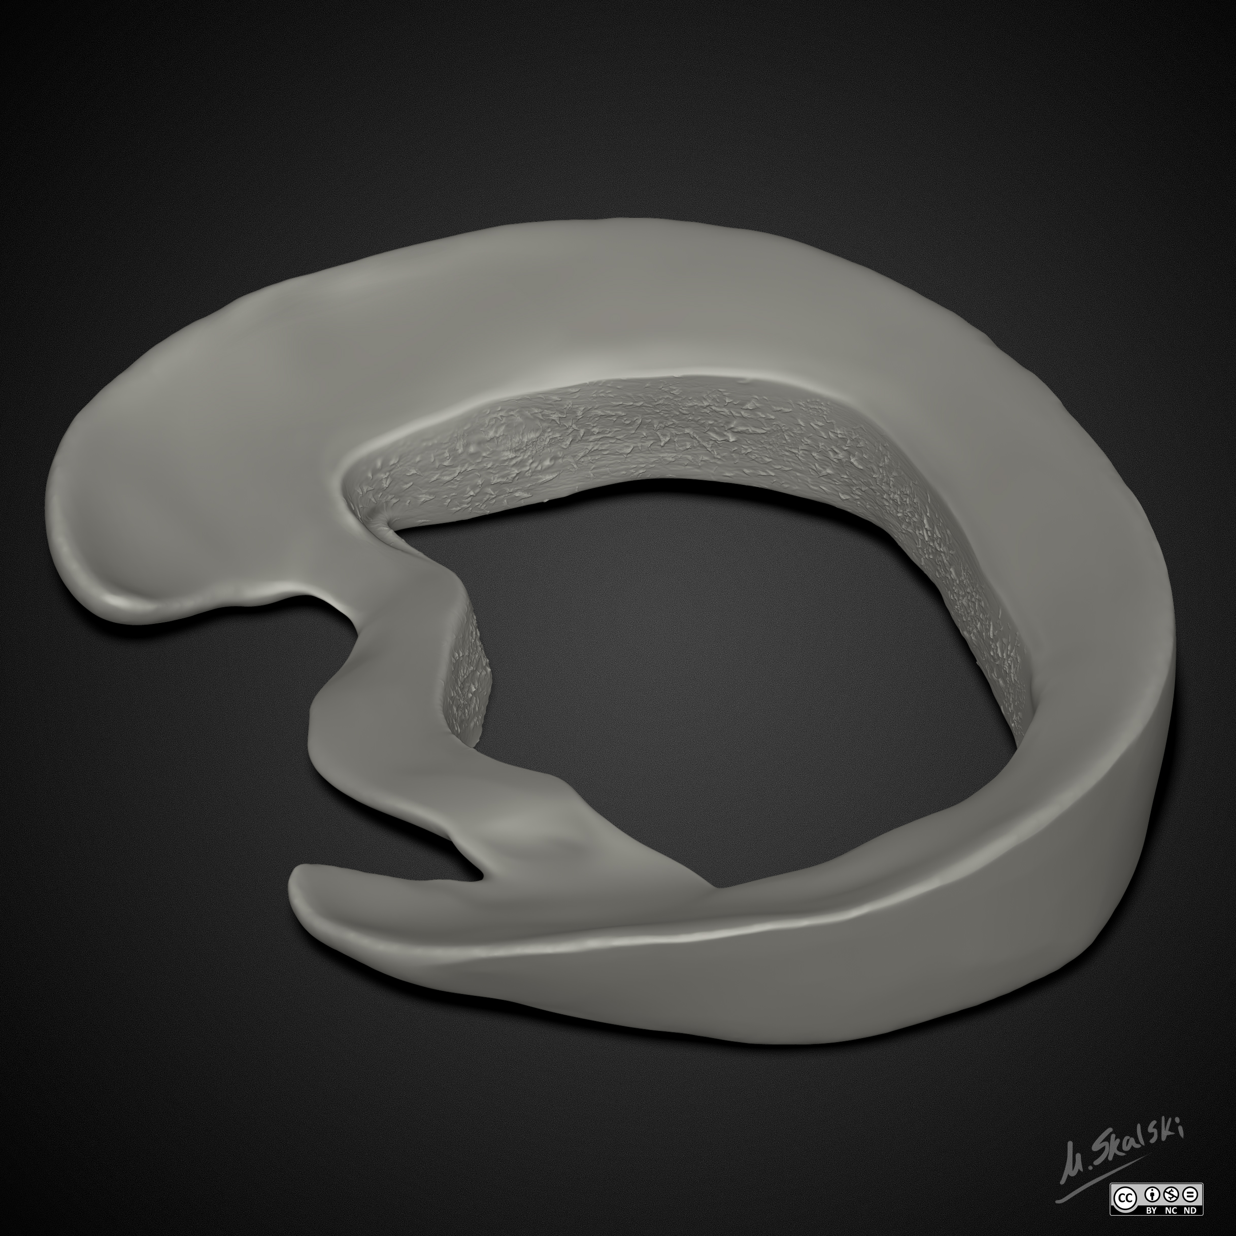

Slide 36
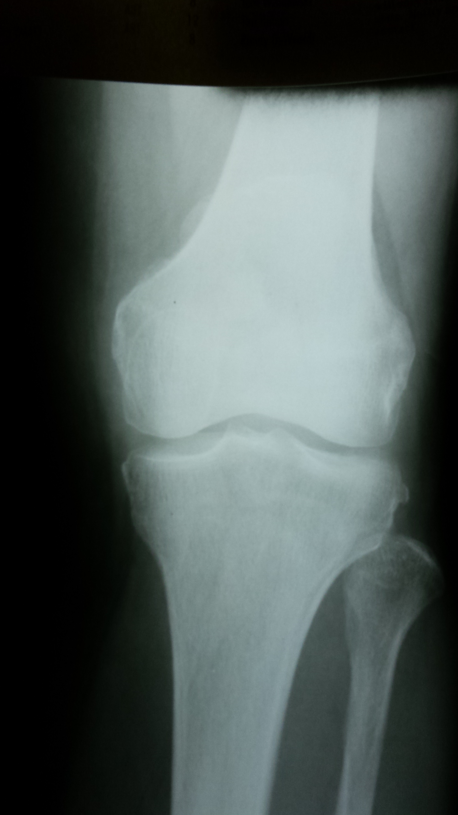
Fell on Knee

Slide 37
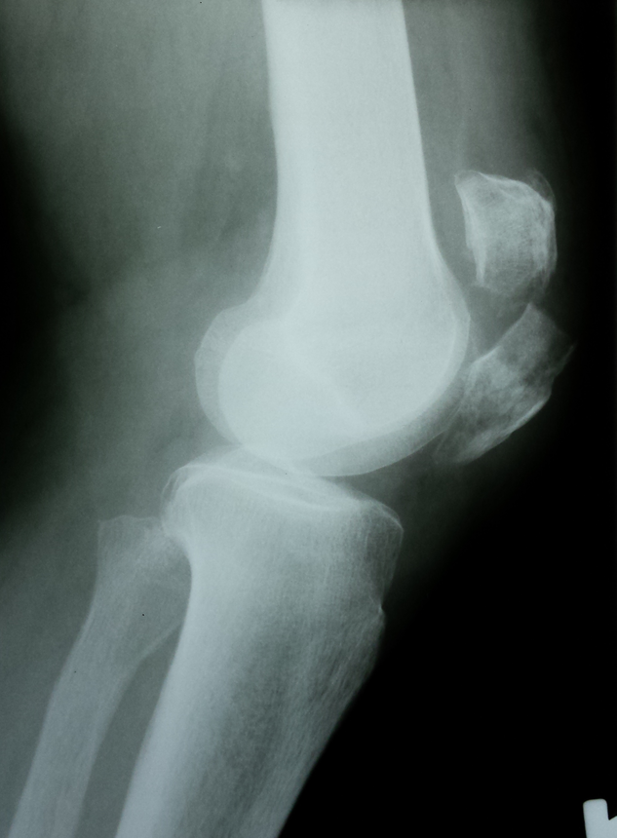
How about a lateral !

Slide 38
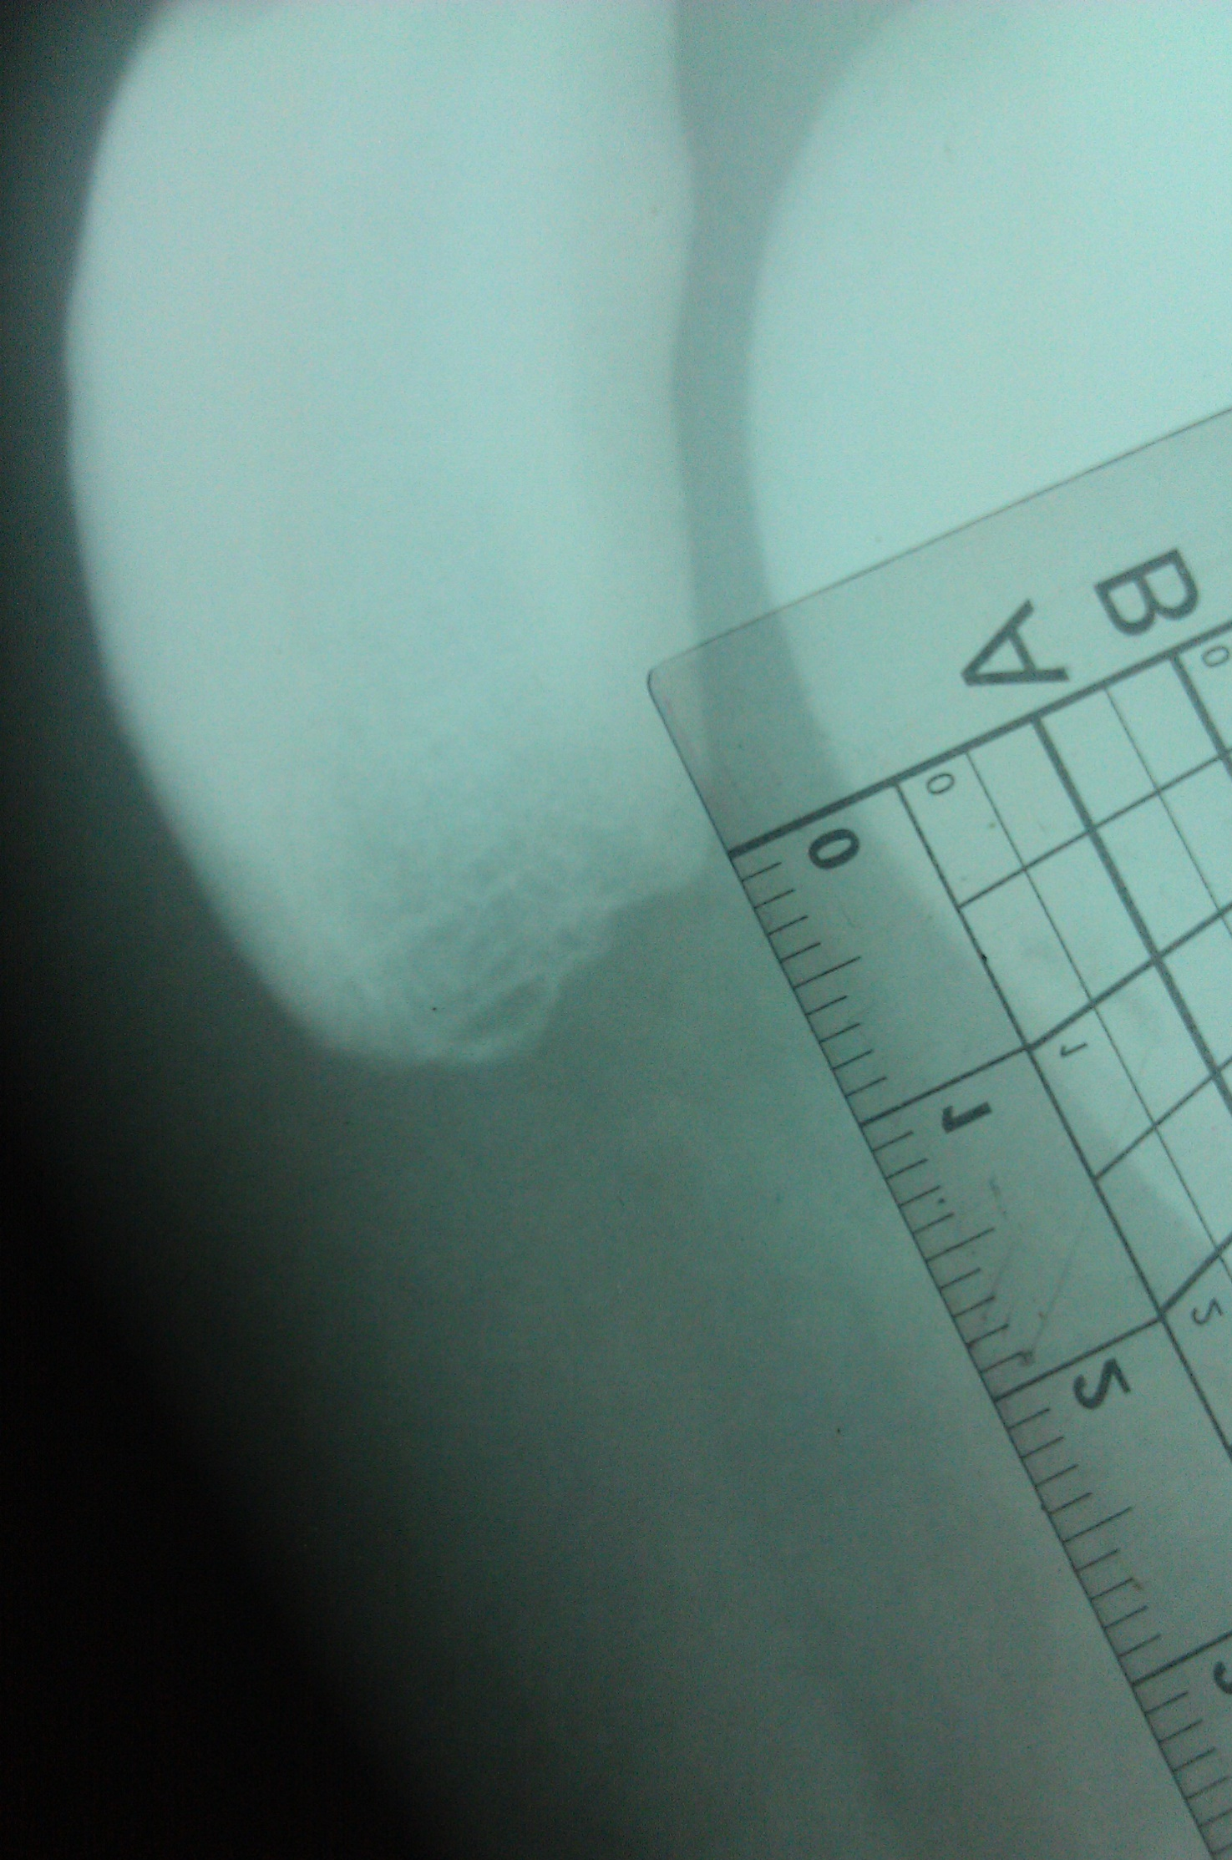
Football and squat injury
14

Slide 39
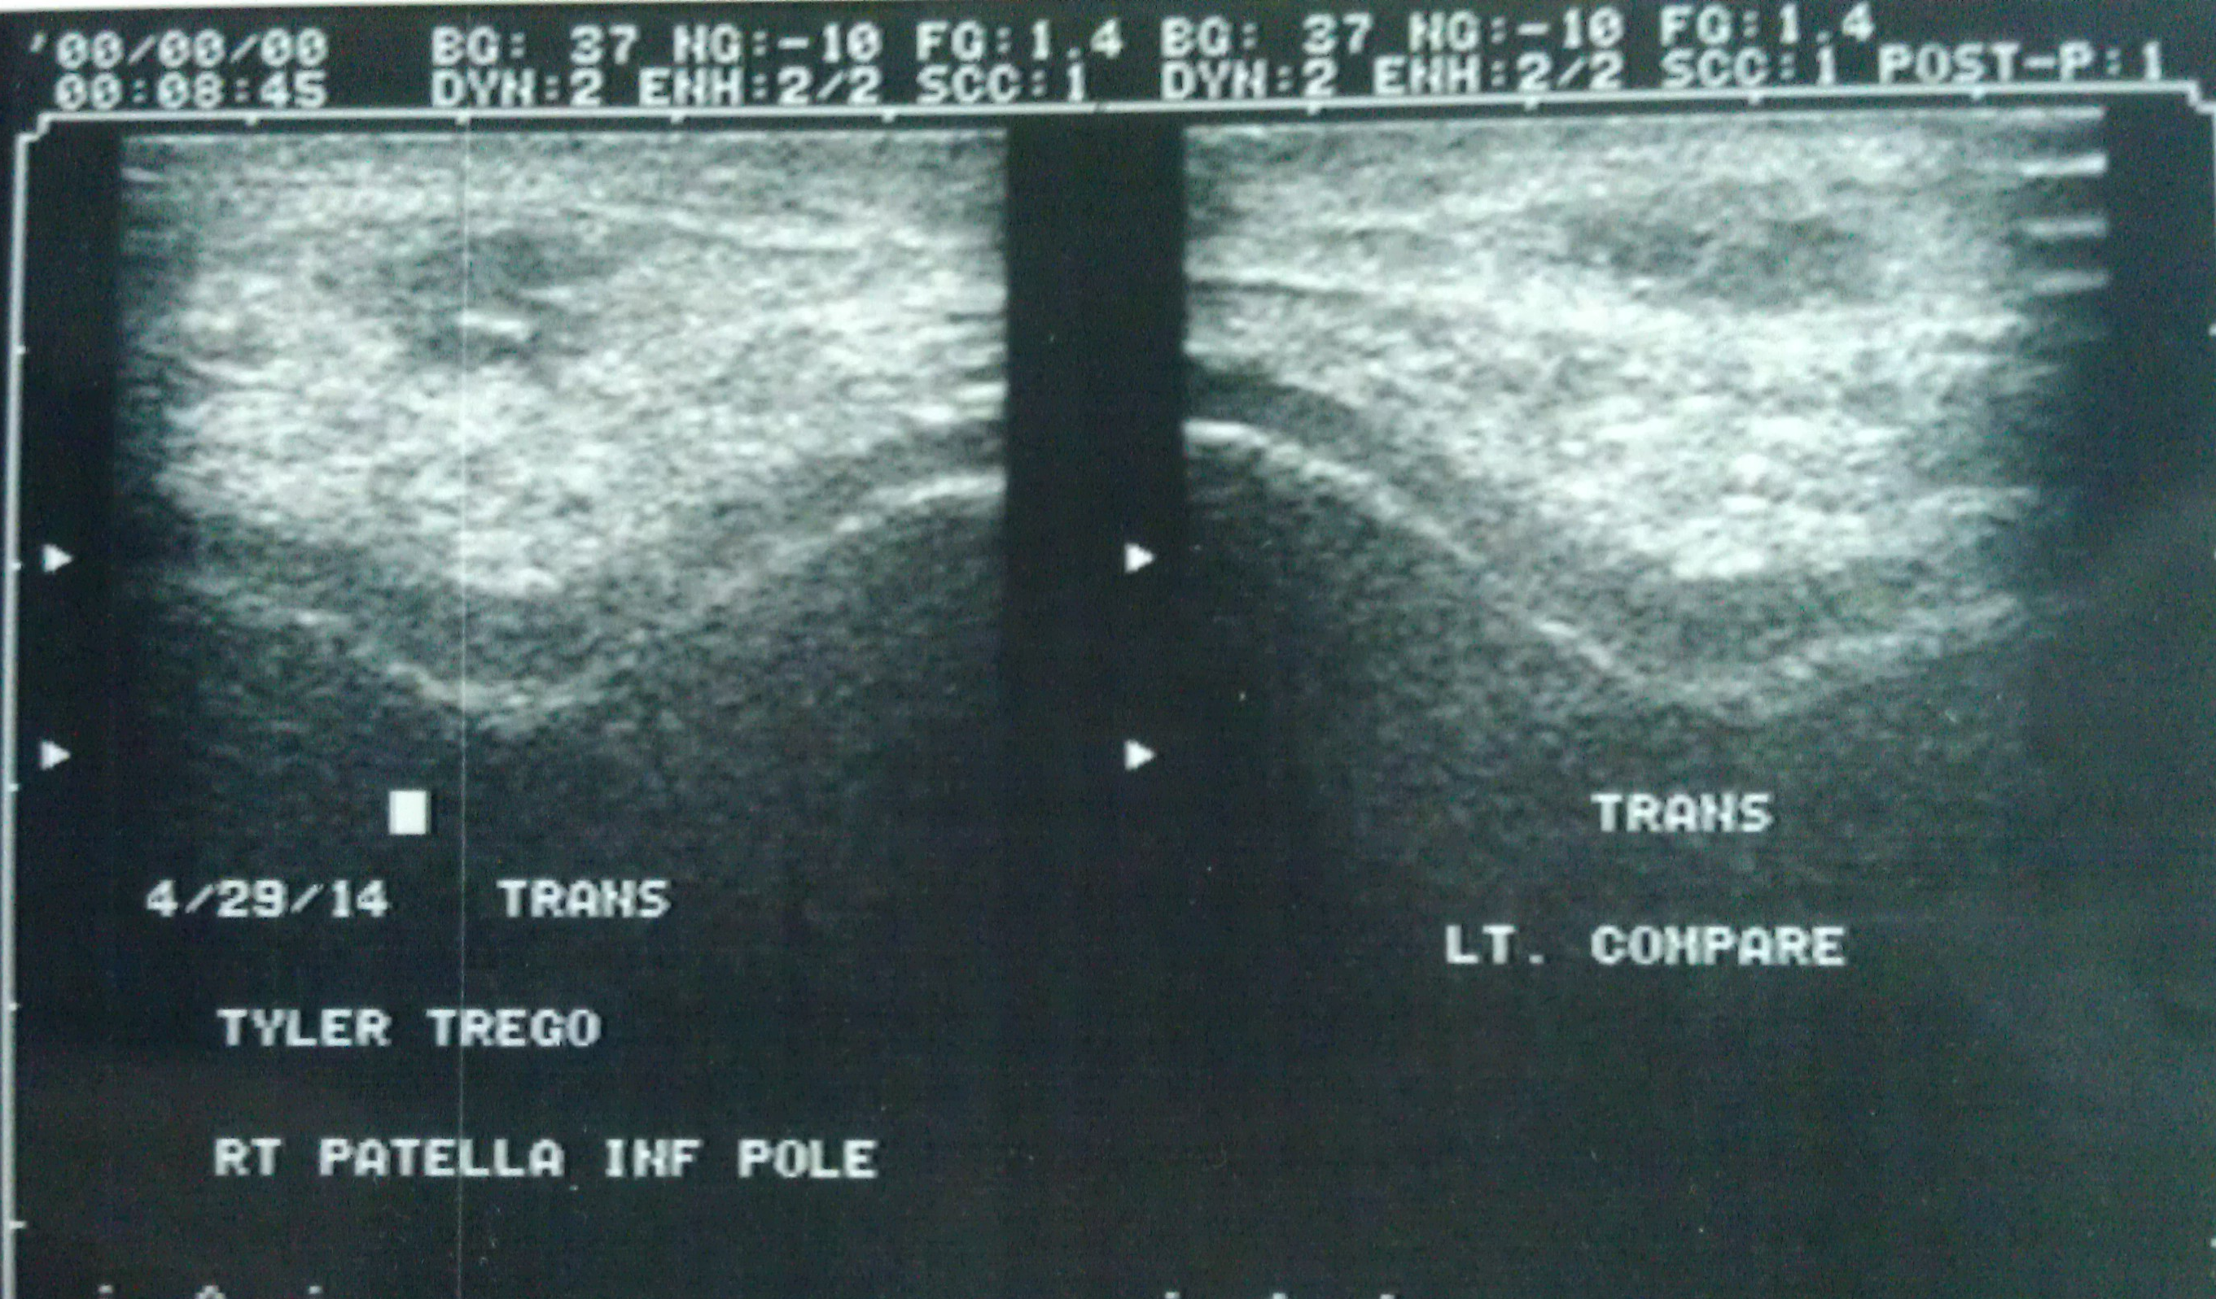

Slide 40


Slide 41
Cortical Desmoid
22 yoa.
Sore medial knee after volleyball.
3-4 months duration.
No plain films.
Subcortical edema. Edema at medial head of gastroc muscl attach.

Slide 42
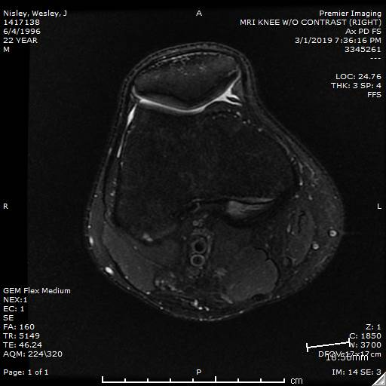
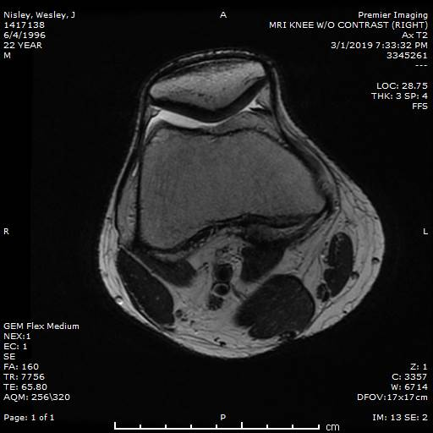
Cortical desmoid

Slide 43
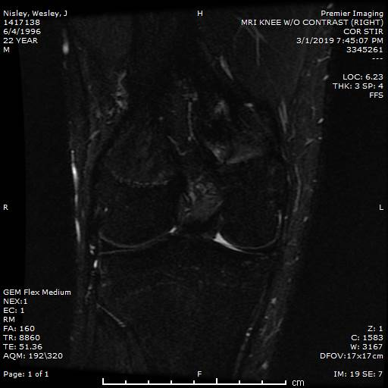

Slide 44
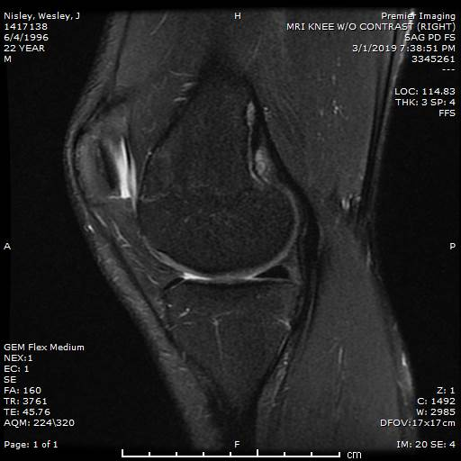
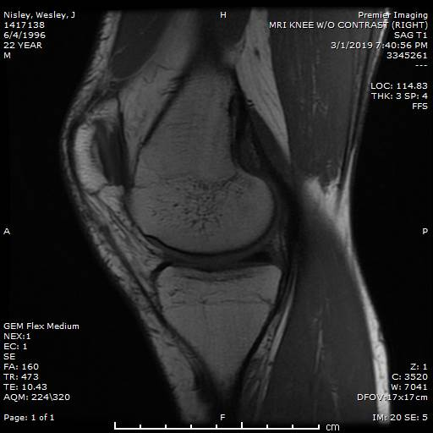

Slide 45
Cortical desmoids, also known in the medical literature as distal femoral cortical irregularities.
Benign self-limiting fibrous or fibro-osseous lesions that most frequently occur in the medial supracondylar femur.
They are most prevalent among boys 10–15 years old and are believed to be tug lesions secondary to traction injury at the insertion of the adductor magnus aponeurosis or at the origin of the medial head of the gastrocnemius tendon.
Although it has been considered a chronic and repetitive injury, this process also may be related to an episode of acute knee trauma, not well recalled by physically active children.
https://www.ajronline.org/doi/pdf/10.2214/AJR.10.4815

Slide 46
The differential diagnosis of cortical desmoid:
Fibrous cortical defect,
Posterior distal femoral stripes,
Parosteal osteosarcoma.
FCD
Post. Dist. Fem. Stripe

Slide 47
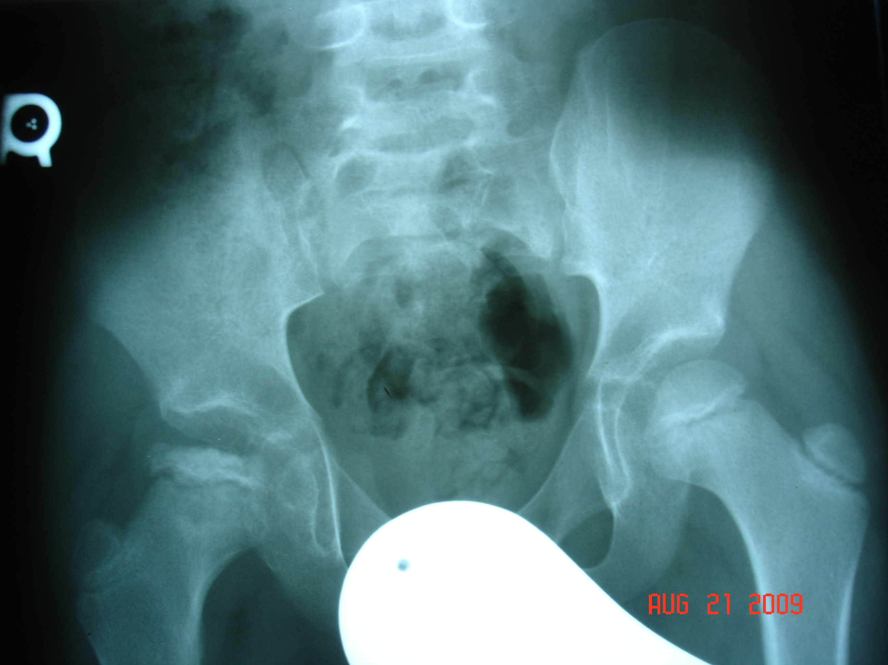
15
Limping gait
DX by PCP as strained
hip in soccer.

Slide 48
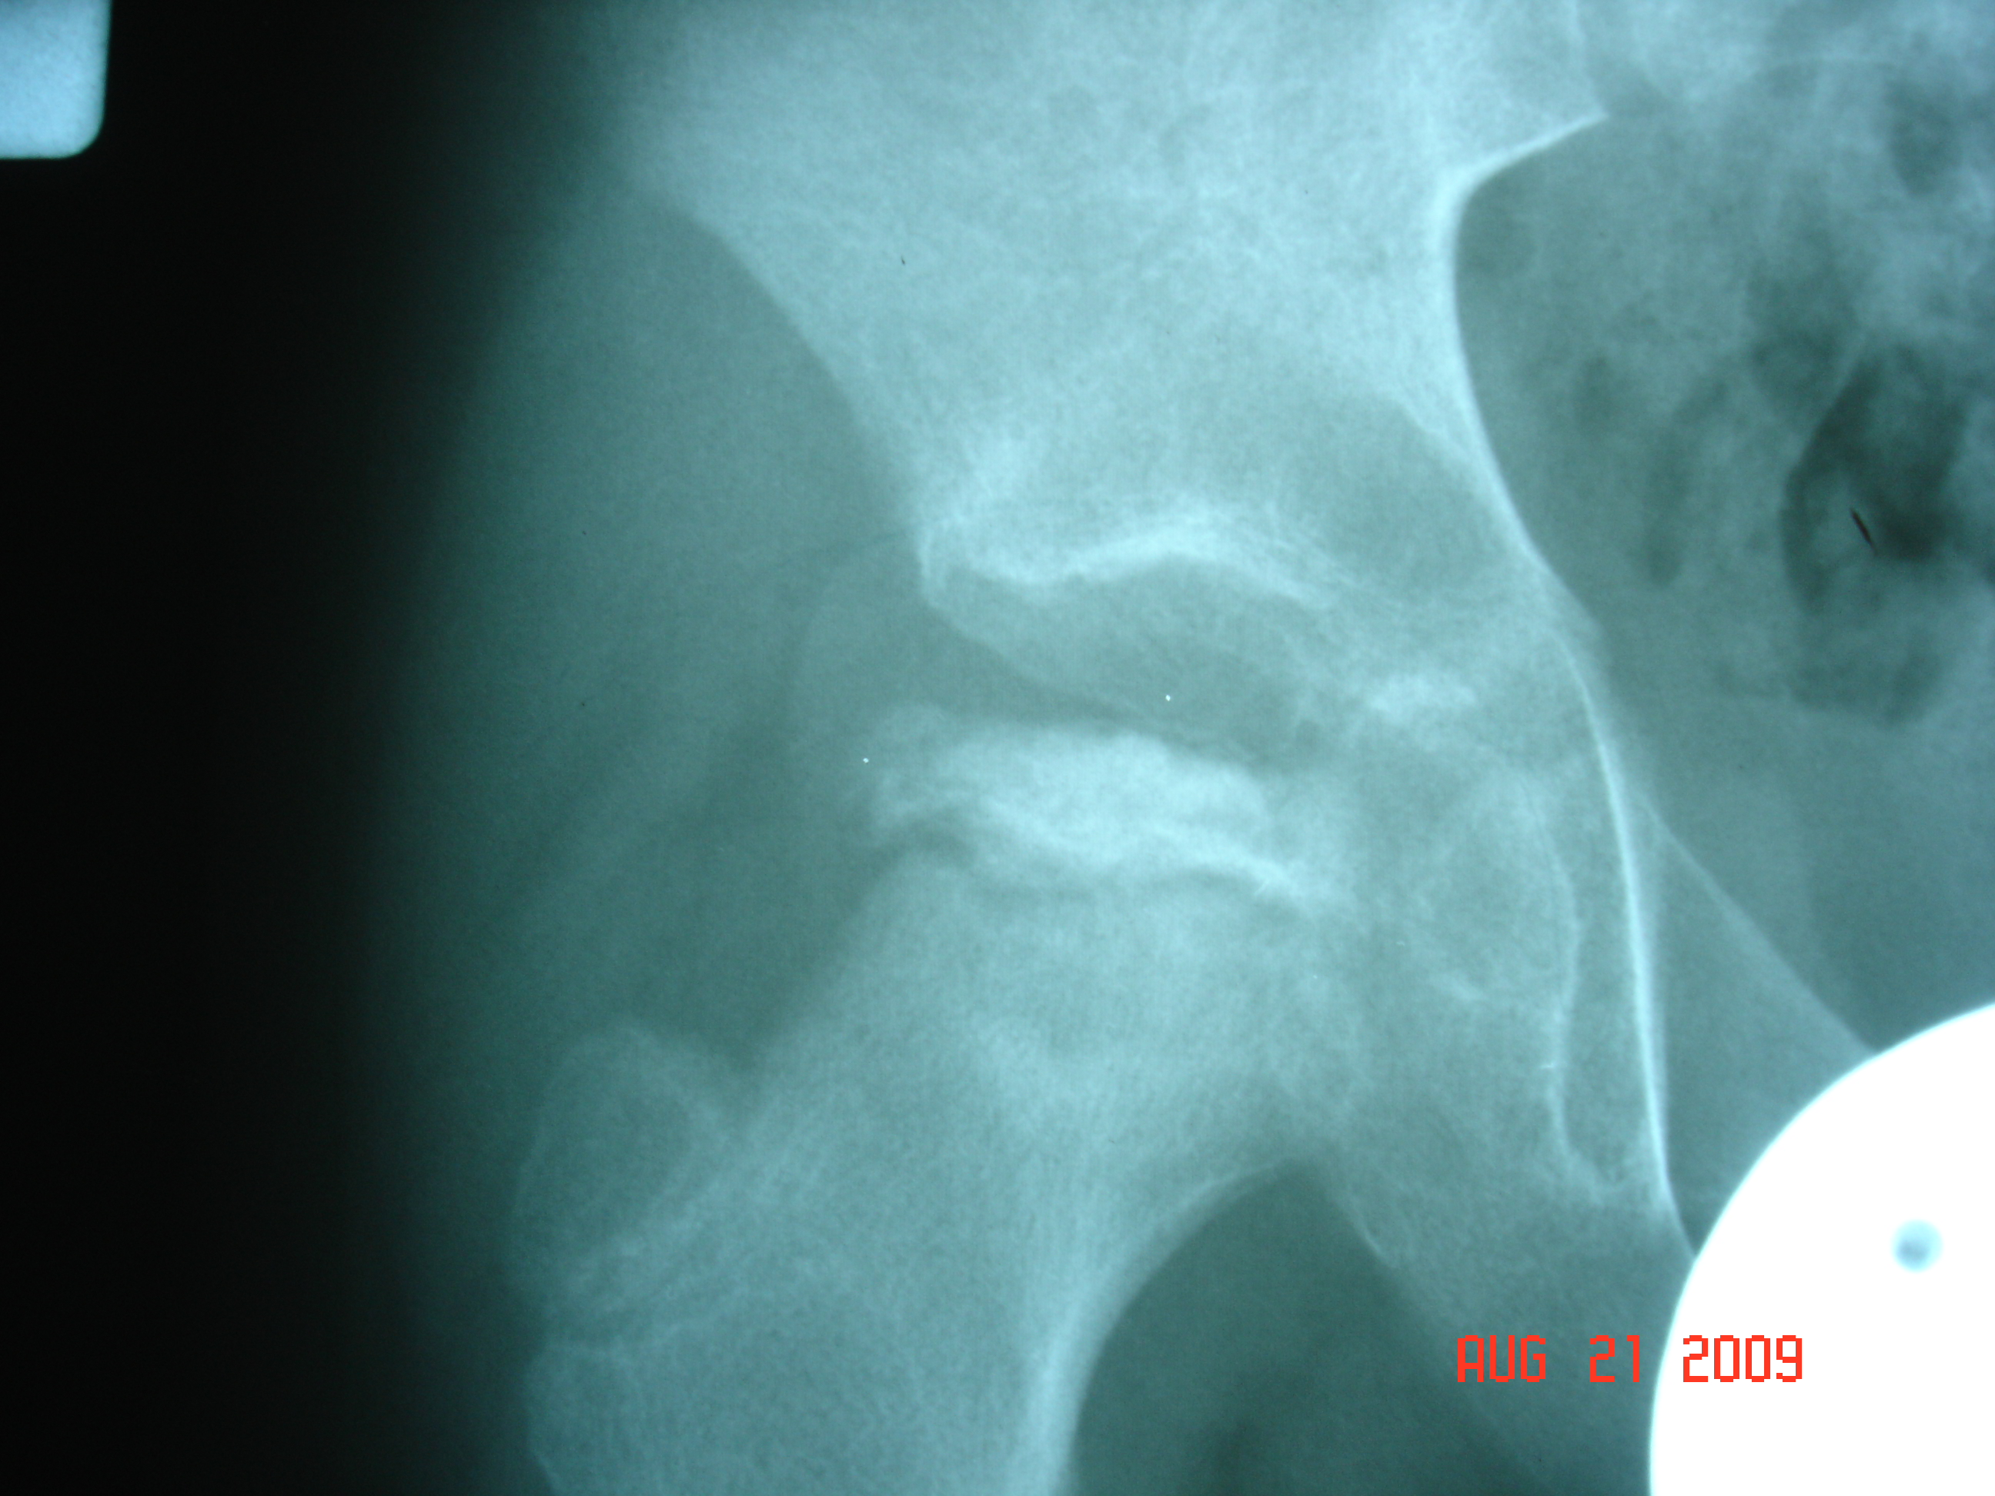

Slide 49
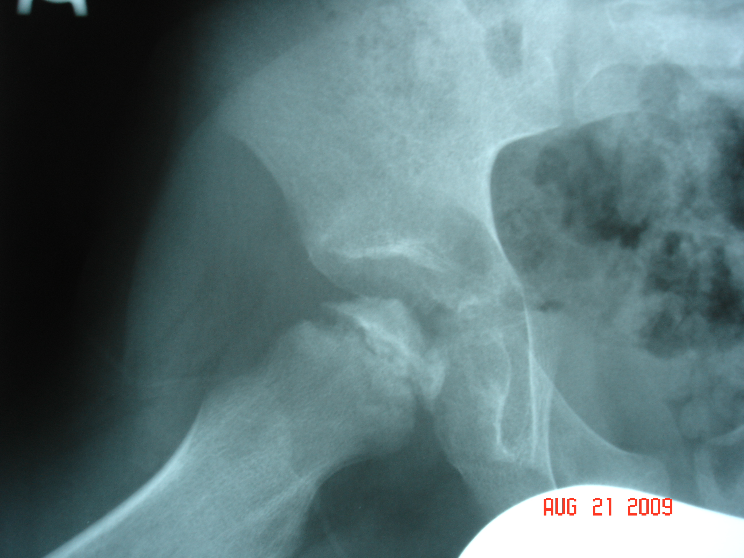

Slide 50
Legg-Calvé-Perthes disease (LCPD) is avascular necrosis (AVN) of the proximal femoral head resulting from compromise of the tenuous blood supply to this area.
LCPD usually occurs in children aged 4-10 years.
The disease has an insidious onset and may occur after an injury to the hip.
In the vast majority of instances, the disorder is unilateral.
Both hips are involved in fewer than 10% of cases, and the joints are involved successively, not simultaneously.
https://emedicine.medscape.com/article/1248267-overview

