Slide 1
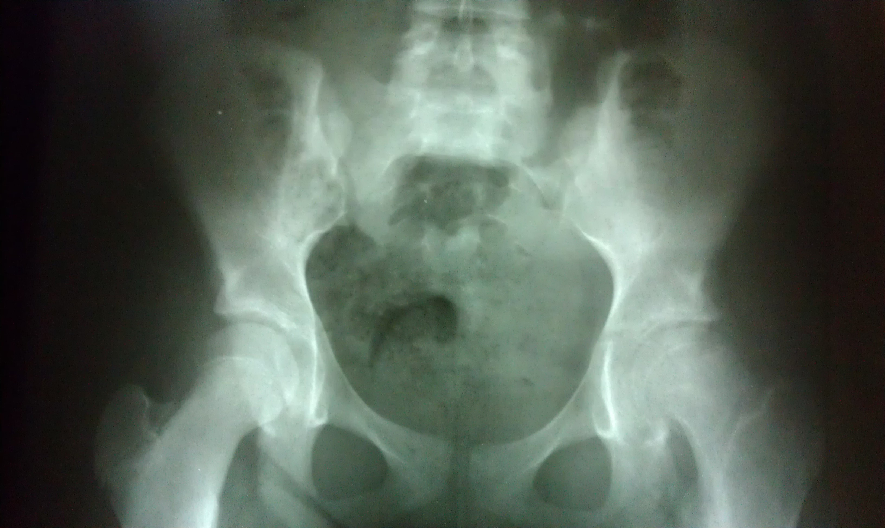
16
Hip pain in volleyball. Cannot run. Referred for X-rays not responding to chiropractic care.

Slide 2
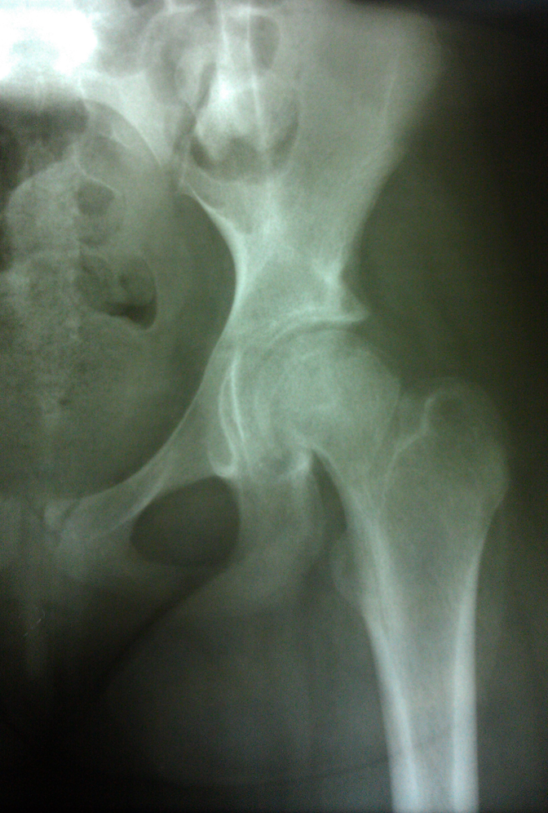
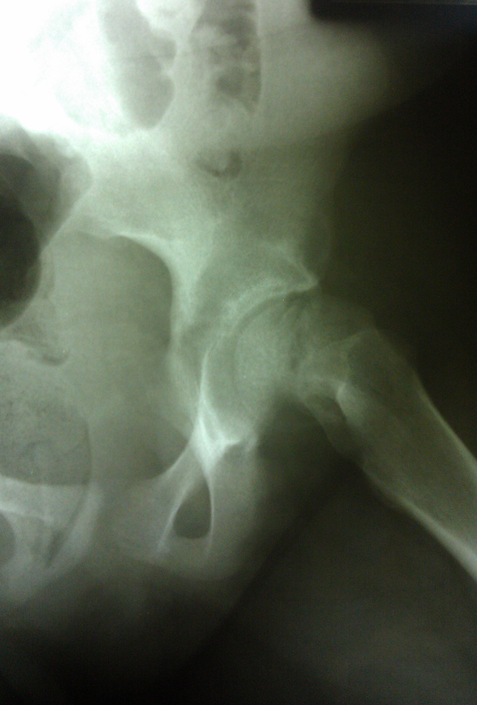

Slide 3
Slipped Capital Femoral Epiphysis, or SCFE, is a condition in which a child’s hip (the top part of the femur, or ball of the ball and socket joint of the hip) slips through the growth plate.
Think of it as an ice cream scoop falling off of the ice cream cone. This can happen slowly over time, or it can happen immediately from a fall, car accident, or trauma, similar to a break or fracture.
This usually happens during the adolescent years,
most commonly between the ages of
11 to 13 years for females
12 to 14 years for males.
For this problem to occur, the child or adolescent must still be growing because the slip happens through an open growth plate.
This problem is more common among overweight or obese patients, but can happen in slim patients.
Children with thyroid or kidney problems are at greater risk for this problem, as are people on growth hormone.
If someone has a SCFE on one side, there is a 1 in 4 chance that the other hip could develop this problem as well.
https://orthokids.org/en-US/Condition/Slipped-Capital-Femoral-Epiphysis-(SCFE)

Slide 4
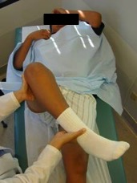
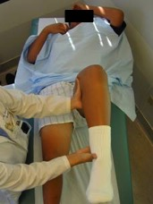
Figure - Right SCFE. The right leg is rotated out
Figure - Normal left hip

Slide 5
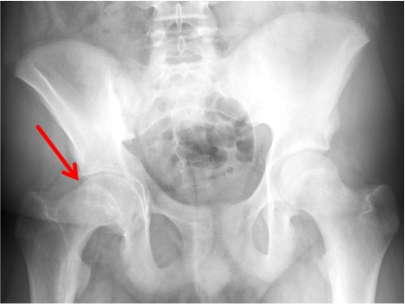
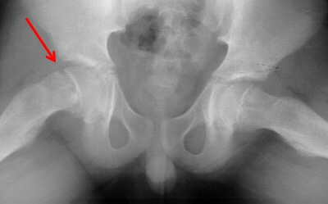
Figure - Red arrow points to the SCFE on the right hip on the “AP” X-ray view
Figure - Red arrow points to the SCFE on the right hip on the “frog lateral” X-ray view.

Slide 6
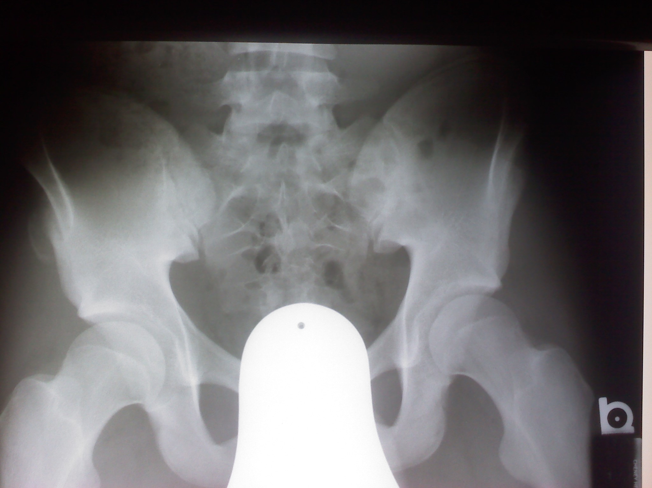
Sprinter – felt pain and fell onto track and couldn’t lift the leg after injury.

Slide 7
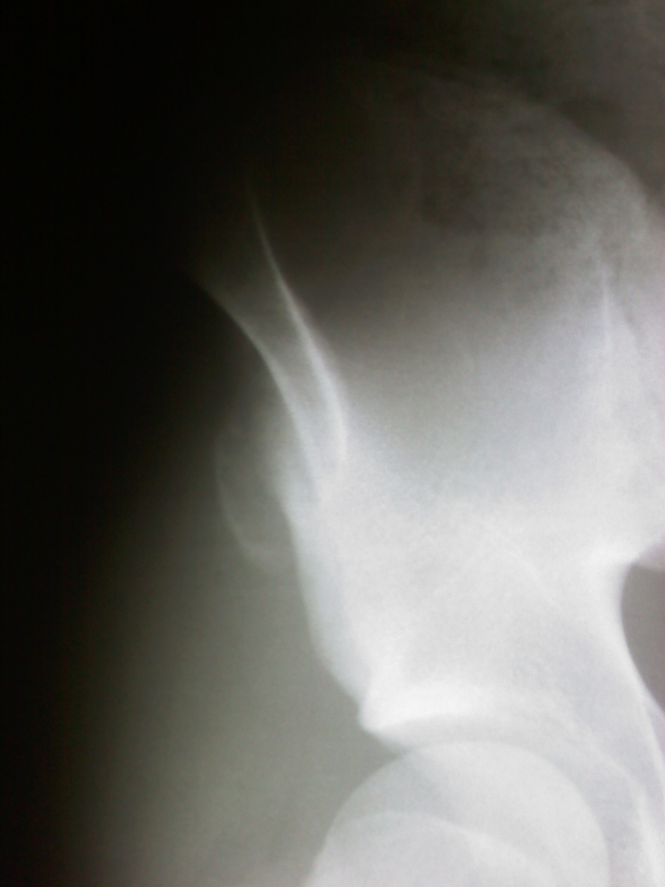
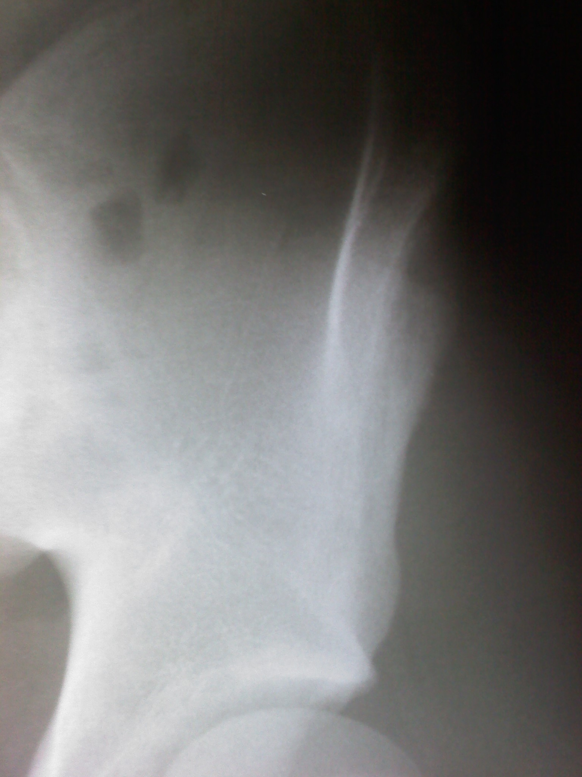

Slide 8
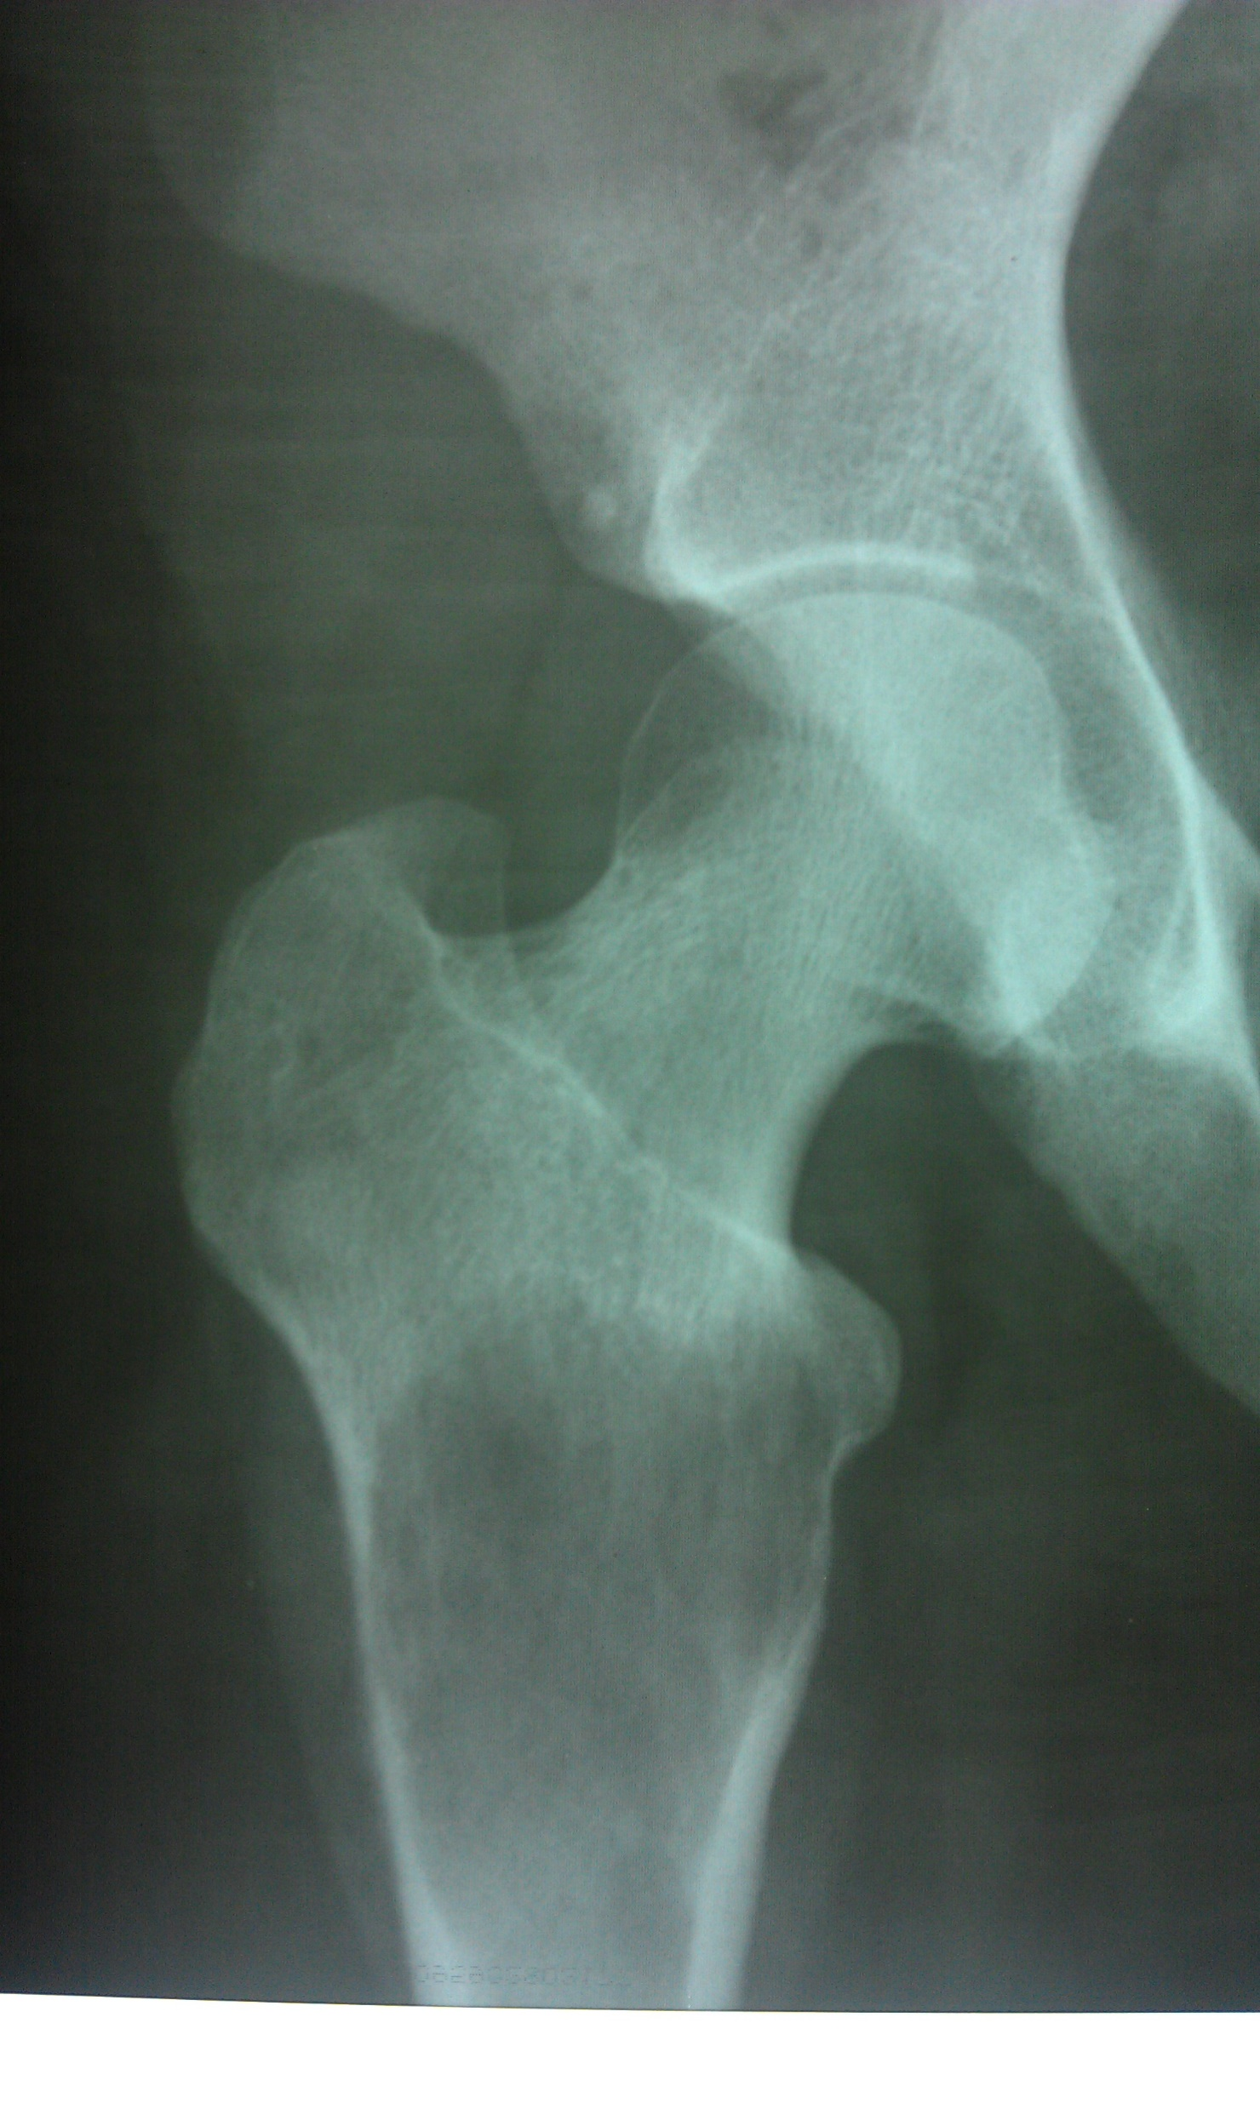
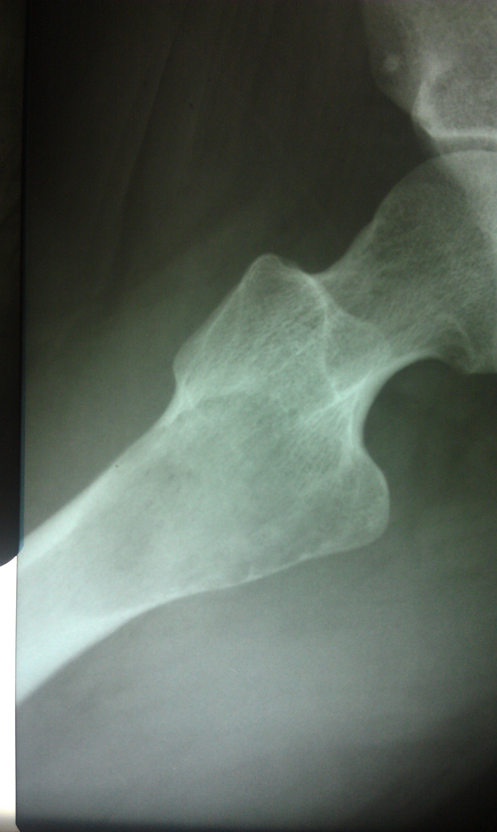
Geographic lytic lesion prox. Fem.

Slide 9
Knowing what to look for…
Knowing what it means when you see it…
Has research caught up with the significance of a finding?
Os Acetabulum. Normal variant or indication of a problem?

Slide 10
AJR 2007; 188:1540–1552

Slide 11
Fig. 16—Secondary radiographic signs of femoroacetabular impingement.
A, Recurrent impingement can lead to ossification of labral basis (white arrow) and to osseous apposition of acetabular rim, which is visible as double contour (black arrows) in 45-year-old woman.
B, Because of abnormal stress in impinging hips, prominent acetabular bone fragment can even be separated from adjacent bone margin (os acetabuli, arrow) in 36-yearold an with pistol-grip deformity.

Slide 12
Femoral-acetabular impingement

Slide 13
Femoral-acetabular impingement

Slide 15
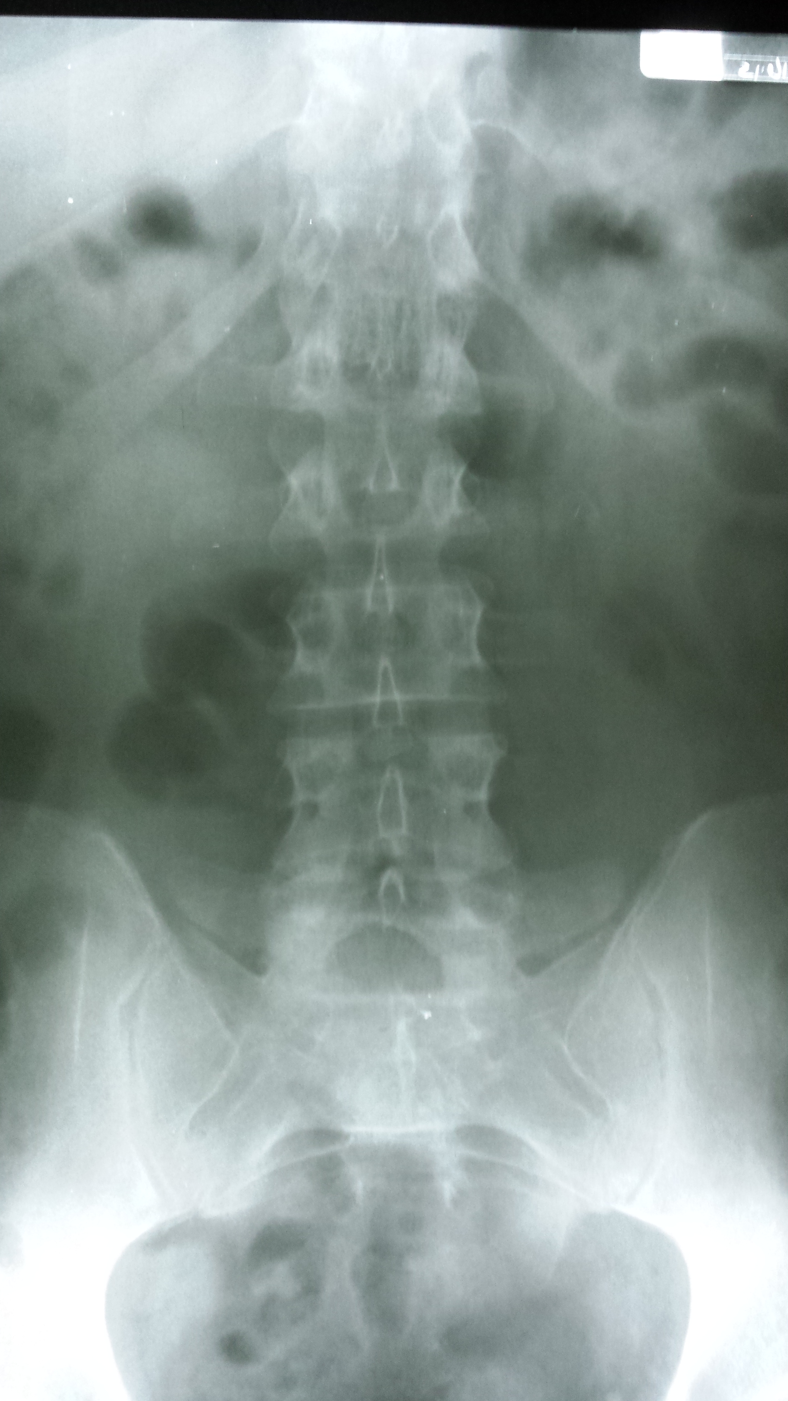
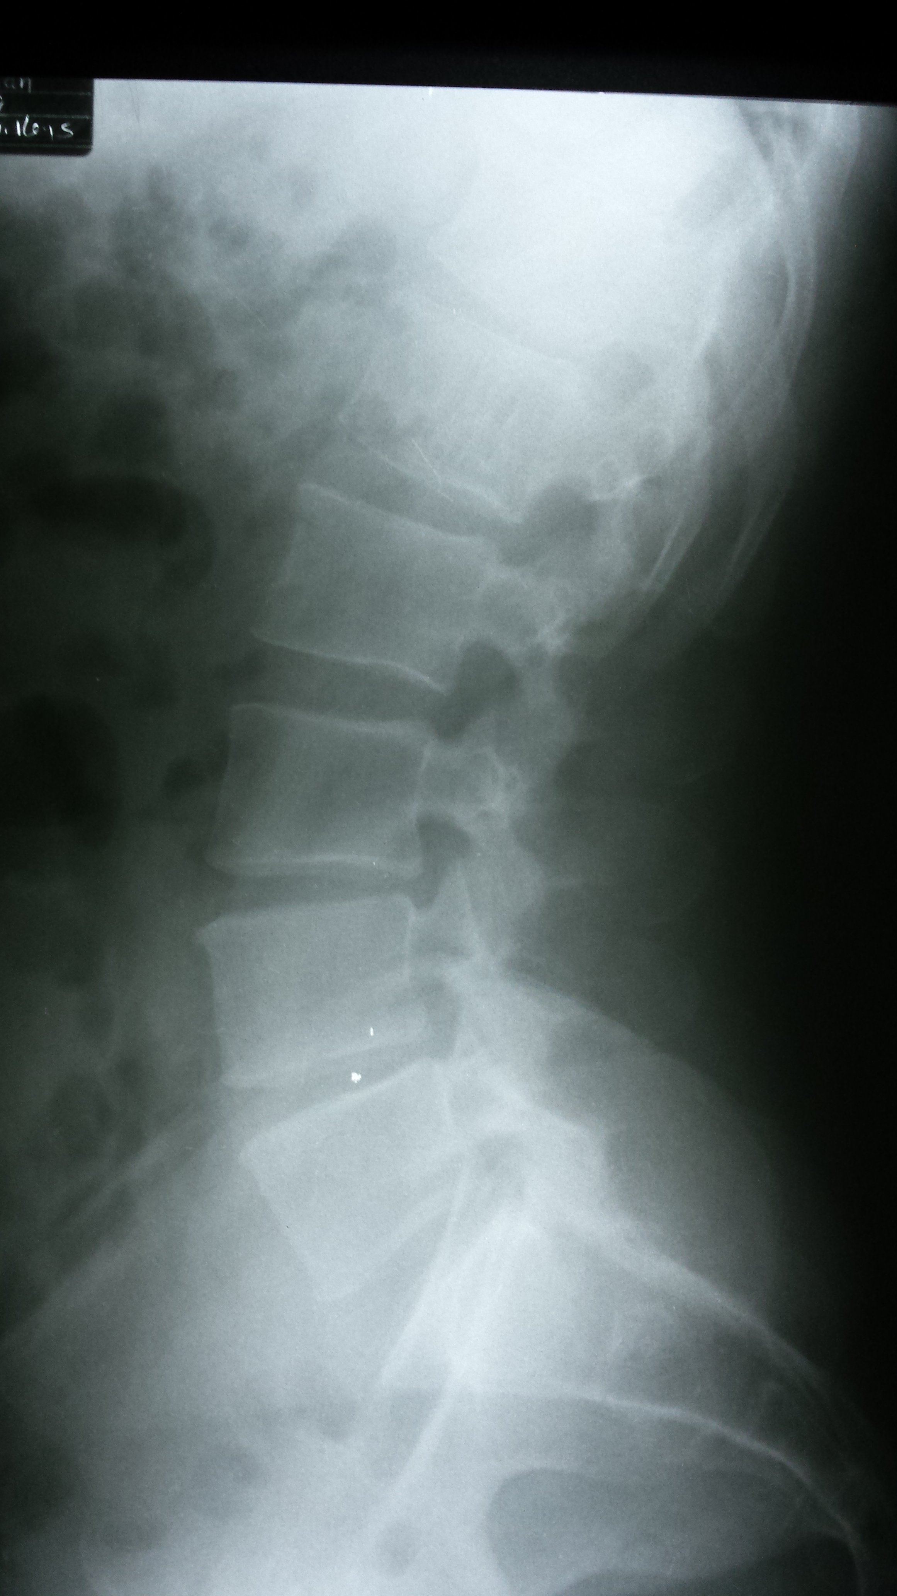
18

Slide 16
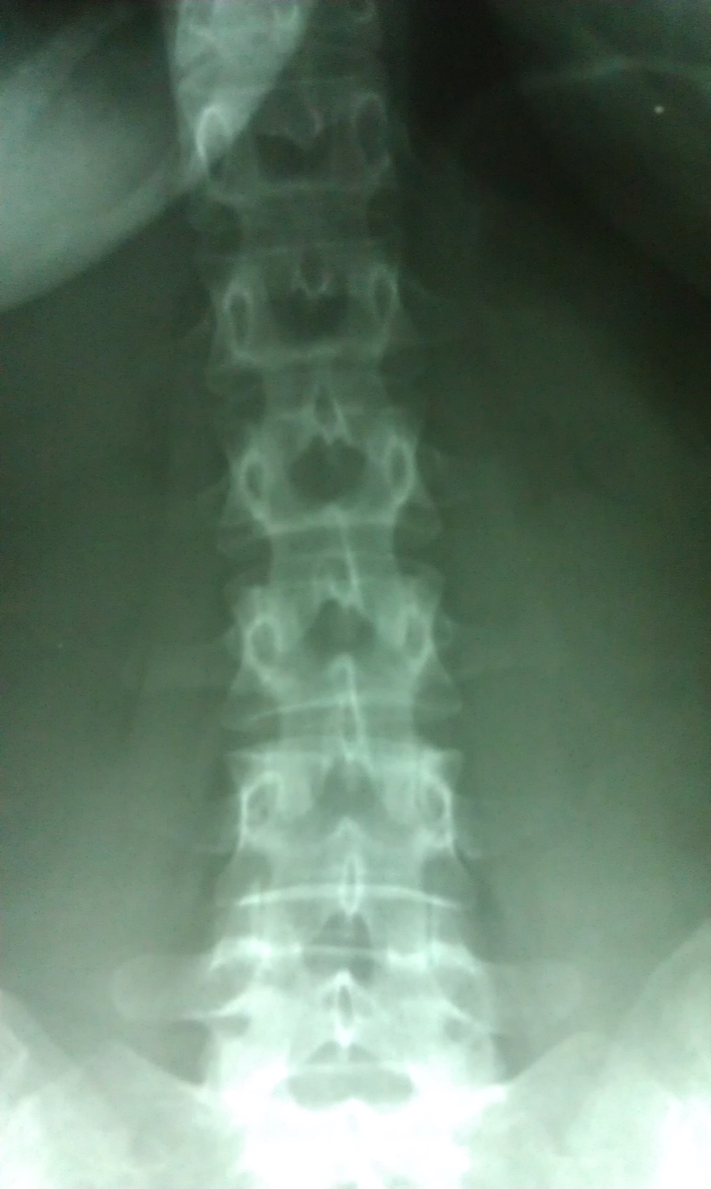
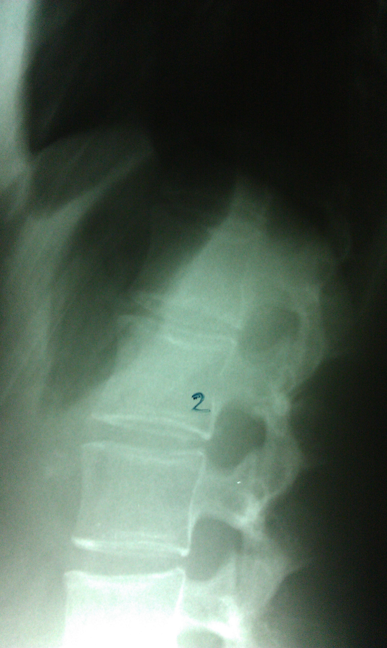
19
New mom – LBP post partum 4 wks.

Slide 17
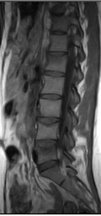
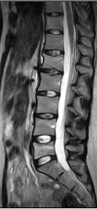
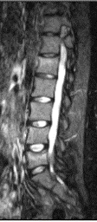
Heparin induced osteoporosis – Levonox tx for prophylaxsis of thrombosis. Hx of prior stroke from contraceptive. Compression fx subsequent to lifting baby.

Slide 18
LBP football player
Lower back pain beginning in summer weights and increasing pain with football.
Pain on extension and hop test.
Pain with running.

Slide 19
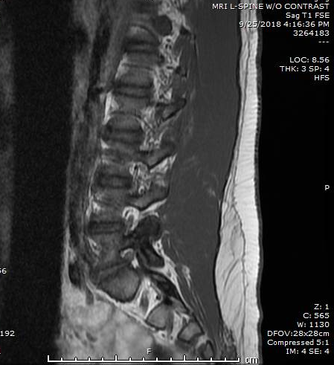
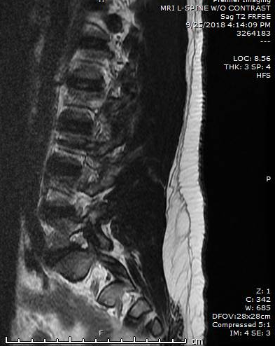
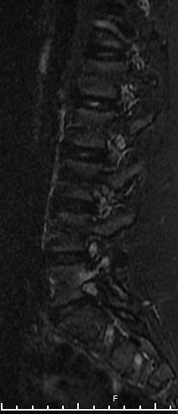

Slide 20
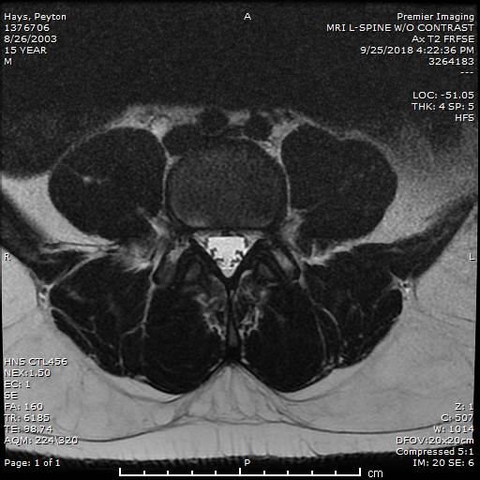

Slide 21
Volleyball player
Pain through volleyball, worsened with basketball and sought care.
Plain film radiographs obtained due to suspicion of spondylolysis on physical exam and history.
Pain with running. Pain on extension and jumping.
Pain on hop test and painful to perform plank exercises. Pain relieved with rest.

Slide 22
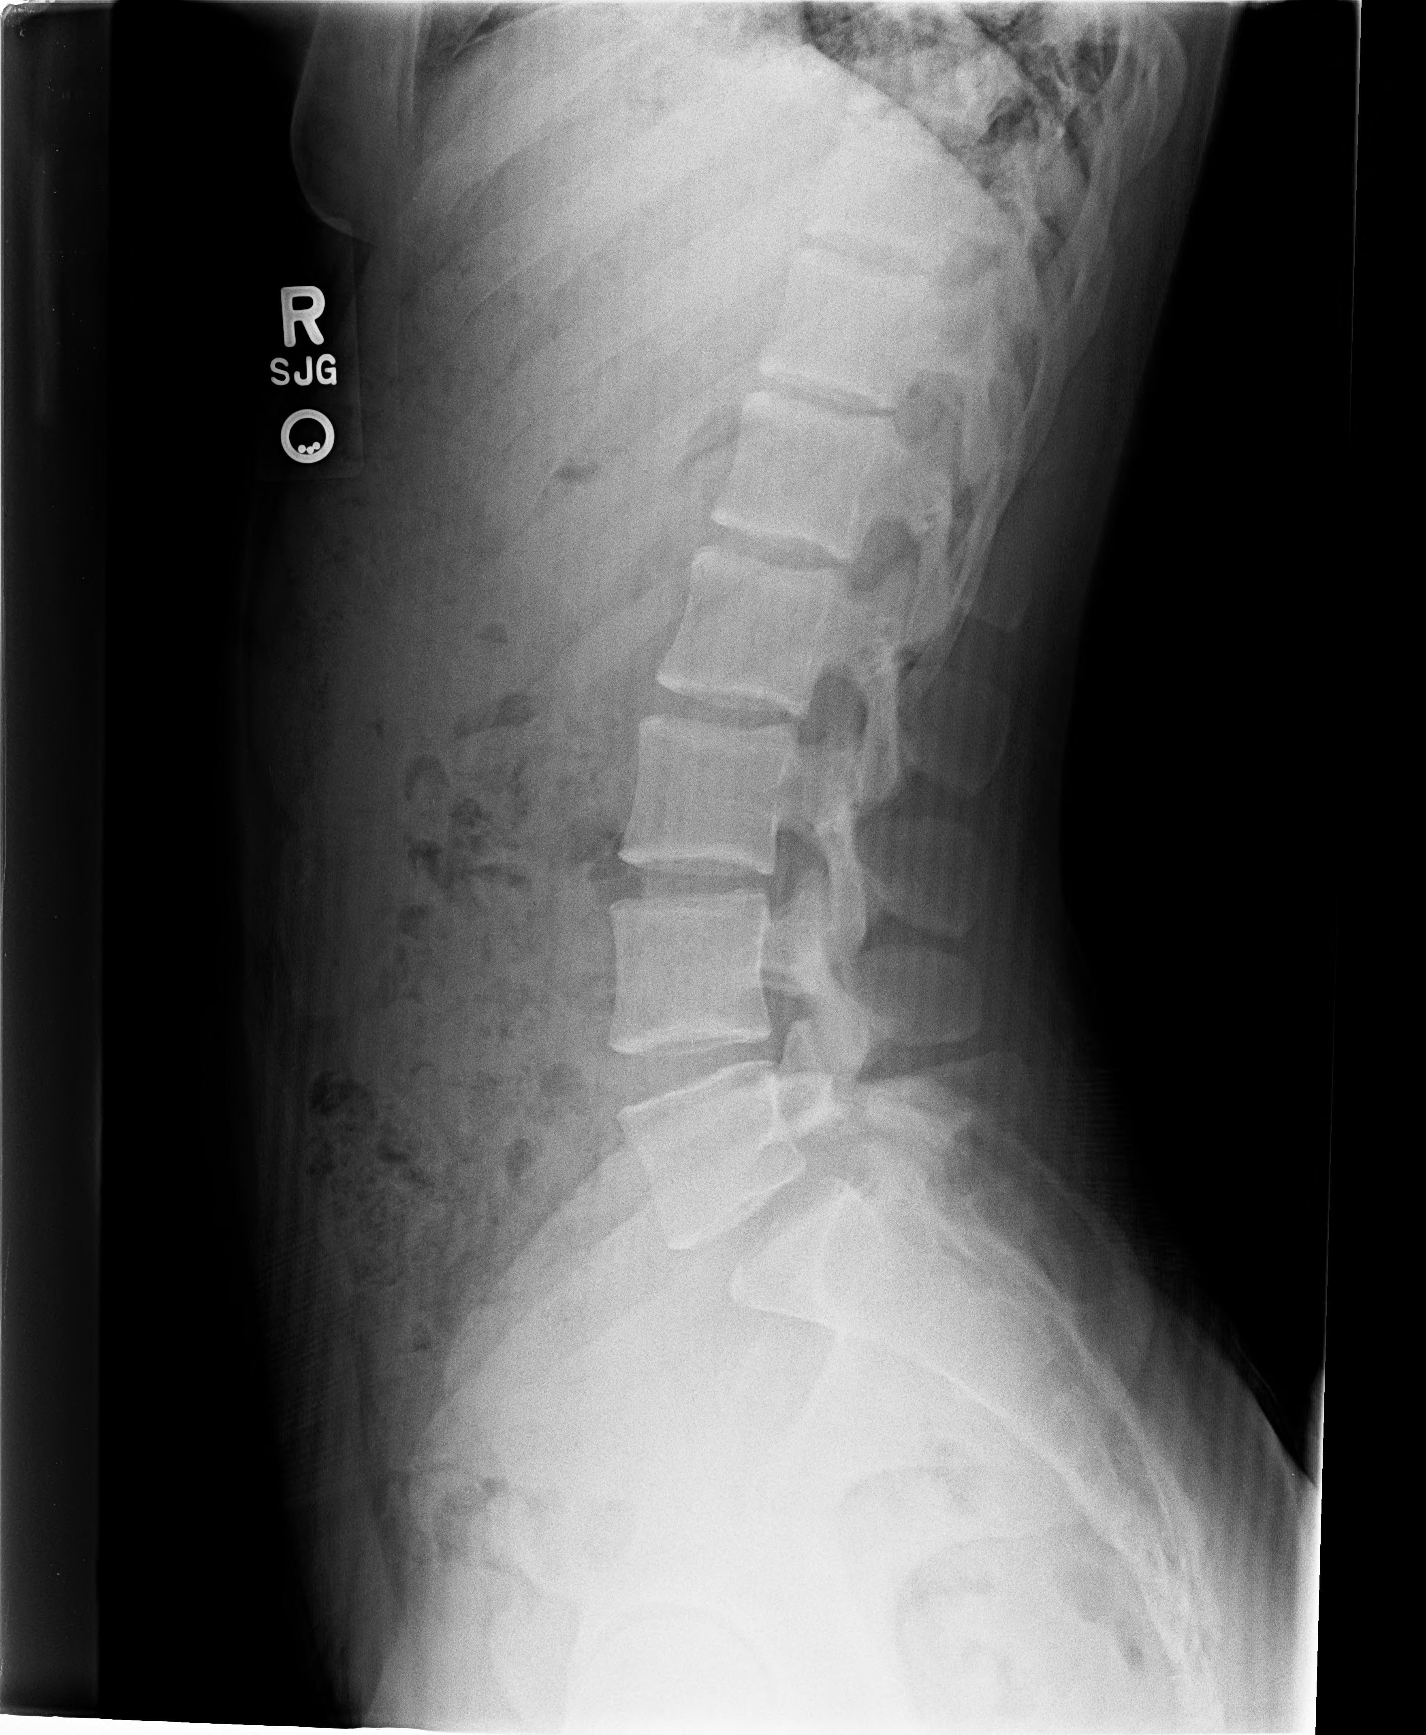
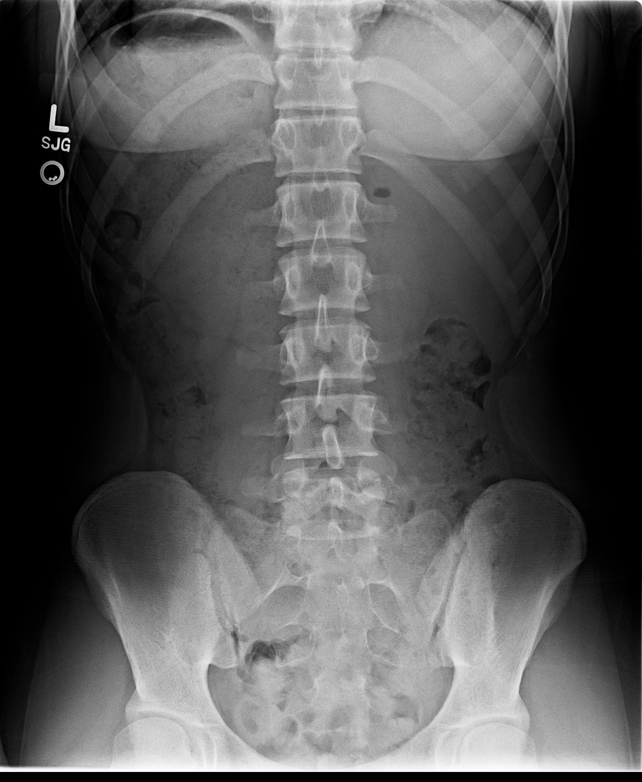
Spondylolisthesis

Slide 23
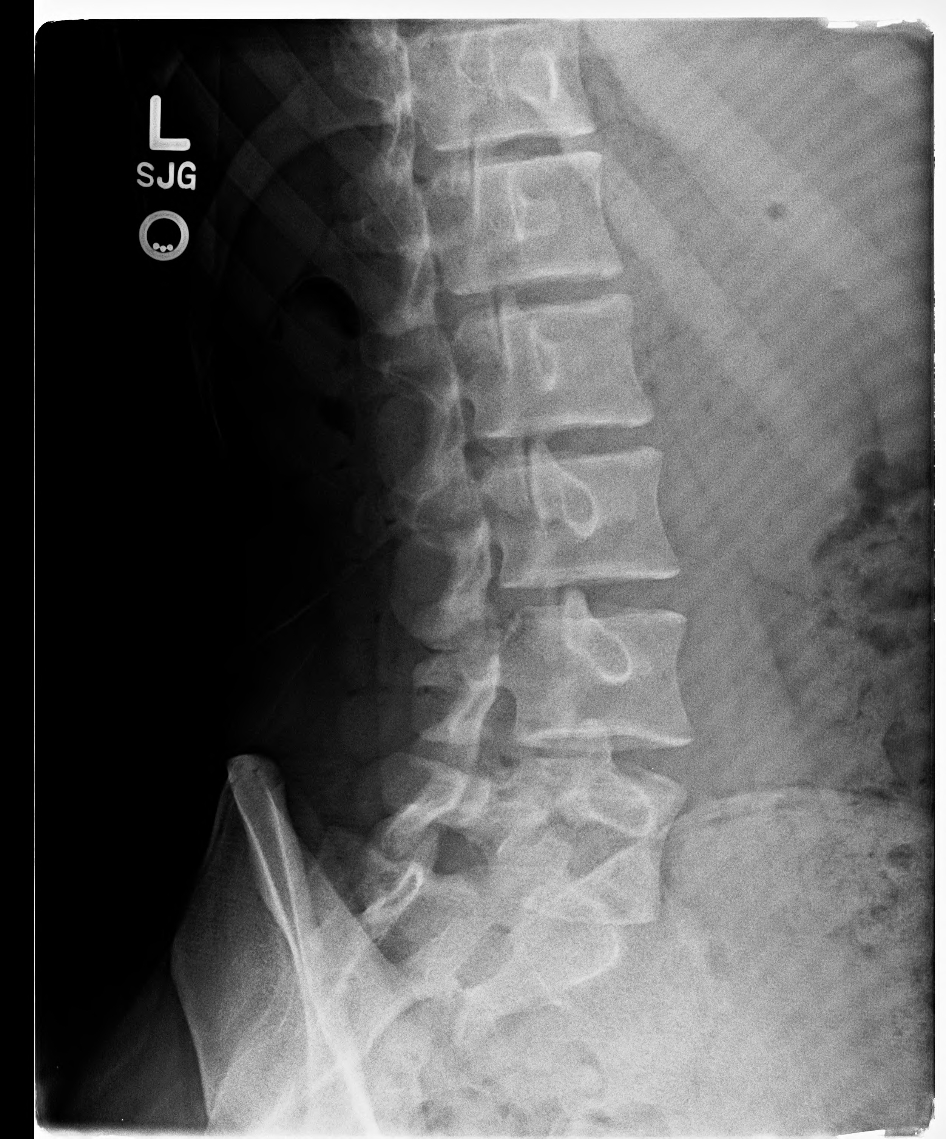
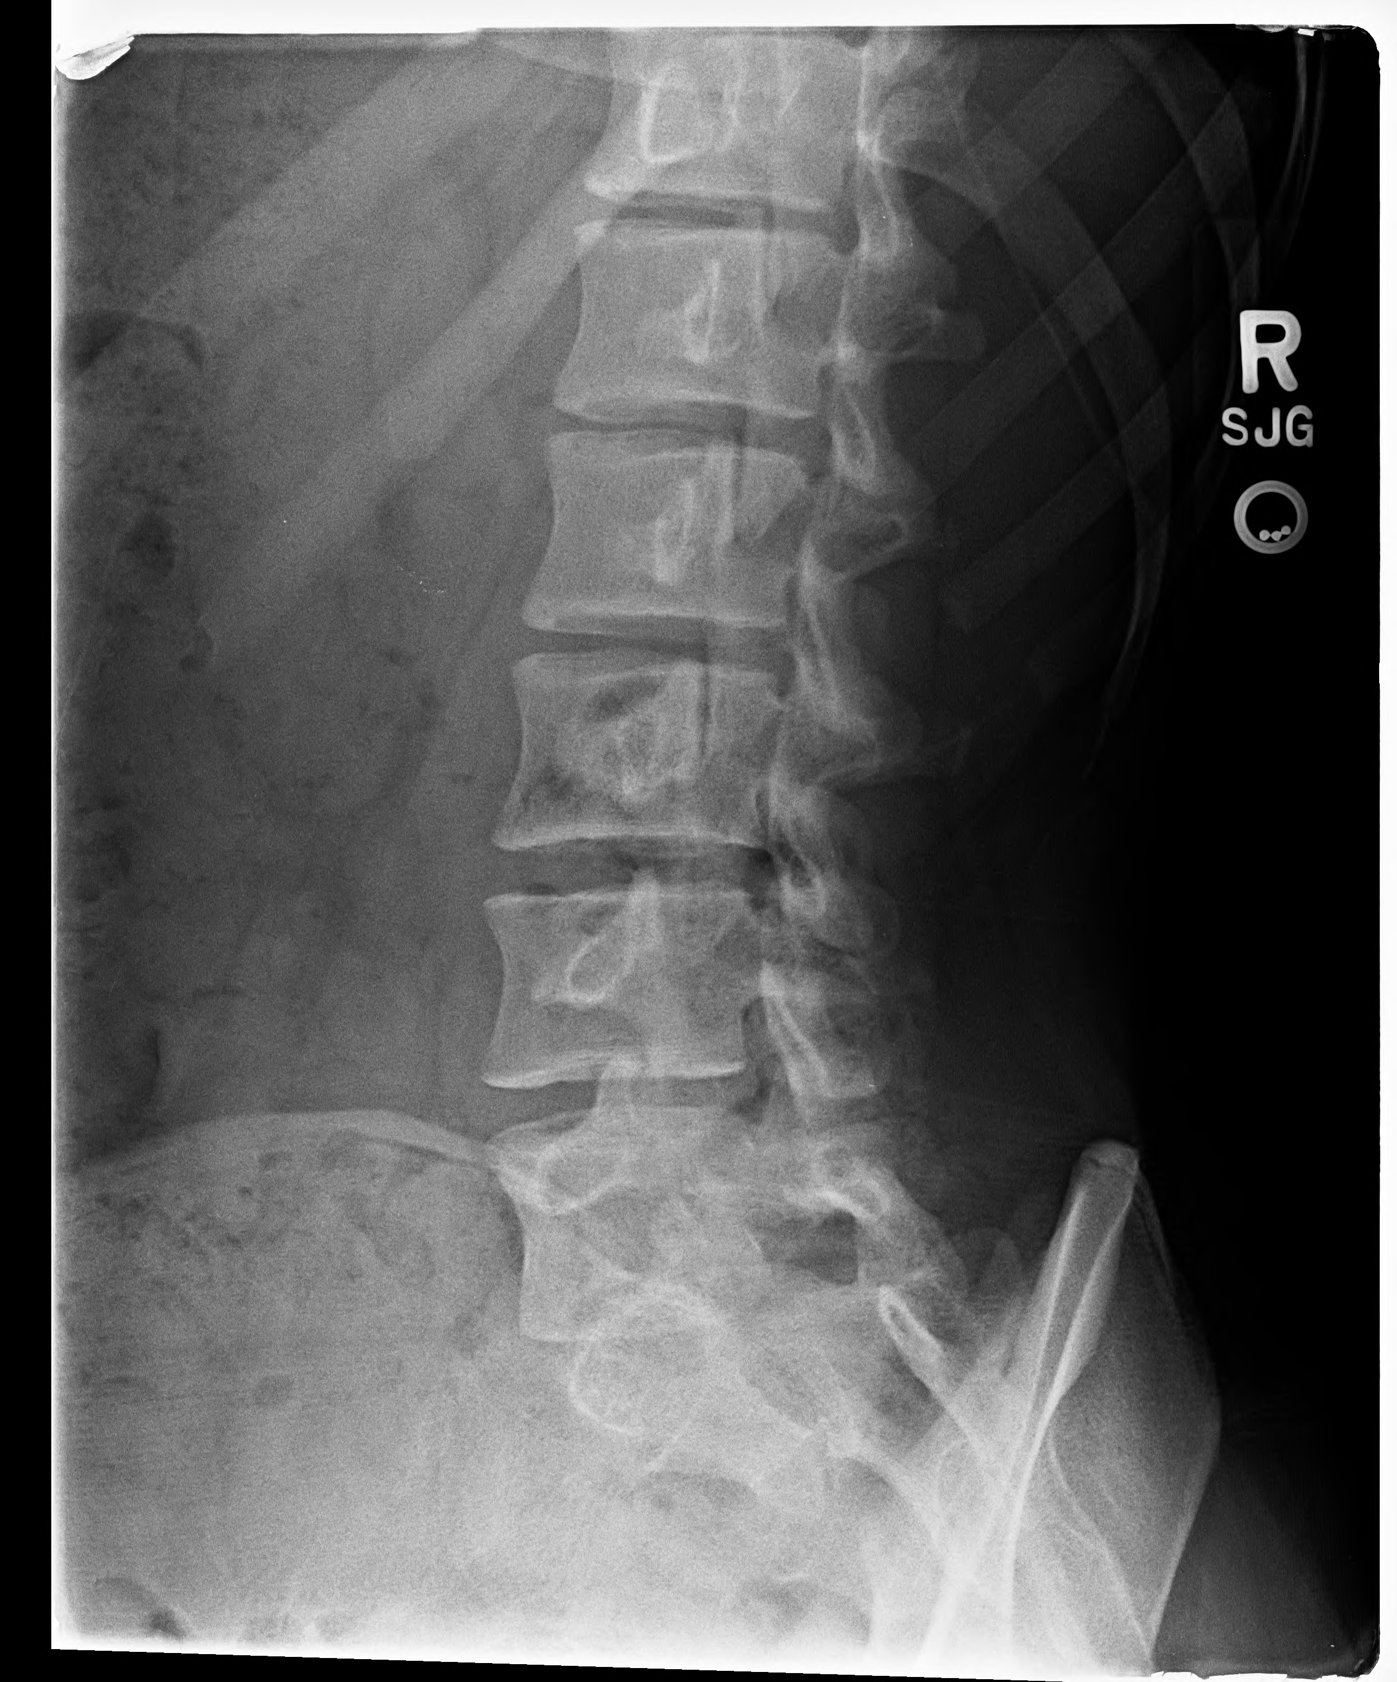

Slide 24
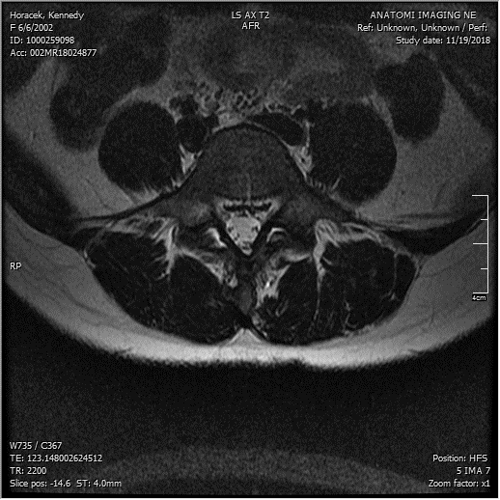
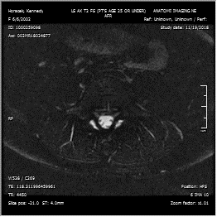

Slide 25
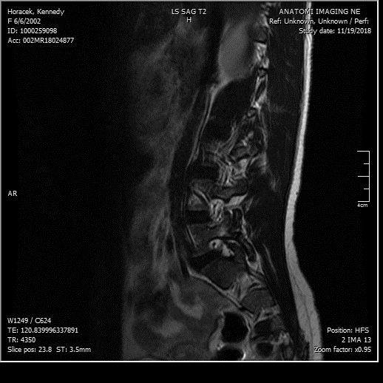
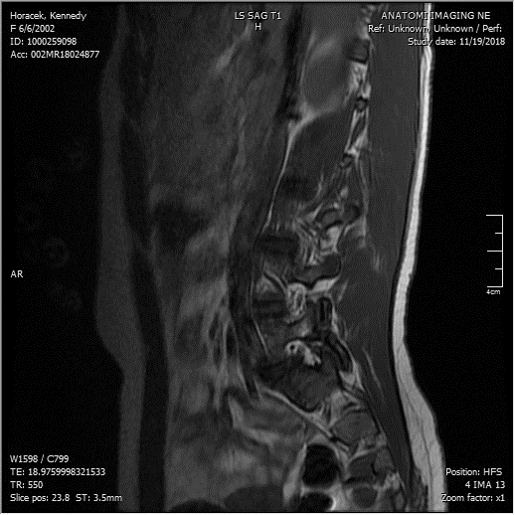

Slide 26
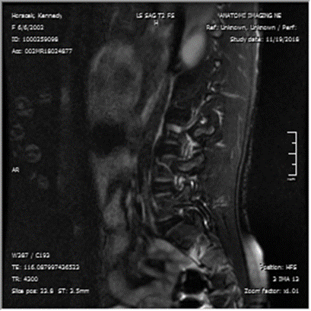
Healing or healed and ununited pars defect.
Does not show high signal change on STIR images,
Not likely to unite with immobilization with lumbar support belt or bracing

Slide 27
Neck pain volleyball player

Slide 28
Neck and upper thoracic pain
Pain is severe with warm up and pregame exercise.
Increasing pain but tries to continue to perform activities.
Plain films obtained and deformities revealed.
Orthopedic referral and was told that they have a congenital abnormality.

Slide 29
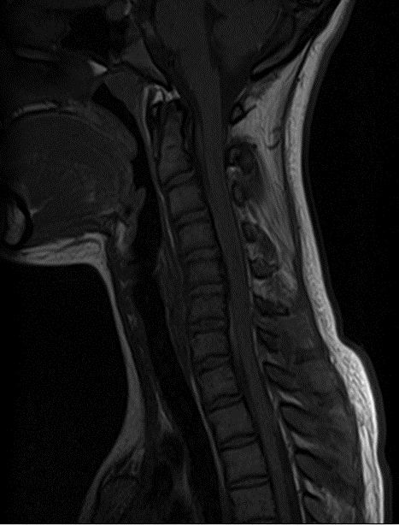
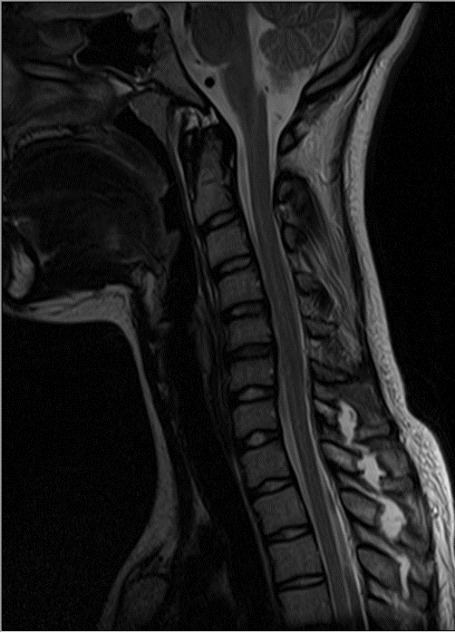

Slide 30
Football and weights
Cervicothoracic pain. Gaining weight and strength with power lifting and weights for football.
No has severe pain and cannot do exercise now. Extreme pain to palpation at the spinous process C/T junction.
MRI read as unremarkable.
2 rounds of Physical Therapy without relief. RX for 3rd round of PT recommended.
Moved from CA to KS and new DC ordered over read on old MRI study

Slide 31
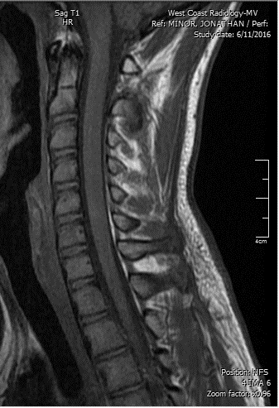
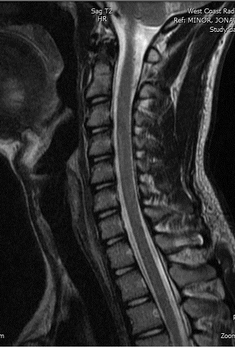
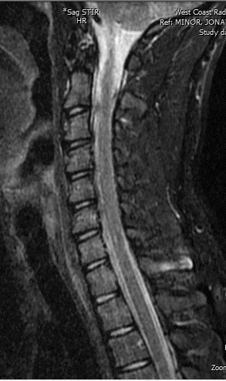

Slide 32
LBP and leg pain

Slide 33
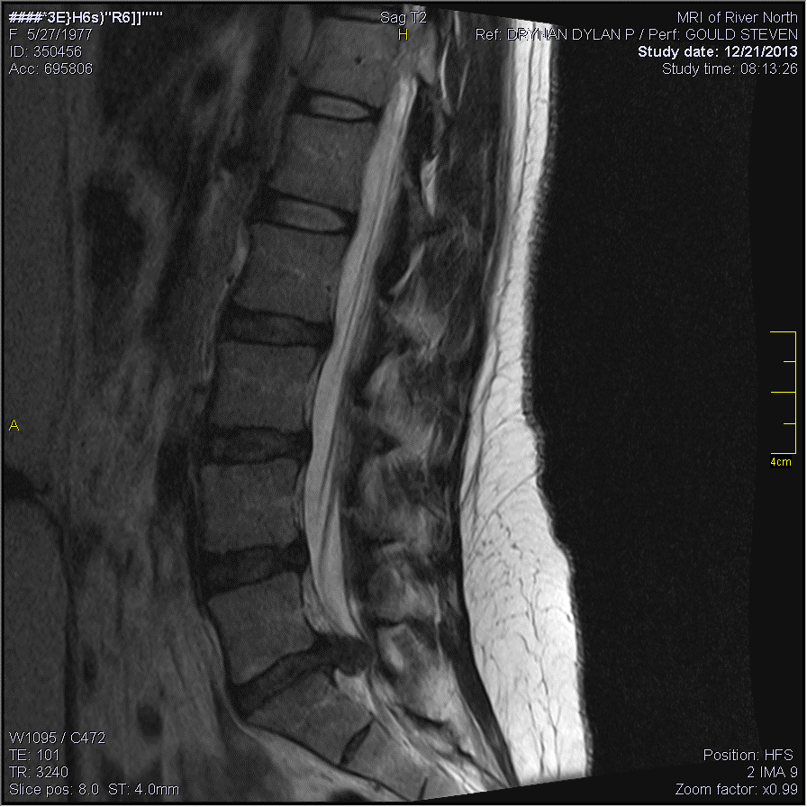
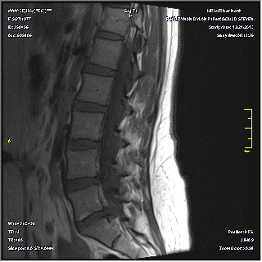

Slide 34
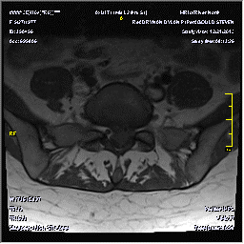
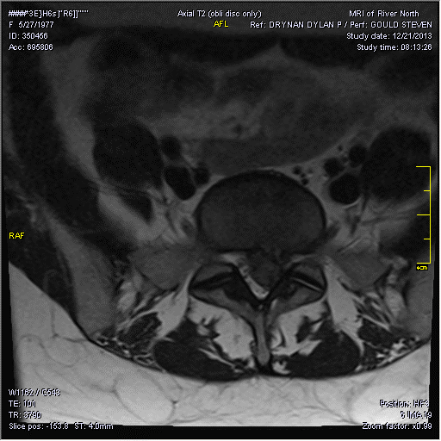

Slide 35
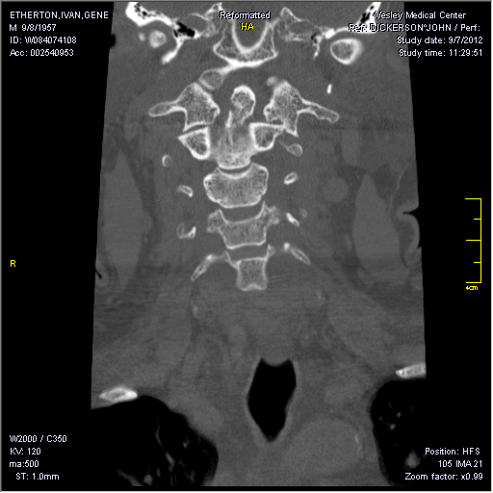
Thrown from Horse

Slide 36
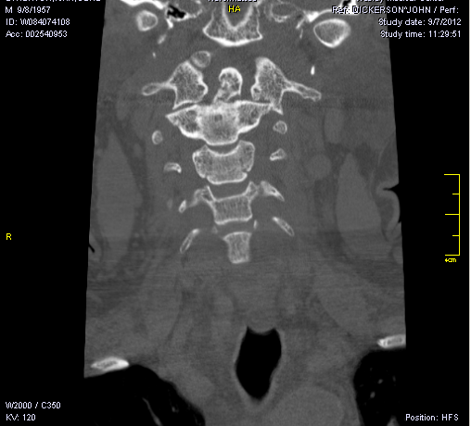
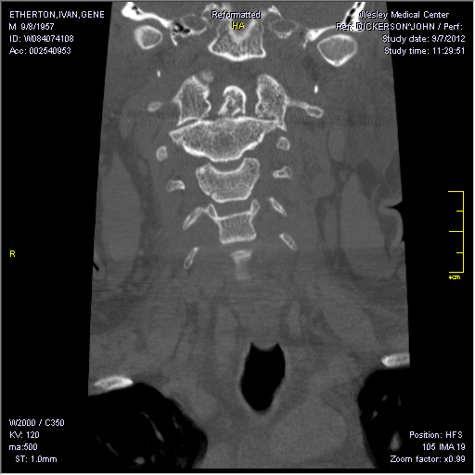

Slide 37
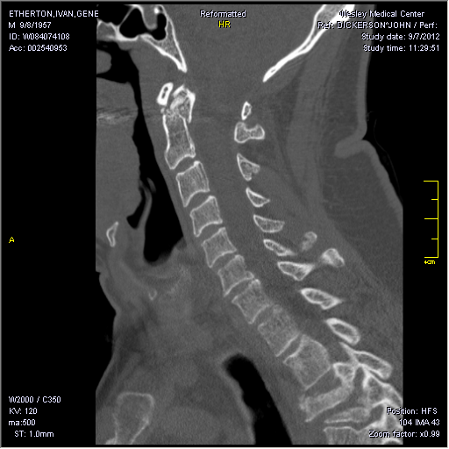


Slide 38

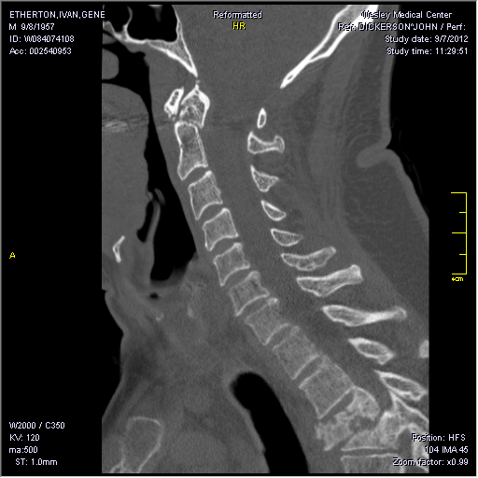

Slide 39
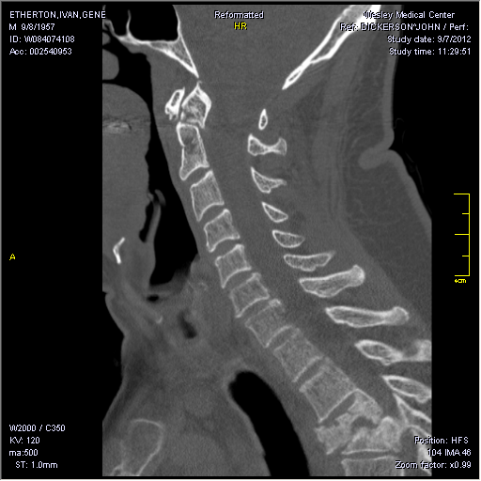
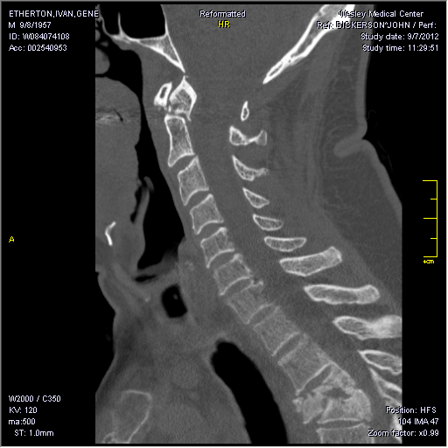

Slide 40

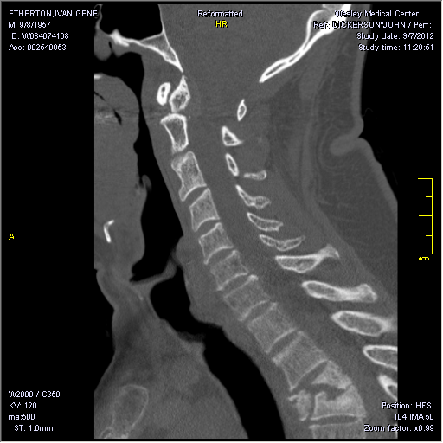

Slide 41
END

